Slide 1
Fundraising Basics for a Changing Charitable Landscape
Mike Kerkorian
United Way Worldwide
Joanne Troutman
Greater Susquehanna Valley United Way

Slide 2
Look familiar?
Defund
Boy Scouts
Merger
Community
Impact

Slide 3
Look familiar?
Defund
Boy Scouts
Merger
Community
Impact

Slide 4
Our History
Lost 41% of annual revenue and 53% of donors over 10 years
No major and few planned gifts
Move to Community Impact, but few grant dollars
Little board engagement in fundraising
Dynamic Community Impact plan but alienated and unengaged donors

Slide 5
Our Journey: Back to Basics and a New Model
Step 1: Develop Infrastructure
Create campaign counting and gift acceptance policy
Redefine staff goals – CEO as CDO
Restructure the Board
Notes:
Never had a gift acceptance policy – prohibits sophisticated fundraising
CEO should ALWAYS be the CDO in every non-profit, regardless of size
Our board were busy on paper and wanted to be engaged but no real hierarchy

Slide 6
Our Journey: Previous Committee Structure
Executive Committee
Strategic Planning
Communications & Outreach
Campaign Cabinet
Membership & Nominations
Audit & Ethics
Finance
Women’s Leadership Council
Union County Trust
Property
Bylaws & Policy
Notes:
Previous structure = 11 committees that only met when needed
Some committees had few to no board members (campaign cabinet – few; communications – none)
Some board members didn’t know they were on certain committees

Slide 7
Our Journey: New Committee Structure
Executive Committee
President & CEO
Resource Development Committee
Community Impact Committee
Operating Committee
Ad-Hoc Committees
Volunteerism
Women’s Leadership Council
Investment
Marketing
* Standing committees meet regularly and year-round
Notes:
Consolidated some major functions into Exec (finance, audit, governance)
All committees are predominantly board members with a few community members
Committee membership is used to cultivate future board membership
Hierarchy below this allows for proper reporting structure and chain of command for issues staff need help with

Slide 8
Our Journey: Back to Basics….but a New Model
Step 2: (Re)establish Expectations
All Board is involved in fundraising
All Board expected to contribute at the leadership level ($500+ if possible)
All staff have some type of fundraising responsibility
CEO is the Chief Development Officer
BASICS: Set goal, develop a scale of gifts, recruit honorary campaign chairs
Notes:
Board is involved at varying degrees according to their level of comfort; flexibility is important
Board was always “required” to give at the leadership level – most did but not all
It is now a board vote every year
Staff had always been involved in fundraising, no one “owned” it
If you expect the board to do all of your fundraising, you will fail
Chairs tend to be in name only

Slide 9
Our Journey: Back to Basics…but a New Model
Step 3: Set Fundraising Priorities and Methods
Many donors don’t want to give unrestricted
Acknowledge old UW model doesn’t work
Need to diversify funding streams
Determine where UW fits in the overall charitable landscape
Need to go back to what did work that we got away from
Notes:
Workplace campaigns have rapidly begun to fail
Evaluate growing vs. shrinking industries to figure out where to invest your time
Healthcare is growing but manufacturing and financial services are shrinking
Diversify means grants and major gifts, as well as restricted gifts, are CRUCIAL
Move to community impact made us ripe for a more sophisticated fundraising environment
UW can have a new and different fundraising role

Slide 10
Our Journey: Back to Basics…but a New Model
Step 4: Set the stage for the future
Continue to convince and develop the board
Pay attention to outcomes and partner relationships
More regional collaboration
Constantly evaluate results according to the basic fundraising pyramid
Notes:
Certain members of the board have been skeptical and want to be wedded to “allocations” – but you can’t argue with success
Community partners will be skeptical – but keep reminding them high performers will be rewarded
Funders will require us to work better together
ALWAYS pay attention to Fundraising 101
Keep a healthy balance of methods and types of gifts

Slide 11
Scales of Gifts: Most Recent Campaigns
 | 2015 |  | 2016
Gift Level | # of Gifts | Total Amount | # of Gifts | Total Amount
$ 75,000 | 0 | $ - | 2 | $ 156,177.04
$ 50,000 | 0 | $ - | 0 | $ -
$ 25,000 | 0 | $ - | 2 | $ 54,703.00
$ 10,000 | 5 | $ 69,256.00 | 8 | $ 111,986.41
$ 5,000 | 7 | $ 48,083.36 | 11 | $ 70,963.91
$ 2,500 | 15 | $ 44,987.38 | 19 | $ 56,171.95
$ 1,000 | 93 | $ 124,338.54 | 94 | $ 127,142.11
$ 500 | 157 | $ 89,741.39 | 172 | $ 102,514.17
$ 250 | 264 | $ 78,272.56 | 300 | $ 88,243.32
$ 100 | 708 | $ 92,613.05 | 706 | $ 95,911.06
Below $100 | 1008 | $ 45,047.11 | 800 | $ 37,799.50
Totals | 2257 | $ 592,339.39 | 2114 | $ 901,612.47
Notes:
Have made a concerted effort to solicit and cultivate leadership gifts
Grants have made a difference
Changed our philosophy about restricted gifts

Slide 12
Our Journey: Old Model
Develop campaign marketing materials
Recruit campaign cabinet and loaned executives
Segment campaign by “campaign map”
Solicit everyone via letter; have cabinet sign
Conduct workplace campaigns
Campaign kickoff event
Notes:
Marketing materials included video, glossy tri-fold brochure, letterhead with campaign cabinet
Loaned executives pool was shrinking
Campaign cabinet had no chair; served as letter signers only
In recent years, no goal was set

Slide 13
Our Journey: Model in 2016
Develop campaign marketing materials
Campaign kick-off event
Segment campaign by leadership and non-leadership – board chooses prospects
Solicit everyone via letter; signed by chairs or Board
Conduct workplace campaigns
Establish goals with Resource Development Committee
Recruit campaign chairs
Leadership prospects receive follow-up contact
Notes:
Process is year-round – goal is established
Campaign chairs are mostly “honorary”
Marketing materials included video, rack card, ROI flyer, letterhead with board
Lumped loaned execs with non-profit leaders to create campaign executives
Entire board gets 5 to prospects to sign letters for and follow

Slide 14
Our Journey: Future Model
Marketing materials
Campaign kick-off event
Segment leadership with Board
Letters
WPC
Analysis &
Goals
Chairs
Follow-up
Cultivation events
Donor Acquisition
Notes:
- So focused on goals, forget the analysis often
Adding mini-cultivation events around UW goals – donors and non-donor prospects
Creating major donor acquisition marketing campaign – very direct, very targeted

Slide 15
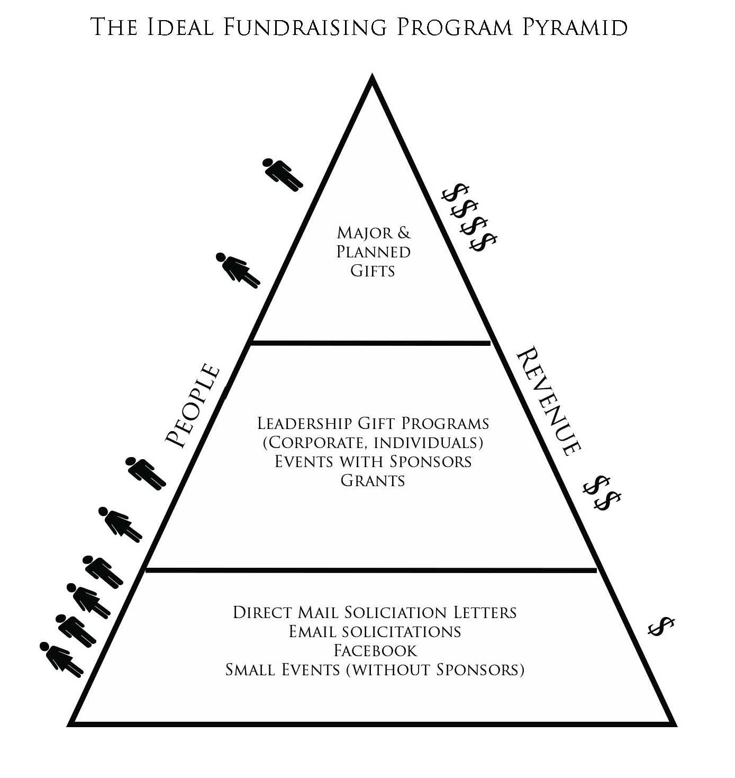
Basic Fundraising Pyramid
Workplace campaigns
Notes:
Basic fundraising pyramid
Need to make it UW-unique to add WPCs
Must ALWAYS come back to this when campaigns are failing

Slide 16
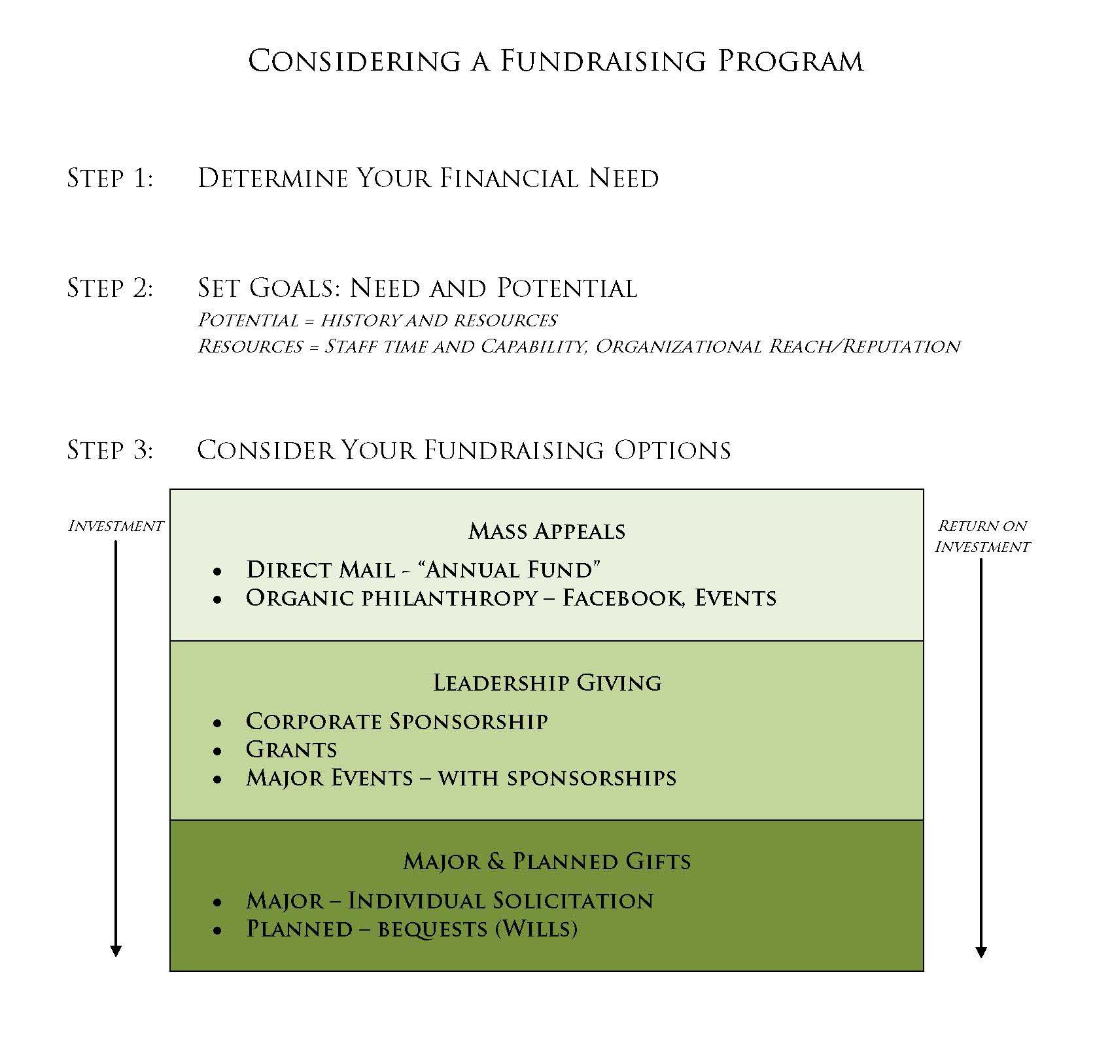
Basic Fundraising Pyramid
Notes:
WPC fit somewhere between mass appeals and leadership giving
Sometimes we forget that non-profits are businesses
Your investment should ALWAYS mirror your projected return

Slide 17
Fundraising Trends & Resources United Way Worldwide
Mike Kerkorian
Director, Corporate Relations United Way Worldwide

Slide 18
Agenda
Philanthropic Trends and the United Way Landscape
Evaluating Local United Way Performance – What is Working?
UWW Resources Available to Support Revenue Generation

Slide 19
Philanthropic Trends & the United Way Landscape

Slide 20
Context for Results
US Economy
The state of the U.S. economy in 2016 was generally strong. Unemployment continued to fall. Now currently at 4.3%. GDP grew every quarter in 2016. Consumer spending increased every quarter as well.
Philanthropy
New Giving USA results just released. Giving to philanthropy increased 1.4% in the U.S. to $390B.
Corporate Giving
Companies have yet to reach their pre-recession levels of corporate giving. This could be a result of using corporate funds for sponsorships, cause marketing, and volunteer activities for employees. (all not included in Giving USA totals)
CFC (2015)
The CFC continued to slide with a decline of -8.4% overall. United Ways sustained a -13% loss, $15M, for its lowest total on record or $103M.

Slide 21
Growth in Philanthropic Sectors
Percent
Source: Giving USA 2016

Slide 22
Many Human Service Partners Have Recovered After Declines During The Great Recession
 | 2014 Contributions | 5 Year Change 2009-2014
American Cancer Society | $807,398,174 | -10.1%
American Red Cross | $734,635,592 | 11.7%
Boy Scouts of America | $392,600,000 | 4.7%
Boys & Girls Clubs | $820,639,255 | 31.4%
Girl Scouts | $103,187,809 | -13.7%
Goodwill Industries | $926,568,371 | 56.3%
Salvation Army | $2,115,646,000 | 23.1%
The Y | $934,231,000 | 20.6%
United Way Worldwide | $3,872,917,029 | 0.8%
Source: Chronicle of Philanthropy

Slide 23
United Way Campaigns Have Declined to Pre 1995 Levels
Source: United Way Research

Slide 24
United Way continues to hold the dominant position in the workplace; declines are small compared to competitors (-3.0% United Way vs. -40% other 9 federations)
Organization | 2011 Giving¹ | 2014 Giving¹ | % Change | 2014 Share of Total²
United Way | $3,012M | $2,921M | -3.0% | 73.0%
Global Impact | $102M | $38M | -62.6% | 1.0%
America’s Charities | $18.6M | $20.5M | 10.0% | 0.5%
Community Health Charities | $28.8M | $20.3M | -29.7% | 0.5%
Community Shares USA | $9.1M | $8.2M | -9.1% | 0.2%
Earthshare | $10.6M | $6.5M | -38.9% | 0.2%
Children First³ | $5.3M | $3.7M | -29.7% | 0.1%
Workplace Giving Alliance | $3.3M | $3.1M | -5.7% | 0.1%
Health First³ | $4.1M | $3.0M | -26.3 | 0.1%
Community First³ | $3.4M | $2.8M | -19.0% | 0.1%

Slide 25
Rate of Donor Loss Accelerated in 2015
Source: United Way Research
Notes:
Secondly, the Rate of UW Donor Loss Accelerated in 2015

Slide 26
Notes:
The Network-Wide Strategy was introduced at the 2014 Community Leaders Conference (CLC) in part to address these revenue problems and is based on ideas shared by network leaders and our stakeholders.
The Strategy clarifies United Way’s unique positioning as a foundation for our strategy and communications
What makes United Way unique is that we…
Develop integrated solutions that improves lives AND communities.
Focus on what’s most needed and what works locally.
Get leaders and organizations from all sectors to work together.
Invite millions of people to be part of the change and amplify the impact.
The Strategy also provides focus and a pathway to address clear, current challenges we face through the Five Bold Plays, the key actions we must take to drive our success.
First, Bold Play 1: Execute on a Clear Business Model advises that United Way must shift from generating resources by providing “One great product marketed the same way to everyone” to getting “The right product to the right donor at the right time in the right way”. I will talk more about this donor-centered approach in a minute.
For Bold Play 2: Create Great Individual Experiences, United Way engages people in ways they prefer in our new digital world: personal, online and in-person, year-round, and over a lifetime.
Bold Play 3: Reignite Strategic Corporate Relationships says we must re-establish ourselves as the Partner-of-Choice for companies by delivering unparalleled employee engagement, community impact, and business value via strategic agreements and network-wide account management.
In Bold Play 4: Drive Transformational Giving we secure large, game-changing gifts by refreshing and expanding the Tocqueville Society and building a network of high-net-worth ambassadors, including a $10 Million Giving Society, who accelerate our impact and innovation worldwide.
Finally, Bold Play 5: Work Together “As One” Network, builds on our greatest asset the great number of United Ways. We must work “as one” when it is to all of our advantage, harness the power of scale to raise our operational performance. and speak as one brand with one voice.

Slide 27
Evaluating Local United Way Performance – What is Working?

Slide 28
United Way Performance: Our Approach
How to evaluate?
Who is good?
What works?

Slide 29
How to Evaluate Revenue Performance
Campaign: Best, most consistent indicator of community support across markets
Growth: Indicates effective resource development practices
Market Penetration: Indicates relevance
Time: Indicates consistency and take into account economic variations
Absolute vs. Relative: Two ways to benchmark

Slide 30
Who is good? Revenue Growth and Changes in Per Capita Giving in 20 High and 20 Low Performing United Ways
 | 1999 | 2014 |  | 1999 | 2014
 | Campaign | Campaign | % Change | Per Capita | Per Capita | Change
Top 20 | $506,329,836 | $669,134,139 | 32.2% | $31.54 | $37.83 | $6.29
Bottom 20 | $582,547,230 | $300,081,523 | -48.5% | $15.31 | $6.84 | -$8.47

Slide 31
What Works: Our POV on Performance
Robust volunteer engagement in workplace and Major Gifts/Tocqueville fundraising
Attention to the top line and adept at incorporating donors/companies who designate
Relationships with corporate CEOs/C-Suite
Ability to unbundle impact into what donors want through integration of Impact/RD/MarComm/Finance
Knowledgeable CEO/Board in the “ways” of United Way RD best practices and accompanying accountability

Slide 32
UWW Resources Available to Support Revenue Generation

Slide 33
The Business Model: Impact is our Business, The Donor is our Customer
Notes:
The United Way donor-centered Business Model is the focus of Bold Play 1. To execute the business model effectively, we must answer the question: “How do we make money and grow our impact work in our communities?” Being donor-centric helps us raise the revenue necessary to maximize our impact.
The model is divided into three key areas: Engage Markets, Develop Impact Products, and Develop Channels and Experiences.
Engage Markets – Understand and Segment Donors: In order to drive revenue, we must know our donors and frame our work in ways that resonate with them.
To effectively connect with donors, it’s critical to discover as much about them as possible – especially in the workplace – to understand what they like and don’t like. Which market segments care about which products/causes, and how do they want to engage.
Using this information, we can group donors into ‘segments’ in order to best take our product to market.
Develop Channels and Experiences – Build multiple pathways to engage donors and market segments: Once segmented, we can begin to craft multiple pathways to engagement, like developing digital strategies, asking people to help build the solutions, and providing opportunities to Give, Advocate, and Volunteer that are tailored to resonate with specific donors. This created a unique experience with the United Way brand, resulting in deeper, more personal connections to our cause.
It’s critical to improve our existing channels – such as rebuilding the mechanics of a best-in-class workplace campaign or a major giving strategy – while innovating to embrace new channels and platforms.
Develop Impact Products – Frame Impact Strategies as Causes/Products: We are in the business of creating impact, and the donor is our customer.
Executing on the business model assumes there’s a strong impact agenda – developed with and through the community – already in place. The goal of engaging and segmenting our markets is to understand what those markets care about within our agenda, and how to effectively connect them to those issues. By framing our impact work as a product to invest in or a cause to commit to, we can drive increased revenue to fund our mission.
Strategy and Operating Policies: The business model’s success relies on a solid organizational foundation. In order to optimize the cycle, a United Way must have 1) staff and volunteers that have a clear understanding of the donor-centered business model, the change that is required to become a customer-focused organization, and risks to mitigate during transition; 2) integrated functional areas aligned to support a donor-centered approach; 3) employees with competencies to effectively deliver for the donor;, 4) solid and transparent governance and finance practices; and 5) a CEO, senior team and volunteer structure deeply engaged to drive success in this way.

Slide 34
Resource #1: Business Model Guided Toolbox
https://online.unitedway.org/bizmodel
Business Model Explainer
Guided Self-Assessment
Bundled Resources & Tools
Continuous education within the United Way network on the elements of our business model
Users answer questions about their United Way to determine areas for potential improvement
Curation on UWO of the best UWW has to offer, geared towards immediate execution locally.
How it helps with Fundraising
#1: Assesses your United Way’s current status on effective processes and practices for revenue generation
#2: Builds understanding of a pathway for improvement on key revenue generation practices
#3: Directs you to tools to help support your United Way’s progress
Notes:
A set of tools has been developed to help you deliver on Bold 1 -- to clarify your own business model and how you’re using impact to drive your revenue.
The Business Model Guided Toolbox includes a Prezi presentation for staff and Board that explains United Way’s donor-centered business model.
Also in the toolbox is a guided diagnostic self-assessment to help you identify your United Way’s current status on practices and processes for driving revenue in a donor-centered way.
For example, a United Way process that is explored in the self-assessment is the extent to which your United Way uses data to identify groups of individuals to cultivate as key market segments. In this section of the diagnostic you are asked whether your United Way captures donor data including personal contact information, demographics, interests and affinities through other engagement channels and enters it into the relationship management system. By using the assessment to understand where you stand today you can set a plan to move forward in getting the right product to the right donor at the right time in the right way.
Finally the toolbox directs you to Resources & Tools geared to help you make progress on the specific practices you identified through the assessment as needing attention.
This is a complete package of support for executing on the donor-centered business model and can be found at
www.online.unitedway.org/bizmodel

Slide 35
Business Model Diagnostic: Priority Practices and Recommendations
Priority Practice Area #1: Drive Major ($25,000+) & Transformational Giving Pipeline to Secure $10 Million Gifts
Priority Practice Area #2: Execute Best in Class Workplace Campaign
Priority Practice Area #3: Create Great Individual Experiences to Acquire & Retain Donors
Priority Practice Area #4: Frame Impact Strategies as Investment Opportunities

Slide 36
Execute Best in Class Workplace Campaign
#1 Activate Resource Development Volunteers
#2 Prioritize accounts, develop goals and plans in key workplace campaigns
#3 Cultivate Relationships with CEOs and Executives
#4 Target key market segments (Churn, Affinity Groups)
#5 Thank, inform, and ask all current and potential donors
#6 Recruit and train company campaign coordinator
#7 Capture personal contact information

Slide 37
Execute Best in Class Workplace Campaigns: Activate Resource Development Volunteers
Recruit - Identify the structure, create job descriptions and make the ask, but don’t forget to thank!
Educate – Define volunteer roles and host training to prepare them for corporate visits and provide key messaging
Inspire – Show volunteers the great work of your organization and empower them to be an ambassador
Activate – Connect with your volunteers throughout the campaign, provide regular progress updates, and publicly thank and recognize them
Recruit
Educate
Inspire
Activate

Slide 38
Resource #2: Campaign and Tocqueville Cabinets Guide (https://online.unitedway.org/groups/resource-development/guide-engaging-volunteers-campaign-fundraising)
Guide includes: Org charts, Case Studies, Staff Roles, Tips
United Ways with a decline in campaign had an average 6% decline in business volunteers, while United Ways that increased in campaign, the average increase in fundraising volunteers is 16%
Peer-to-peer asks yield better results than direct solicitations from United Way
Effectively managed volunteers increase the organizational capacity of United Way, expanding our ability to reach, cultivate, and steward donors
Engaged volunteers help us share the story of our impact and help us forge deeper connections in our communities

Slide 39
Resource #3: Prioritize accounts, develop goals, and account plans in key workplace campaigns (https://online.unitedway.org/workplace-campaign-tools)
Prioritize your relationships
Represent 60 – 80% of revenue
Understand historical trends, current giving and areas for growth
Set account goals
Set annual projections/goals, with specific strategies for growth areas
Complete account plans
Check progress consistently

Slide 40
Resource #4: Cultivate Relationships with CEOs & Executives (https://online.unitedway.org/bp3toolkit)
Ensure regular connection points outside of the campaign between United Way CEOs and CEOs of key workplace campaigns
Engage volunteers in execution of CEO calls and relationship cultivation
Listen, Listen, Listen!!
Don’t ask for money every time you talk with them
Give them something to do besides write a check
Inform them on where their dollars are making a difference
Learn about their business needs (How can United Way help??)

Slide 41
Results: High Performing United Ways
United Way Community | # Campaign Volunteers | Results (2010 – 2014)
Birmingham, AL | 40 Cabinet Segment Volunteers; 650 face-to-face calls | $1.1M in campaign growth $900k increase in Tocqueville and Mega giving
Cincinnati, OH | 300+ Campaign Volunteers | $1.7M growth in Tocqueville giving
Twin Cities, MN | 200+ CEO Calls | $10 M growth in RUM $1 M growth in Tocqueville giving
Milwaukee, WI | 231 Campaign Volunteers | 14.4% increase in campaign (20+ years of consecutive growth!) 20% increase in Leadership, Tocqueville & Major giving
Notes:
This correlates not just the effective use of volunteers but also deepened relationships with CEOs. For example, Milwaukee makes more than 500 CEO calls! Mechanics are in place to support rigorous execution of best practices.

Slide 42
Thank You!

