Slide 1

What Does Collective Impact Really Mean, and Will It Work in My Community?
Dan Jurman - MAR

Slide 2

“He is no fool who gives
what he cannot keep
to gain what he cannot lose.”
- Jim Elliot

Slide 3
“Whosoever shall seek to save his life shall lose it; and whosoever shall lose his life shall preserve it.”
- Luke 17:33

Slide 4
“When you are discontent, you always want more, more, more. Your desire can never be satisfied. But when you practice contentment, you can say to yourself, 'Oh yes - I already have everything that I really need.”
~ Dalai Lama

Slide 5
“Everyone thinks of changing the world, but no one thinks of changing himself.”
~Leo Nikolaevich Tolstoy

Slide 6
“If you want to go fast, go alone.
If you want to go far, go together.”
~ African Proverb

Slide 7
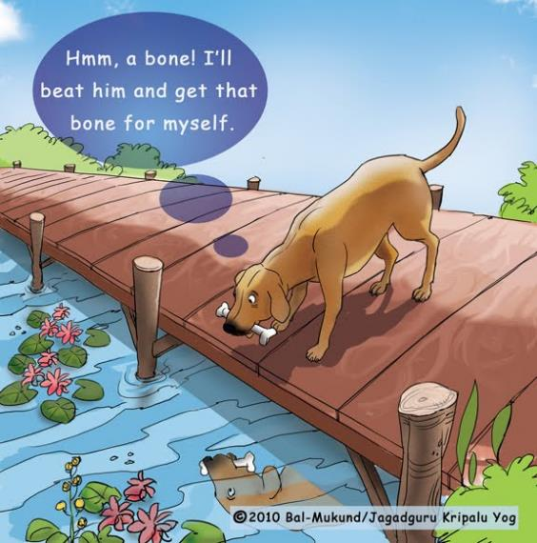
~ Aesop

Slide 8
“Get over yourself. It’s not all about you.”
~ My Mother

Slide 9
Why am I convinced that Collective Impact
is the right way
to move forward?

Slide 10
Crisis Happens

Slide 11
Crisis Intervention is Necessary

Slide 12
Crisis Intervention is NOT a Long-term Strategy

Slide 13

It’s too easy to just treat symptoms

Slide 14
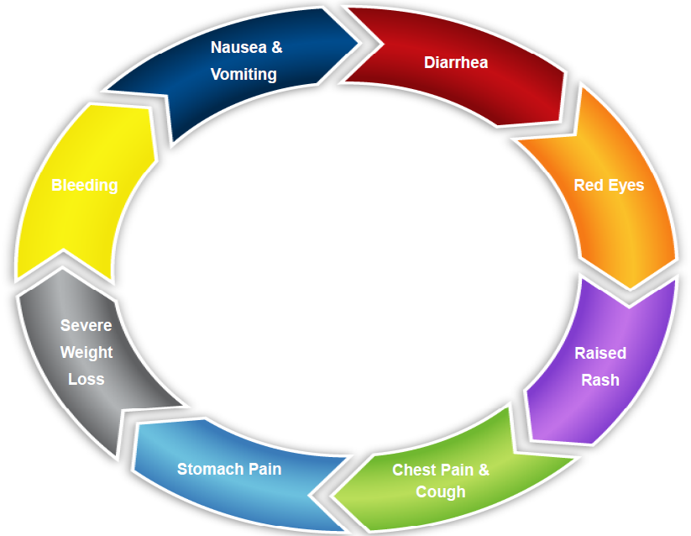

Slide 15
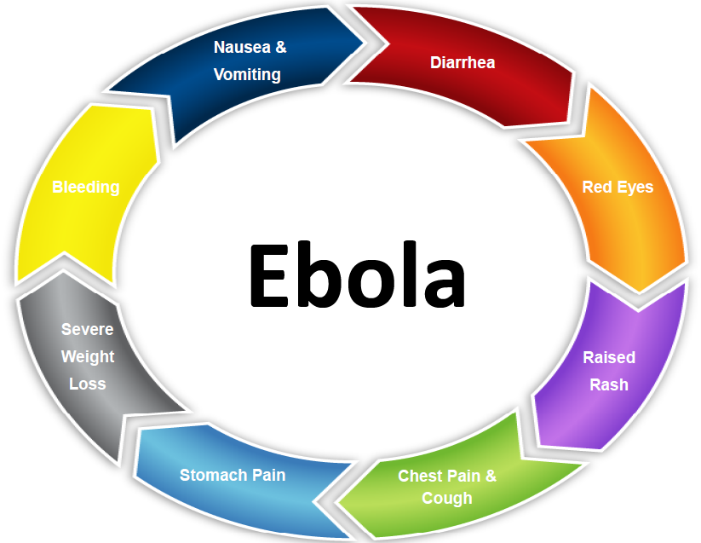

Slide 16
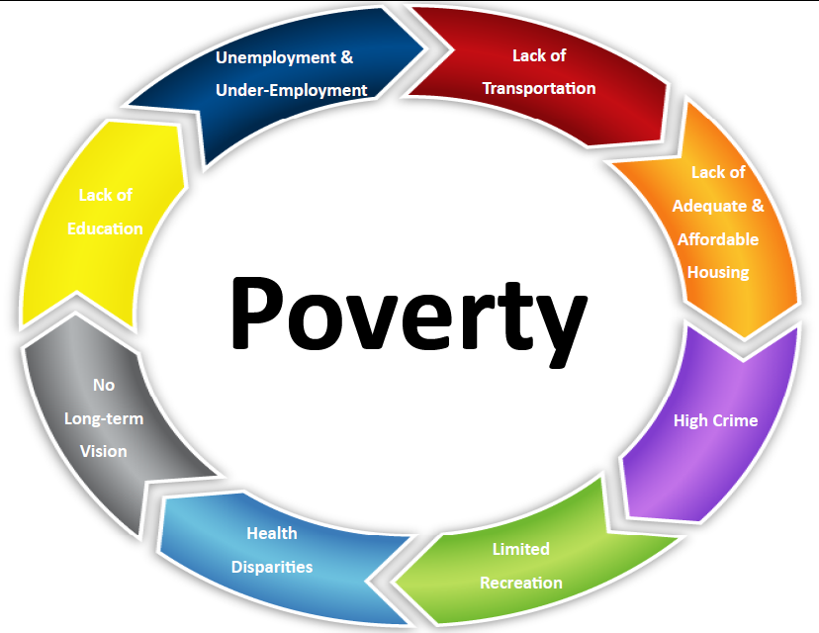

Slide 17


Slide 18
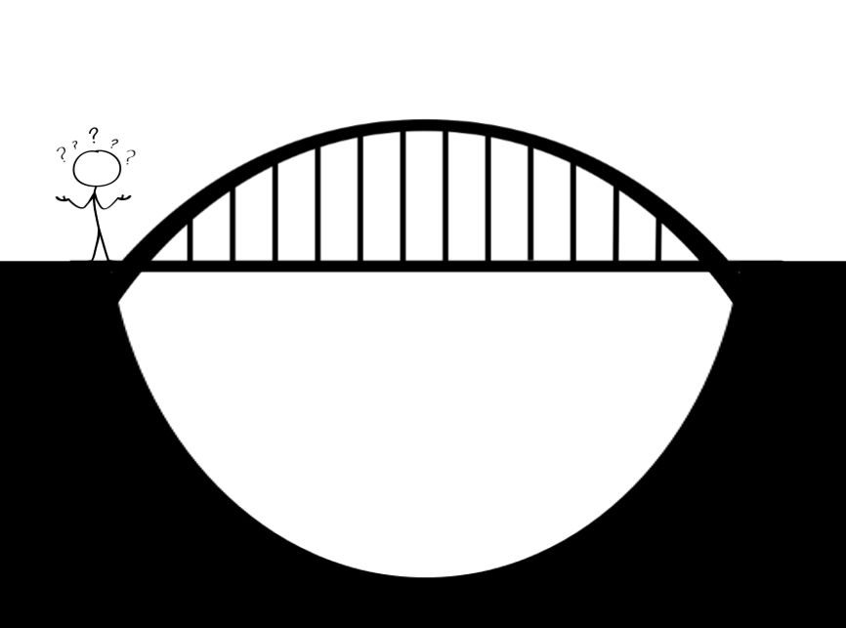

Slide 19
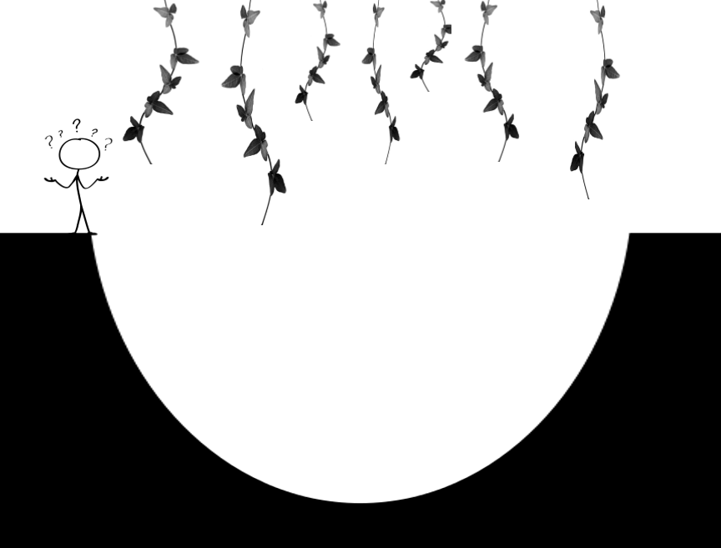

Slide 20
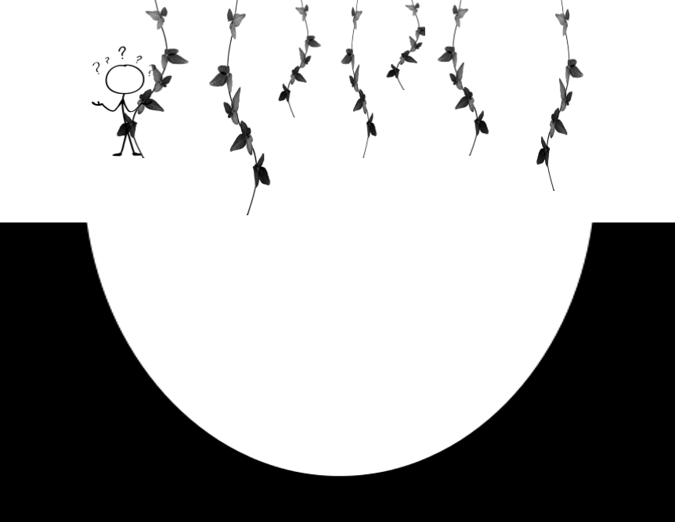

Slide 21
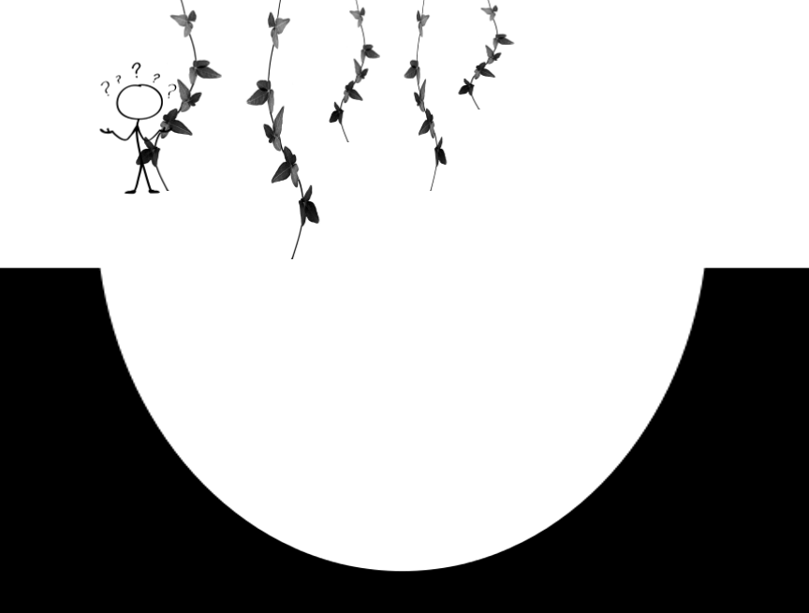

Slide 22
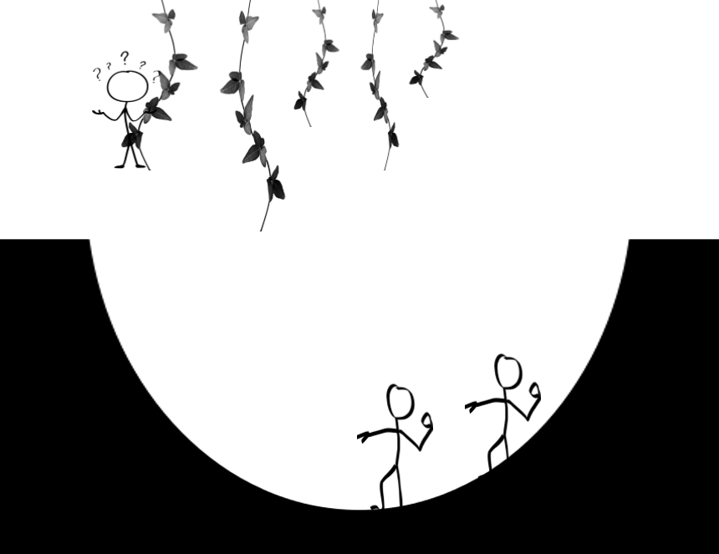

Slide 23
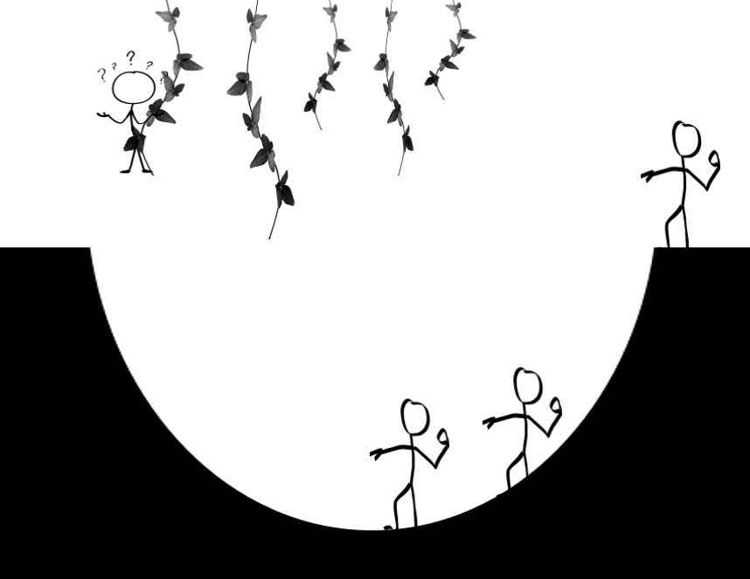

Slide 24
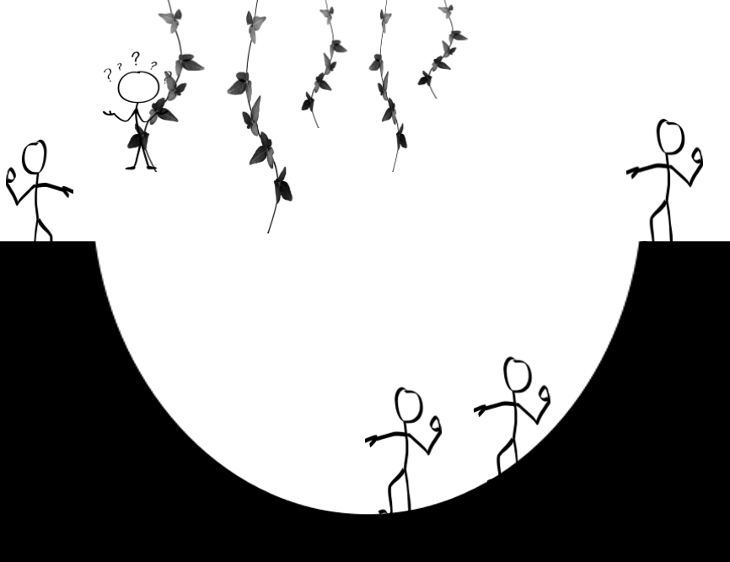

Slide 25
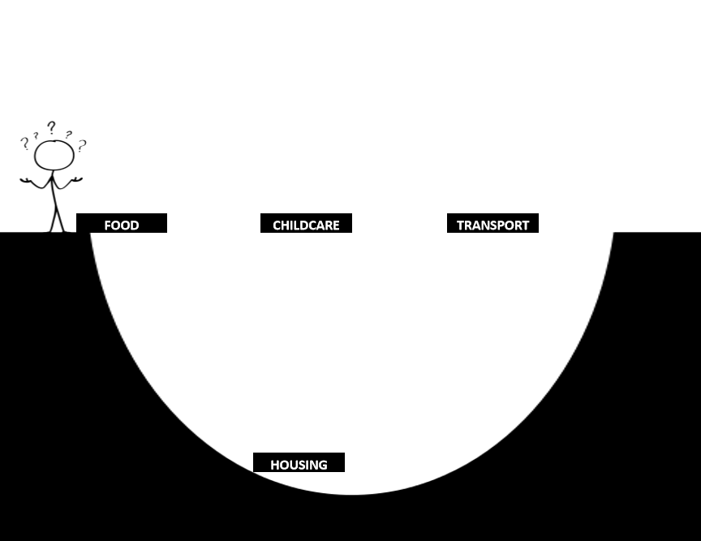

Slide 26
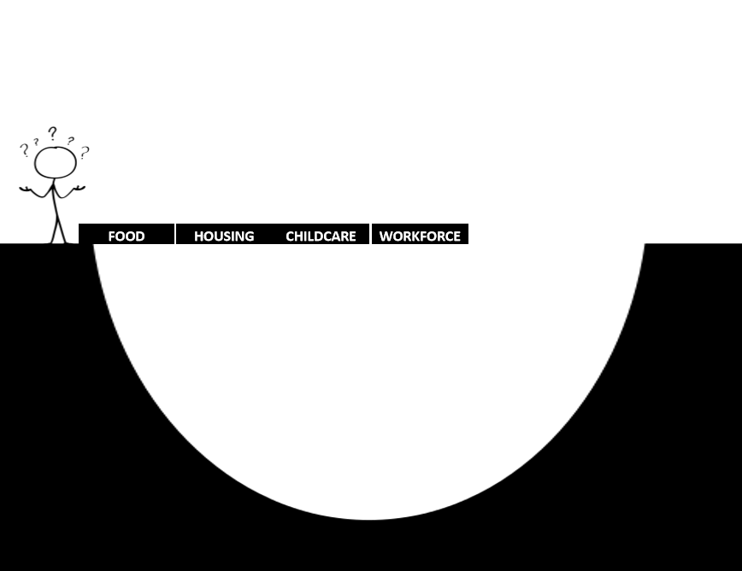

Slide 27
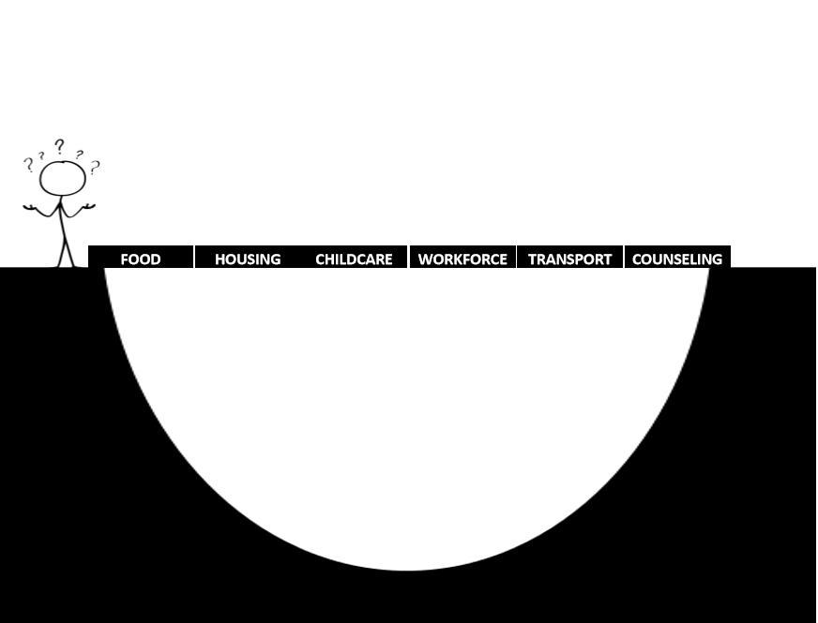

Slide 28
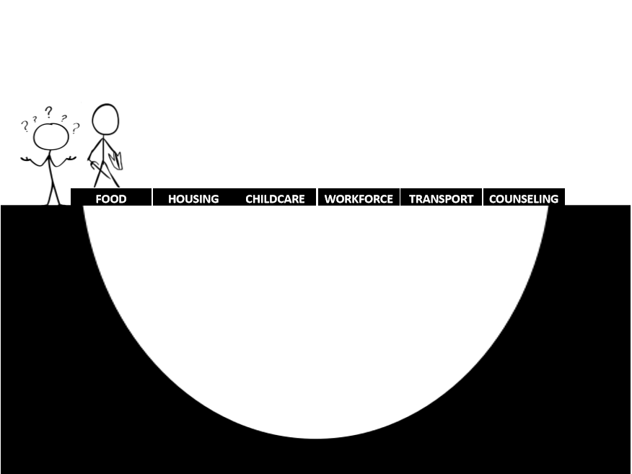

Slide 29
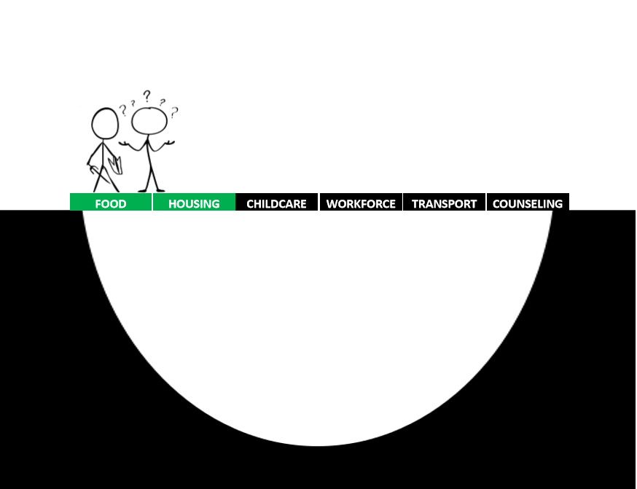

Slide 30
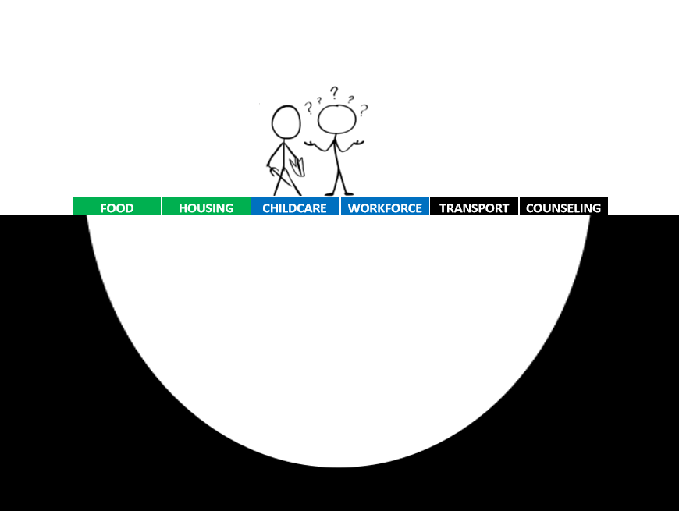

Slide 31
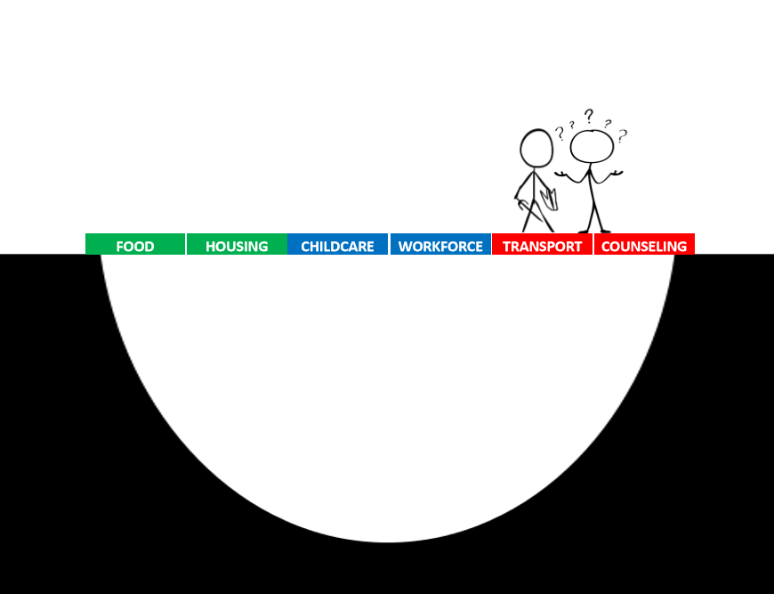

Slide 32

Collective Impact is NOT a New Idea

Slide 33
Definition of Disease Management
Disease management is defined as "a system of coordinated healthcare interventions and communications for populations with conditions in which patient self-care efforts are significant."

Slide 34
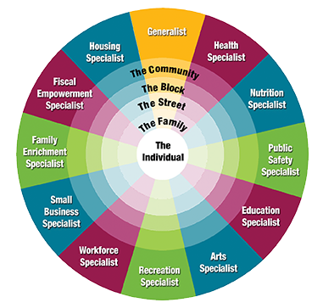

Slide 35
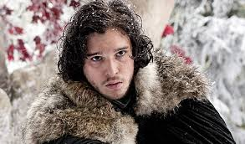
John Snow

Slide 36
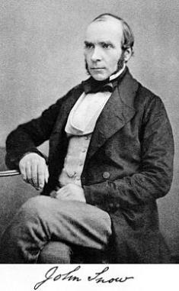
John Snow

Slide 37
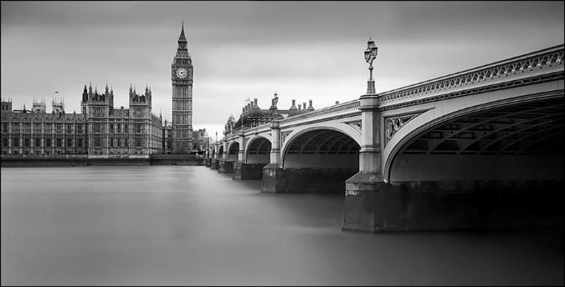
1854 Cholera Outbreak

Slide 38
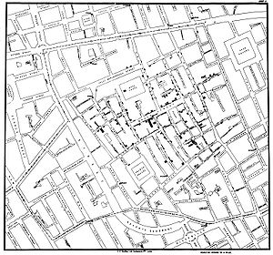
Mapping the Problem

Slide 39
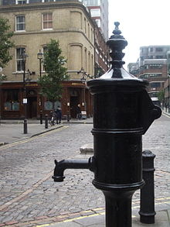
Take the Handle Off the Pump

Slide 40
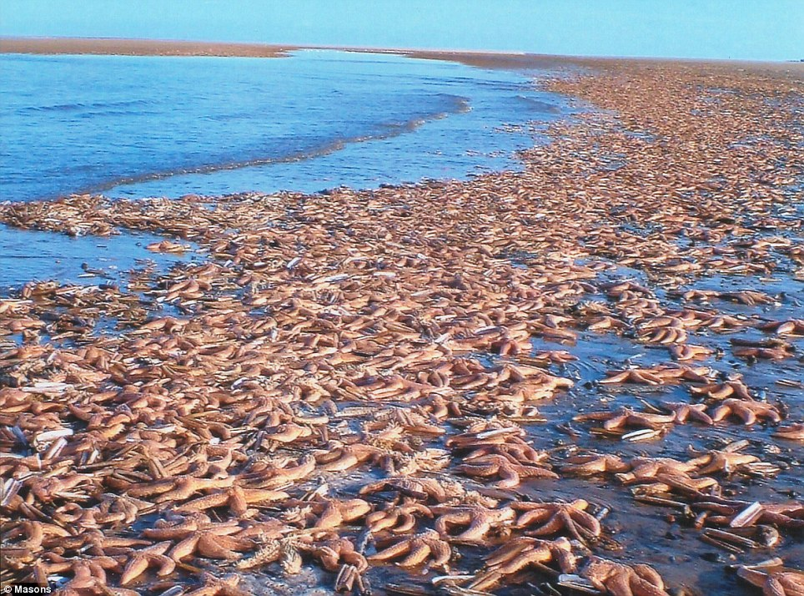
Starfish

Slide 41
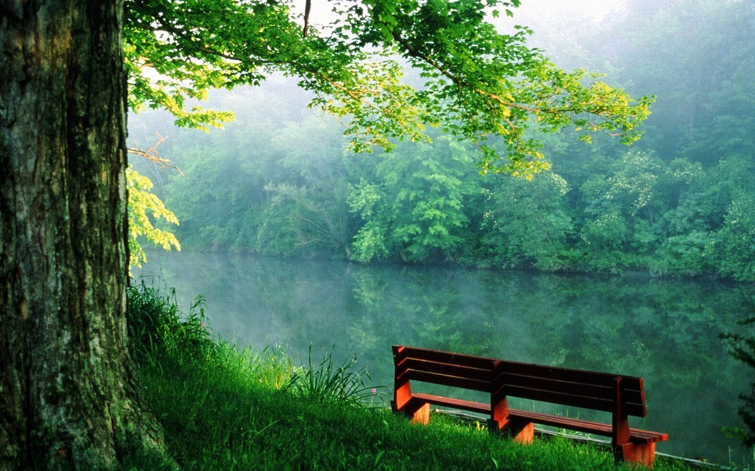
The River

Slide 42
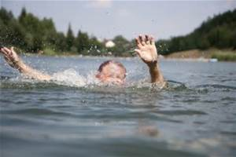
The River

Slide 43
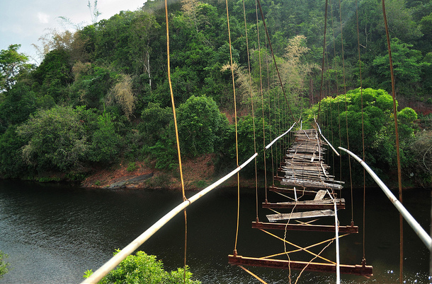
The River

Slide 44
Social Ecological Model
 | Determinants
Individual | Knowledge Attitudes Skills Intentions Values
Interpersonal | Social norms Social influence Social support system Informal social networks Families Work and peer groups Neighbors

Slide 45
Social Ecological Model
 | Determinants
Organizational | Organizational: culture, policies, norms, incentives for health, Management styles, Communication
Community | Social resources, Social identity, Relationships among community groups, Community norms, Power structures
Policy | Legislation, Policies, Taxes, Regulations

Slide 46
Social Ecological Model
 | Short Term | Medium Term | Long Term
Individual
Interpersonal
Organizational
Community
Policy

Slide 47


Slide 48
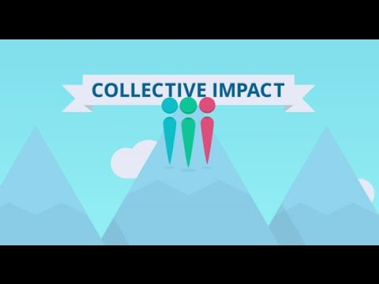
https://www.youtube.com/watch?v=8CT41uUw8Fc

Slide 49
The Core Elements of Collective Impact
Common Agenda
Shared Measurement
Mutually Reinforcing Activities
Continuous Communication
Backbone Support

Slide 50
Common Agenda
Not:
The lead agency’s agenda
An agenda focused on your operating budget
Whatever agenda United Way wants
Whatever agenda other funders will support

Slide 51
Shared Measurement
Not:
You report your outcomes and I’ll report mine
I can’t let you steal my good ideas
I can’t let you know about my failures
You measure, I’m more qualitative

Slide 52
Mutually Reinforcing Activities
Not:
My part in this is most important
We don’t need help
I’ll work with these guys to get the money
The gaps are someone else’s problems
I’ll do a program and add a partner
Lets get 5 partners who do what we do

Slide 53
Continuous Communication
Not:
Meetings are a waste of time
Our first idea is perfect
Our team configuration is perfect
We don’t have time to meet

Slide 54
Backbone Support
Not:
We’ll run this thing
We deserve the most money
We’ll convene it as long as we’re getting paid
Big organizations rule

Slide 55
The Foundation of Any Partnership is Trust
First - Focus on what you’re trying to accomplish together
Second – Focus on the needs of your partners
Third – Focus on your own needs

Slide 56
2. Embrace the Open Exchange of Ideas and Conflict
Create a team of equals
Be a servant leader
Allow and even encourage debate and conflict

Slide 57
3. Don’t Allow the Team to Drift for Any Longer Than Needed
Some drift may not be a bad thing
Engage in creative exercises
Lay the framework for the team to decide goals and direction
When/if the team falters, take the reins
Once directions is established, hand the reins back
Make the direction formal

Slide 58
4. Agree on duties for each partner
Everyone needs something meaningful to do
Everyone needs to be held accountable
Accountabilities need to be written down

Slide 59
5. Focus on meaningful, collective outcomes
Know what you’re tracking
Have qualitative and quantitative outcomes
Be able to drill down on BIG goals
Rome wasn’t built in a day
Share the credit
Celebrate victories

Slide 60
6. Work in a Lean Start-up Model
Minimal viable product
Perfection is for people who never start
Give yourself permission to be imperfect
Give yourself permission to fail
Target early adopters
Assess, Pivot, Re-launch

Slide 61

Brainstorm Together
What Needs To Be Better
In Your Community?

Slide 62
Brainstorm Together
What Are You Going To Do About It?

Slide 63
Brainstorm Together
What Is It Going To Cost?

Slide 64
Brainstorm Together
What Assets Do You Already Have Toward Accomplishing Bold Goals?

Slide 65
Brainstorm Together
What Assets Are You Missing If You Are Going To Accomplish Bold Goals?

Slide 66
Brainstorm Together
Who Else Do You Need At The Table?

Slide 67



Successful For Profit Business
Focuses on Its Desired Customers
So Should You!

Slide 69
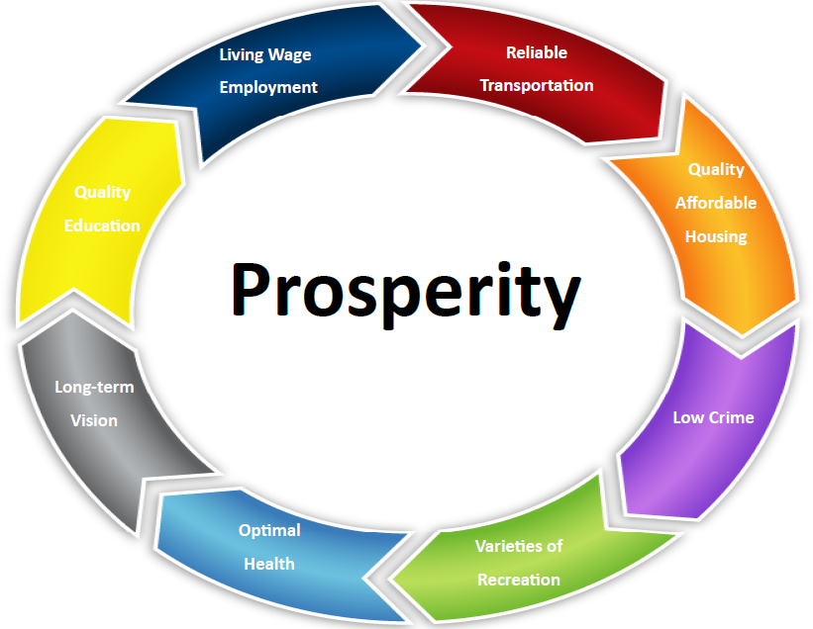

Slide 70
“Take the first step in faith. You don't have to see the whole staircase, just take the first step.”
~Martin Luther King Jr.

Slide 71
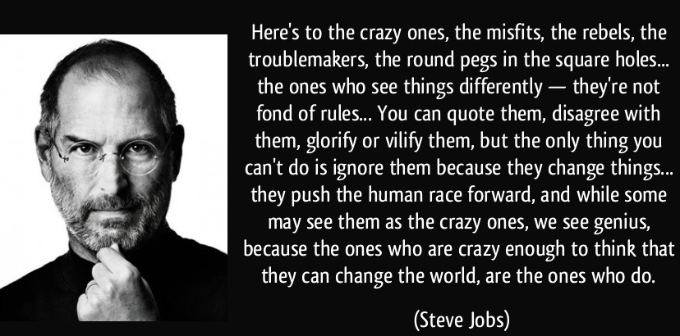

Slide 72
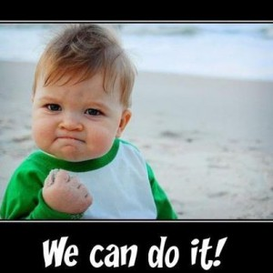

Slide 73

Questions

Slide 74

Dan Jurman, MAR
Chief Executive Officer
djurman@caplanc.org
Notes:
Intros-New and Goods
Housekeeping
Why Bridges for Allies-go over material and end will be a brief summary of Circles with Q&A
Page numbers on slides

