Slide 1

Introduction to
Product Development
Wednesday, June 21, 2017
Notes:
Welcome. Thank you for joining us today.

Slide 2
Agenda
Welcome
Local Examples
Product Definition and Elements
After Today

Slide 3
UWGPSNJ’s Approach to Change (United Way Value)
Convening
Leverage Funding
Advocacy
Capacity Building
Tools at UW’s Disposal
Low-Cost Fundraising
Grant Investments
Volunteer Mobilization
Community Expertise
Drive Systems Change
Strengthen the Capacity of Service Providers
Invest Financial, Social, and Human Capital
Prevent or decrease occurrence of issue
Increase Scale & Efficacy
Stabilize Service Provision
Notes:
UW Value Add:
Other Funders/Foundations do not have all of these tools at their disposal

Slide 4
Siemer Family Stability Initiative: Second gift for Tocqueville members
Opportunity to ask Tocqueville members to do more
Leveraged by a match
Program with clear outcomes
Education by way of Basic Needs—Compelling for our donors!
Small enough that we can articulate one person’s impact
Opportunities to get to know the work
Opportunities to report back to donors
Ability to celebrate idea of second ask through other publications

Slide 5
Women’s Leadership Initiative: Girls Today Leaders Tomorrow program
Women’s Leadership branded around signature program
Volunteer
Mentor
Social
Networking
Education
WLI members have gotten to know the GTLT participants and connect their support of UW to the direct benefit of the girls in the program.

Slide 6

Product Definition
FUNCTIONS
FEATURES
BENEFITS
Notes:
A product has three key elements, functions, features, and benefits.

Slide 7
Functions
Functions – What it does
  Only one or two basic functions for any product
    e.g.:
    Dishwasher automates dishwashing
    Bluetooth provides hands-free phone use
    Flu shot prevents or minimizes the flu
    Homeless shelter provides a place to sleep for people who don’t have a home
Notes:
Let’s start with functions.
Functions are what a product does.
Any product has just one or two basic functions.
For example, a phone’s basic function is communicate with someone else from a distance.
This is true for any product: its functions are the same for everyone who invests in it.

Slide 8
Functions: United Way Examples
Functions – What it does
    Early language/literacy initiative: Builds language & literacy skills in low-income children
      Strategy 1 (caregiver support):
      Helps parents and other caregivers build that child’s language skills
      Strategy 2 (environment enrichment):
      Brings books into the home to promote literacy
      Strategy 3 (child care):
      Trains child care staff to increase children’s language skills
Notes:
What were some functions of the product we just sold?

Slide 9
Features: United Way Examples
Features – What makes it different from other products with the same function
  e.g., Early language/literacy initiative
    Provides tools for parents and child care staff
    Based on tested strategies
    Endorsed by the Chamber of Commerce
    Leverages existing resources
Only describe those features that are of interest to a specific investor
Notes:
These might be some features of our example early language and literacy work. [Refer to bullets.] The first feature is evident from the description of the first strategy. The other features don’t show up in the strategy description but we would know about them because of our involvement in the strategy development process.
Remember that some potential investors will care about some features, other investors will care about other features. While you will want to understand all of the features of your work, when you communicate with a particular investor, you will focus only on the features of interest to that investor.

Slide 10
Benefits: United Way Examples
Benefits – Why it matters to the investor
  Benefits for the community and/or benefits the investor, depending on what motivates the investor
    e.g., Early language/literacy initiative
    Creates a stronger future workforce
    Reduces costs of remedial education, students performing poorly and dropping out
    Results in more children who like to read
    Helps the investor make a difference for children
Notes:
The functions of our early language and literacy work are inspiring and the features are rock solid, but why will potential investors invest? Because they perceive a benefit that matters to them.
Remember that benefits are in the eye of the beholder. You need to understand what is important to different potential investors and then identify benefits that align with their concerns.
Here are three potential benefits from the early language and literacy work. What kind of person might we present these benefits to? What is this person’s role in the community? A business person. How do you know? Second bullet appeals to business interests.
What else is probably true of this potential investor? Cares about children’s issues/contributes to children’s causes.

Slide 11
Prioritize—Top Features and Benefits for United Way Staff
Donor Segment | Top Features | Top Benefits
United Way Staff | 1. 2. 3. | 1. 2. 3.
High Net Worth Individuals | 1. 2. 3. | 1. 2. 3.
Campaign Donors | 1. 2. 3. | 1. 2. 3.
Emerging Leaders/ Millennials | 1. 2. 3. | 1. 2. 3.
Notes:
So now that you’ve identified a list of features and benefits based on the feedback you received from your United Way donors, you can prioritize the top 3 features and benefits most important to the United Way staff donor segment. If you try this exercise with a different donor segment, you can prioritize the top features and benefits for them as well.
From that basic understanding, you can develop your engagement plan highlighting the elements that are most important to each donor segment.

Slide 12
After Today
United Way Online Resources
Impact Approach
Product Development
Product Playbooks
Global Results Framework
2028 Impact Goals
Contact Information
Questions? Need help along the way?
Rebecca Forman
United Way of Greater Philadelphia and Southern New Jersey
rforman@uwgpsnj.org
Stephanie Chin
Stephanie.chin@uww.unitedway.org
703-836-7112 x239
Notes:
So if you liked this training and want to do it again, you can use all the materials we’ve shared.
We have more information about product development and the business model guided toolbox on United Way Online.
If you have questions, you can contact Stephanie Chin.

Slide 13
Thank you
Notes:
One more time…

Slide 14
Appendix for Reference

Slide 15
Impact Approach

Slide 16
What Makes Our Impact Approach Unique and Relevant
  We solve problems no one organization can solve alone.
  We develop integrated solutions that meet the complexities of communities and people’s lives
  We focus on what’s most needed and what works locally with global scale via 1,800 LUWs in 41 countries
  We get leaders and organizations from all sectors to work together
  We engage millions of people to be part of the change

Slide 17
How our Impact Approach Connects With Our Brand
  Our Brand Credo:
United Way fights for the health, education, and financial stability of every person in every community.
How We Win by Living United.
By forging unlikely partnerships.
By finding new solutions to old problems.
By mobilizing the best resources.
By inspiring individuals to join the fight against their community’s most daunting social crises.

Slide 18
Impact Agenda
WORLDWIDE GOALS
EARLY CHILDHOOD SUCCESS
YOUTH
SUCCESS
ECONOMIC
MOBILITY
ACCESS
TO
HEALTH
Children enter school ready
Children are successful in primary school
Youth successfully graduate secondary school
Youth gain knowledge, skills to obtain employment
Individuals attain good jobs
Individual can effectively manage their financial resources
Individuals/ families have access to healthcare
and improve their health
Notes:
Our agenda enables us to set global/national goals and drive actions/results at a community level.
We bring a special focus to key populations through our work on Human Trafficking, Veterans, etc.

Slide 19
Current Product Examples
 | Products
CHILDHOOD SUCCESS | Abriendo Puertas Club Connect Community Schools Dolly Parton’s Imagination Library Family School Community Partnership | First Book Pay for Success Play to Learn Raising A Reader Reach Out and Read Read to Succeed | Reading Corps Ready By 21 Strive Together United Way Born Learning Academies United Way Center for Excellence in Early Education
YOUTH SUCCESS | Accelerated Student Assistance Program Achievers for Life Airbus Flying Challenge Be a Middle School Mentor Communities in Schools Community Schools | Cradle-to-Career/Collective Impact Approaches Destination Graduation Dropout Prevention Early Warning and Response Systems | Linked Learning Middle School Success Out-of-School Time Turn-Around High Schools Whole School, Whole Child Youth Career Awareness
ECONOMIC MOBILITY | Bank On Financial Capability@Work Financial education and coaching Integrated Service Delivery | Jobs + Mission United MyFreeTaxes Sector-based workforce development | Tax time savings programs Volunteer Income Tax Assistance Working Bridges’ Income Advance Loan
ACCESS TO HEALTH | 5210+ Babies Born Healthy Community gardens and playgrounds Community Health Needs Assessments | Community Schools Fun, Fly & Fit Health Insurance Navigators Healthy Food Initiative Healthy Girls Initiative | Integrated Service Delivery Mission United Share Our Strength United Way Born Learning resources Vision and Dental Screenings

Slide 20
2028 Goals

Slide 21
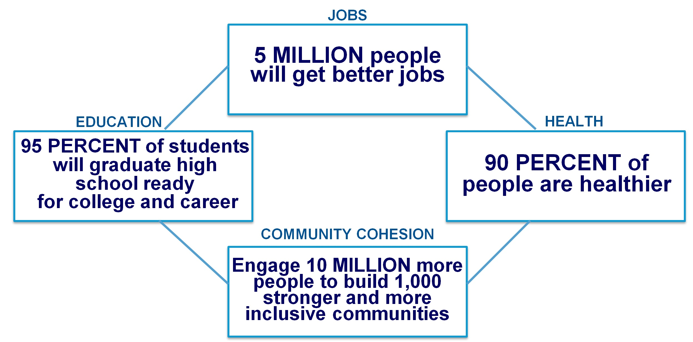
2018 - 2028 US Impact Goals
We fight for the health, education, and financial stability of every person in every community.
Our goals over the next 10 years:
  5 million people will get better jobs
  95% of students will graduate high school ready for college and career
  90% of people will be healthier
  These goals are only possible when we do this together.
  To that end, United Ways will engage 10 million people to build inclusive and stronger communities in 1,000 cities and towns across America

Slide 22
Global Results Framework

Slide 23
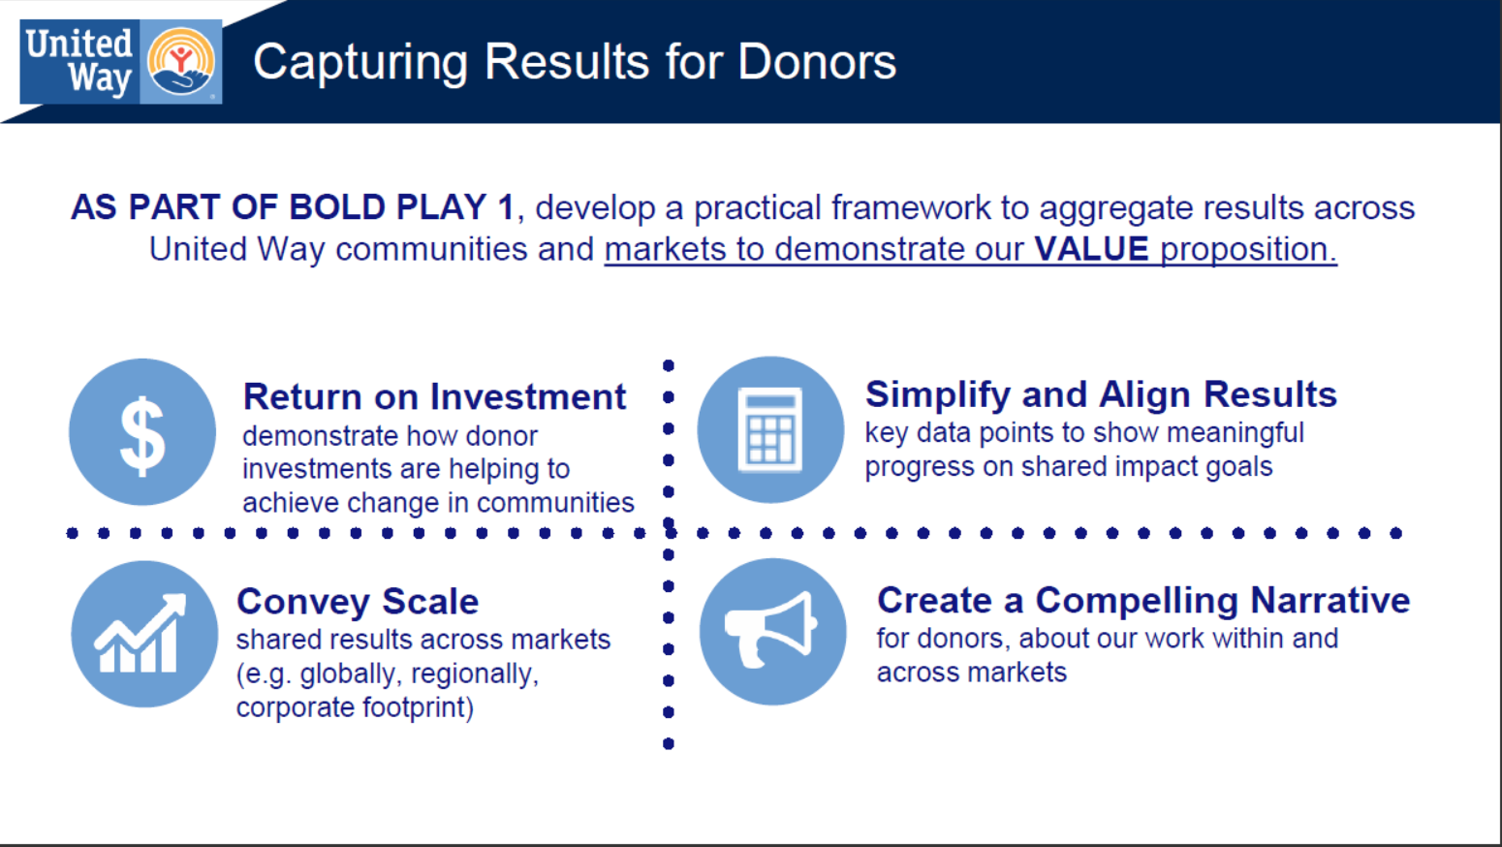

Slide 24
