Slide 1
Give. Advocate. Volunteer.
UWP Member Updates

Slide 2
“Member Only” Section on UWP Website
Access by member CPOs
Ability to find up-to-date information easily
Communications from UWP staff
Notes:
The website will be available for all member CPOs and others if United Ways would like to add additional users.
Website was designed so our members can access various information.
The information placed on the website will be updated regularly by UWP’s staff as information changes.

Slide 3
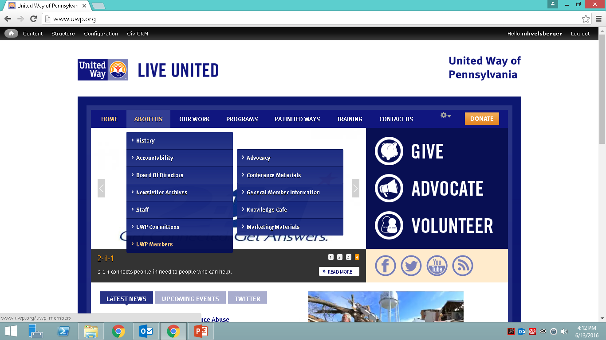
“Members Only” Section
Notes:
To sign in go to the bottom of the UWP website and click login. There you can put in your email address and say forgot password to get a new password set up. Once logged in, please go to the about us tab and go

Slide 4
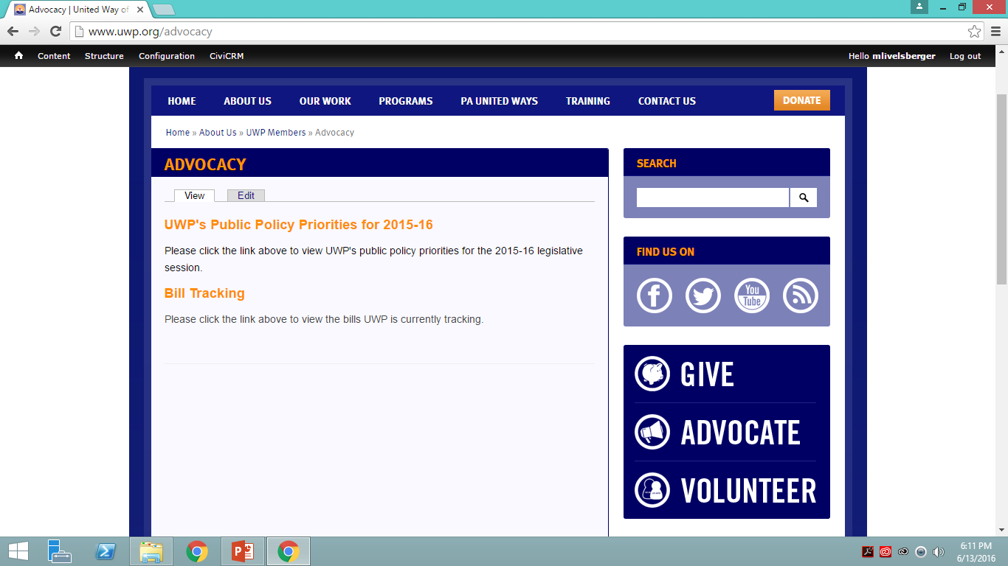
“Members Only” Section: Advocacy
Notes:
There is an outline of the bills UWP is currently tracking. You can also see which bills have moved where in the process.

Slide 5
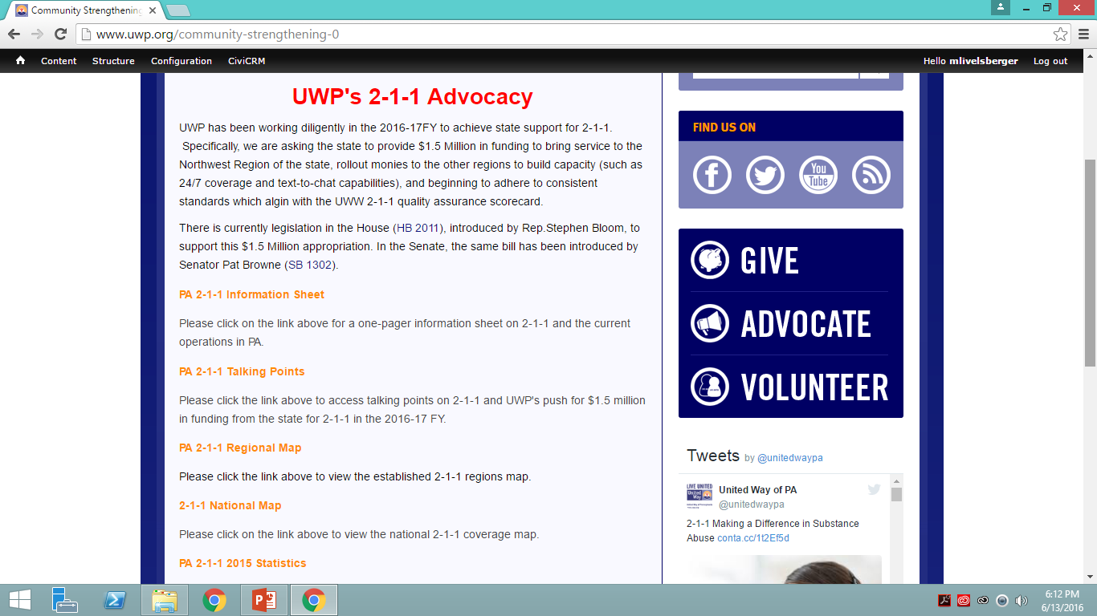
“Members Only” Section: Community Strengthening
Notes:
Under “community strengthening” you will find various documents on 2-1-1 advocacy. There is a one-page overview of 2-1-1, current talking points on UWP’s advocacy asks for 2-1-1 funding from the state, the 2-1-1 regional map (very useful for legislators), 2-1-1 national map (shows how much of the country is covered by 2-1-1), PA 2-1-1 2015 statistics (top needs, top call areas), social media messaging (sample Twitter, Facebook, and Email posts), and a copy of the 2-1-1 sign-on letter (over 300 signatures!)

Slide 6
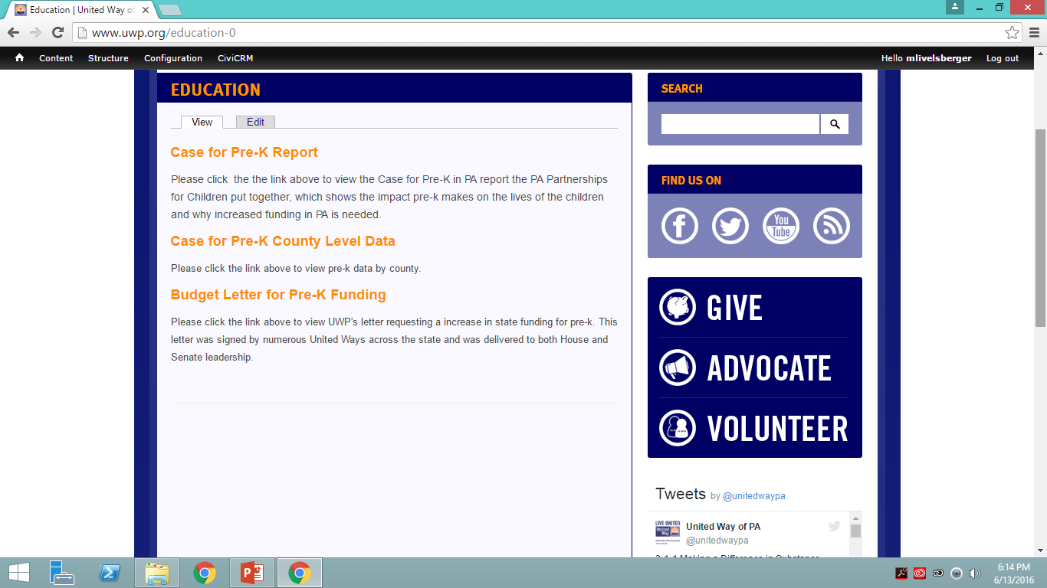
“Members Only” Section: Education
Notes:
Case for Pre-K report, Case for Pre-K County Level data, sign-on budget letter ask for an investment in increased funding for Pre-k (delivered)

Slide 7
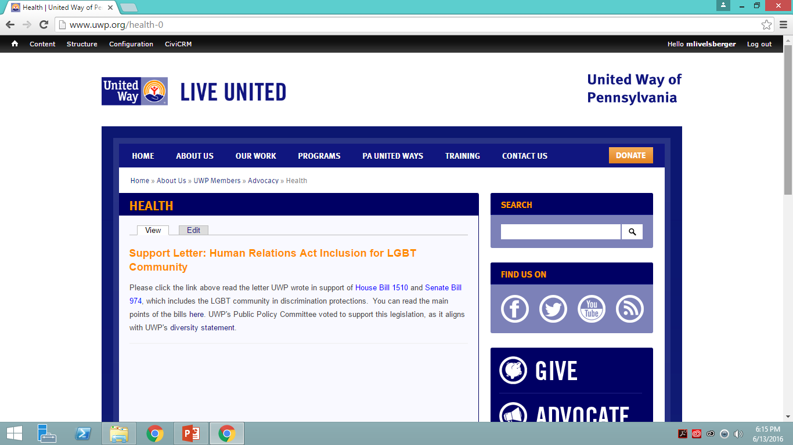
“Members Only” Section: Health
Notes:
Support letter for human relations inclusions act for LGBT community. Main points, links to bills, and letter

Slide 8
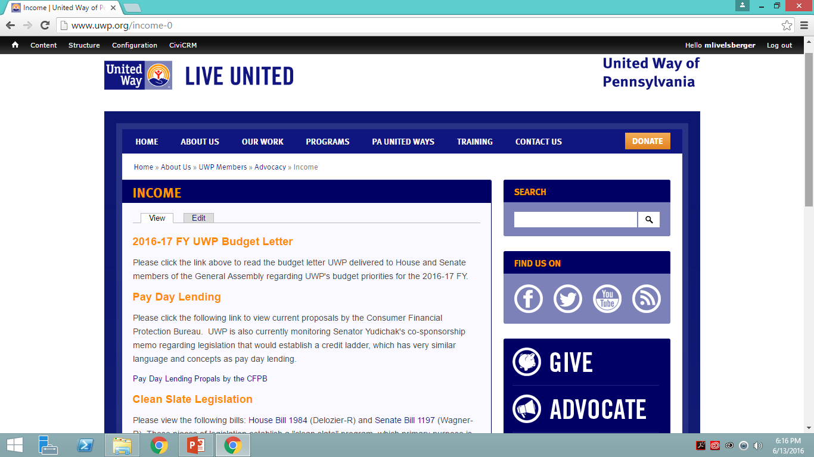
“Members Only” Section: Income
Notes:
Budget letter delivered outlining UWP’s budget priorities for 2016-17FY, Pay day lending information, clean slate legislation.

Slide 9

“Members Only” Section: Legislative Contact
Notes:
Numerous documents for easy access to legislators and legislative contacts. Emails, mailing labels, lists, etc.

Slide 10
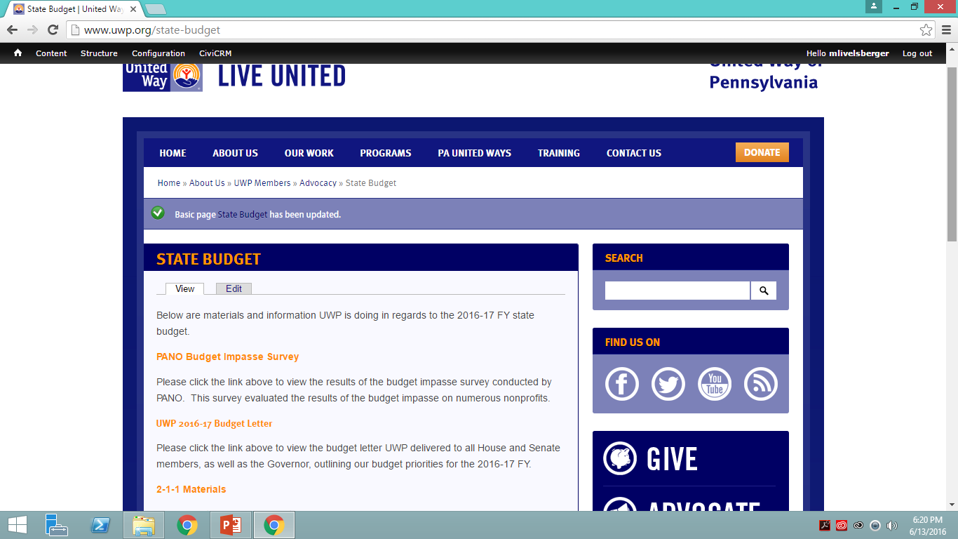
“Members Only” Section: State Budget
Notes:
PANO Budget Impasse Survery, UWP budget letter, 2-1-1 materials, early childhood education

Slide 11
“Members Only” Section: Conference Materials
Notes:
Place to add conference materials, link to videos, program, etc.

Slide 12
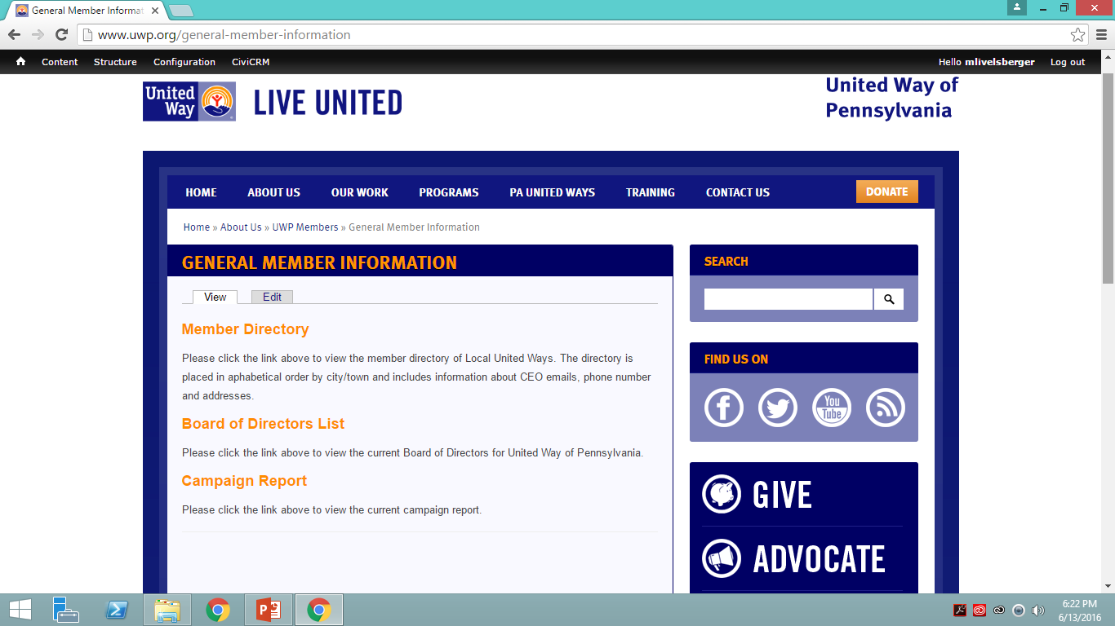
“Members Only” Section: General Member Information
Notes:
Member director, BOD list, Campaign report

Slide 13
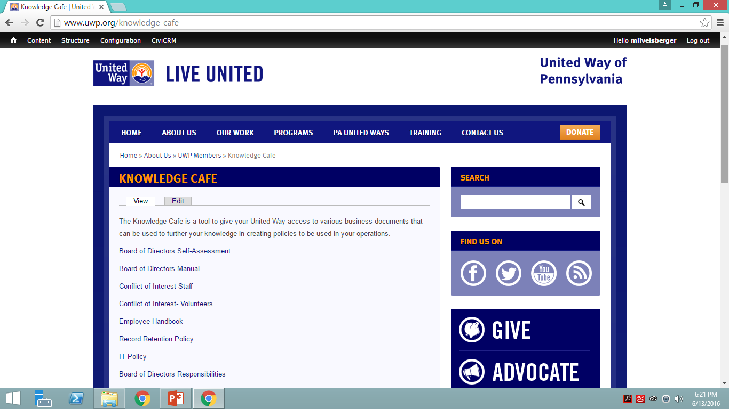
“Members Only” Section: Knowledge Cafe
Notes:
Various documents that can be utilized as templates for business duties

Slide 14
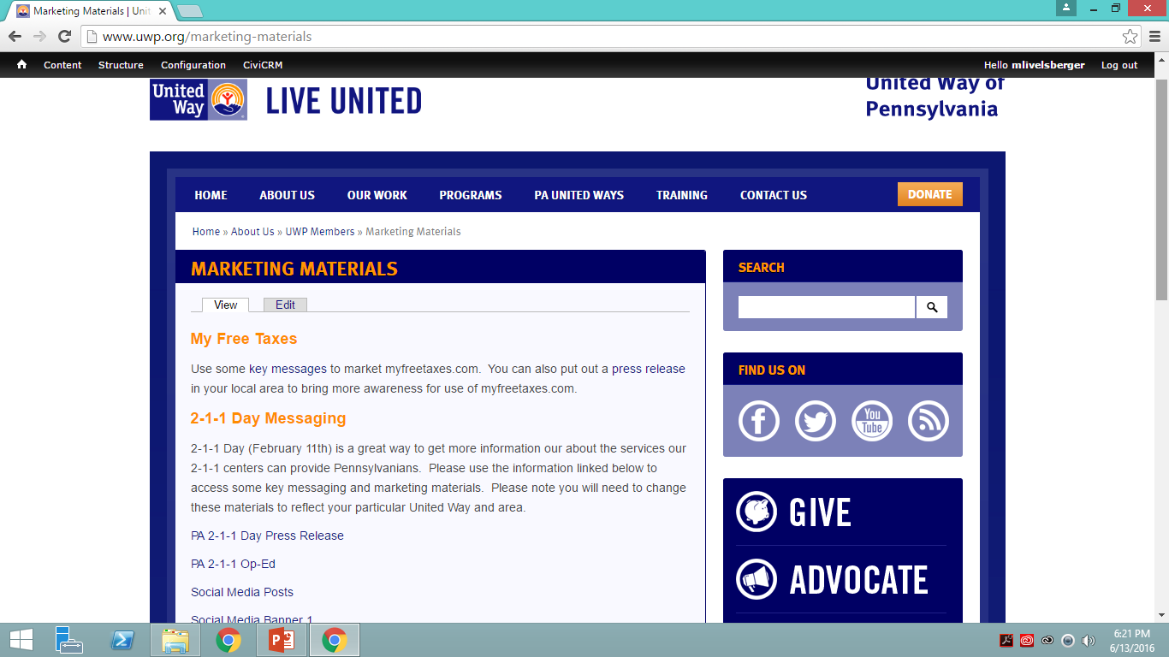
“Members Only” Section: Marketing Materials
Notes:
Marketing information on MFT, 2-1-1 Day, EITC Awareness Day, PA Senate and House Twitter handles, Media contacts (split into regions)

