Slide 1
Federal Tax Reform Once in a generation opportunity to advocate for Pennsylvania workers
Kristen Rotz, UWP President
Maggie Livelsberger, UWP Public Policy and Communications Manager

Slide 2
Federal Tax Reform in process
The House and Senate have both voted on a budget bill which sets the process in motion. It kicked off a process known as “reconciliation” during which the Senate only needs 51 votes to pass a proposal.
The House vote was very close, revealing divides over how much money is being spent, as well as the proposed elimination of some deductions such as the one for local taxes.
The actual tax reform bill was introduced November 2 – House wants to vote before Nov. 23. Senate is crafting their own plan.
There will be a push to complete tax reform by the end of the year, and pressure to deliver based on the inability to meet campaign promises on health care.

Slide 3
United Way Policy Goals
Make sure all Americans continue to have the ability to deduct their charitable giving
Protect and expand EITC for workers not raising children at home
Strengthen the Child Tax Credit for very low-income families, especially those with young children (lowest priority)

Slide 4
GOAL: Make sure all Americans have access to the charitable giving deduction
Proposal to increase the standard deduction while keeping the charitable tax incentive as a deduction for those who itemize = far fewer Americans will see a tax benefit from their charitable giving
BOTTOM LINE: Only 5% of Americans are expected to itemize their taxes because of the increase in the standard deduction. This means 28 million people (representing 36% of the country’s giving) will be taxed on their donations to charities. Provisions in current proposals could result in at least $13.1 billion less in giving each year

Slide 5
Charitable Deduction
Current proposals= $13BN loss in charitable giving.
H.R.3988 = a charitable deduction up to 1/3rd of standard deduction.
Goal:
Universal Charitable Deduction
Support for HR3988
Notes:
Currently, the charitable deduction is available to tax payers who itemize, or about 30% of taxpayers.
The proposal, would decrease the incentive to itemize by increasing the standard deduction
Studies suggest this would result in about a $13 billion reduction in gifts to the charitable sector
Representative Mark Walker (R-NC), Chairman of the Republican Study Committee, introduced HR 3988 that would keep in place the charitable deduction to itemizers, but would also institute a charitable deduction for taxpayers taking the standard deduction, up to 1/3rd of the standard deduction. So:
Under the House proposal, a single filer, claiming the increased standard deduction, could also deduct their charitable gift up to $4,000. (Married filers could deduct up to $8,000)
While United Way is not in support of any kind of cut, cap, or floor on the charitable deduction, this proposal is the most encourage policy we’ve seen in a long time. We’re encouraging support of this legislation on the House side, while advocating for a universal charitable deduction in the Senate.
The current call to action link on UnitedWay.org calls for Members of Congress to co-sponsor HR 3988
The ultimate goal is a “universal charitable deduction”. Or simply, for every taxpayer, no matter their income or size of their gift, to be able to apple CD.
*The term “universal” has a bad connotation when messaging to conservatives.

Slide 6
GOAL: Make sure all Americans have access to the charitable giving deduction
The charitable deduction is a nearly century-old tradition and reflection of American values and our commitment to helping our neighbors. It is a unique incentive that encourages a selfless act.
Expanding the charitable deduction to all American taxpayers will preserve the American commitment to giving, and support investment in community solutions.
Notes:
Note: I wrote that text out for you but you might want to cut the text and just say some of this info
(this is sometimes referred to as the “childless” population – but that’s not really accurate. In many cases these are non-custodial parents who have a big role in their children’s lives).
Max amount of the credit is $506 compared with nearly $6,269 for larger families
Single filers no longer eligible after earning $14,880
EITC, primarily designed for working parents
Working parents, individuals age 25-64
Under income thresholds

Slide 7
Charitable Giving protection – US House Strategy
OUR ASK: Co-sponsor HR 3988 to create a special charitable deduction in addition to the standard deduction.
US Representative Walker (R-NC) has introduced the Universal Charitable Giving Act (H.R. 3988) which would do this. This proposal has a maximum benefit of 1/3 of the standard deduction – applied to the proposed SD, this means about $4k for individuals and $8k for couples.
This would incentivize charitable giving for low- and middle-income taxpayers, as well as protect giving for those affected by an increased standard deduction.
A summary of the bill from Representative Walker’s office can be found here.
No PA Reps are cosponsoring the Walker legislation at this time.

Slide 8
Charitable Giving protection – US Senate Strategy
OUR ASK: Protect the charitable deduction by expanding it to all American taxpayers.
The charitable deduction is a unique incentive that encourages a selfless act and any limitation on the charitable deduction would result in reduced giving and communities would pay the price.
At the end of the day, it’s not about donors, or nonprofits--it’s about the children and families whose lives are strengthened through charitable giving.
Expanding the charitable deduction to all American taxpayers will preserve the American commitment to giving, and support investment in community solutions.

Slide 9
Charitable Giving protection – Tools for engaging boards, donors, volunteers and partner organizations
Send a letter: (personalization encouraged)
https://www.unitedway.org/get-involved/take-action/fight-for-charities
https://www.unitedway.org/get-involved/take-action/stand-up-for-working-americans
Author an Op Ed about how important the charitable giving deduction is to the nonprofit sector as a whole.
UWP can assist with developing an op ed that is customized for your community
Use your Twitter/ Facebook platform for tax reform advocacy
Utilize UWW’s Bambu tool
Template messages available on United Way online
Echo and re-post UWP’s social media messages with your own twist

Slide 10
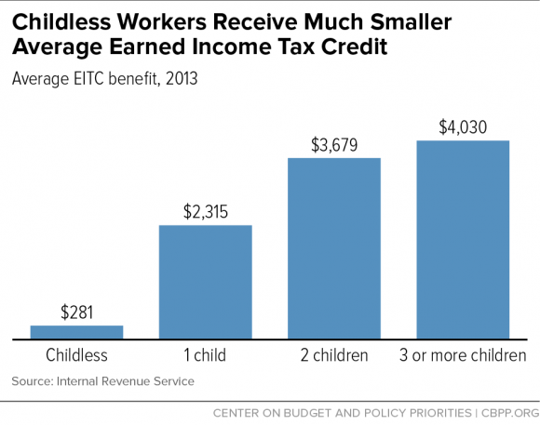
GOAL: Expand EITC for Workers Not Raising Children at Home
Right now the credit is structured to help families.
7.5 million workers are taxed into poverty because they are not raising children at home, and that’s largely due to their exclusion from the EITC
Young workers just starting out are entirely ineligible. You must be 25 to claim the credit unless you are raising children at home.

Slide 11
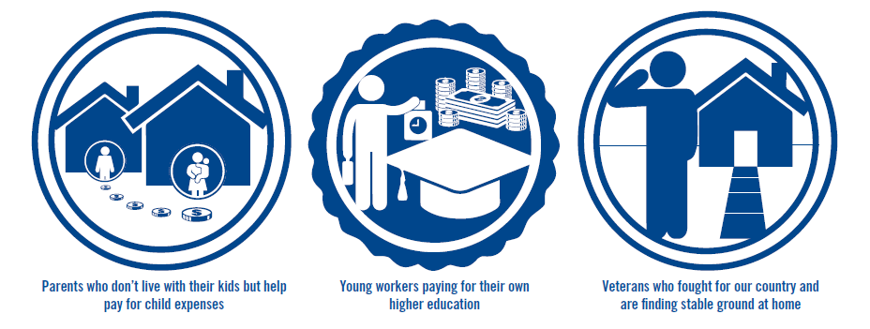
Who is most impacted?
Notes:
Also, older working adults with grown children.

Slide 12
EITC - PA Impacts
In Pennsylvania, this expansion would help 554,000 people including:
30,000 military members / veterans
166,000 young workers
61,000 rural workers

Slide 13
Federal Tax Reform proposals for EITC
The House proposal maintains the EITC as a refundable tax credit.
The House proposal includes an additional change for EITC - requiring SSNs. There may be additional provisions affecting EITC in the Chairman’s amendment for the House.

Slide 14
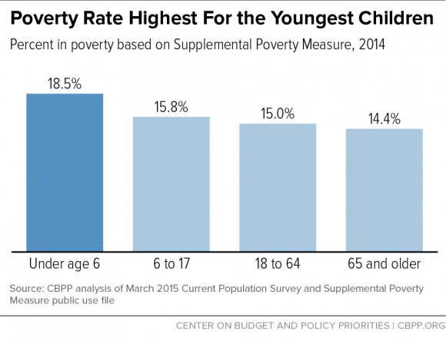
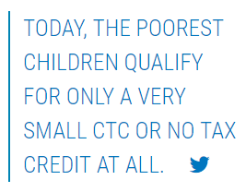
Secondary Focus: Strengthen the Child Tax Credit for low-income families and those with young children

Slide 15
Federal Tax Reform proposals for CTC
The House proposal does several things to strengthen the Child Tax Credit for middle and upper income families – it increases the maximum credit ($1600 per child), doubles the income level at which the credit phases out, and indexes for inflation.
The House proposal does nothing to strengthen the CTC for the poorest families in our country. The first $3000 of income is still excluded, and the tax credit scales up gradually based on income.

Slide 17
Other Issues
Eliminating the estate tax – United Way has no position
Johnson Amendment (nonpartisan political activity ban for 501(c)(3)s – not a priority for United Way, we are not advocating on this topic. The House proposes to make changes limited in scope to allow churches and integrated auxiliaries to endorse candidates in “regular and customary activities” or for “de minimis” expenses
- Deductions for mortgage interest, state and local taxes, etc. – United Way has no position

Slide 18
Key Dates to Strategize Around
Nov. 20-24: House and Senate State Work Period
Dec. 18-29: House and Senate State Work Period
End of Year: Beat the Clock
Tell a story about year-end impacts on charitable giving, supporting the idea that the deduction is an incentive which people respond to
January 26, 2018: EITC Awareness Day
Consider Op-Eds, Letters, Social Media
Notes:
Caitlin

Slide 19
Tax Reform Hub https://online.unitedway.org/taxreformhub
Notes:
(this only works for UW staff who can access United Way Online).

Slide 20
Congressional Meetings
November Congressional Recess: Nov. 20th-24th
Find your local office
https://www.govtrack.us/congress/members
Focus on Senators
Senator Toomey on Senate Finance Committee
Know your content
Topics for discussion
You are the expert- value add
Make the call
Speak to the scheduler- May be in D.C. or district office
Let the office know you’re a constituent
Follow-up
Before the meeting confirm details and send thank you following

Slide 21
Congressional Meetings – Tax Reform Asks
Congress should make sure all Americans continue to have the ability to deduct their charitable giving
House: co-sponsor HR 3988 (capped universal deduction)
Senate: expand the charitable deduction to all taxpayers
Congress should build on the success of pro-work, anti-poverty policies, and expand the EITC and the low-income CTC, in tax reform.
Increase the maximum credit for workers not raising children at home to $1000 (from $500) and lower the age of eligibility to 21
Count the first dollar of income for the CTC, and increase how quickly taxpayers are eligible for higher credits

Slide 22
Social Media Engagement
Tips for Engagement:
Hashtags to Use: #UWAdvocate #EITC #expandEITC #taxreform
Work best on Twitter and Instagram
Include photos and videos. UWW has some on the Tax Reform Hub and any local photos/videos would be great to include!
Consider linking to blog posts or news article that illustrate the local impact of policies
On Instagram, consider putting the call to action link in your bio and adding the line “Take action to join the fight by clicking the link in our bio”
Consider sharing the calls to action via your email lists to amplify the message further
Find your member of Congress and their Twitter handle here.

Slide 23
Social Media Engagement
Sample Tweets Directed Towards Members of Congress:
@Member of Congress Expand the #EITC in #taxreform to help workers keep more of what they earn. #UWAdvocate #expandEITC
@Member of Congress Expand the low income #CTC in #taxreform to help families that need it most #UWAdvocate #expandEITC
Congress, let’s work for working Americans. And make the tax code work for them too. #expandEITC and low-income #CTC in #taxreform
Sample Tweets to Engage the General Public:
If Congress expands #EITC in #taxreform it would help 554,000 workers/vets/rural/young/occupation in PA #UWAdvocate
Tell @Member of Congress to stand up for rural workers, veterans, and young Pennsylvanians in #taxreform

Slide 24
Social Media Engagement
Facebook/Instagram Examples:
United Way fights for the health, education, and financial stability of every person in every community. We are the volunteers preparing taxes free of charge for the single mother of three. We are the neighbor that shows up at 3rd shift, asking plant workers for $5 a paycheck to better the community. We are the hand raisers and the game changers. We work for hard-working Americans. Let’s make sure Congress works for them too. Take action now, so that those teetering on the edge of poverty, can keep more of what they’ve earned. Take action to join out fight: unitedway.co/2jXCF0t7.
The EITC makes an important difference in the lives of 26 million working families across the country. It helps by allowing them to keep more of what they earn, bringing $64 billion to main street economies and communities for basics like transportation, groceries, and childcare.

Slide 25
PA Specific Infographics and Stories to Share

Slide 26
PA Specific Infographics and Stories to Share

Slide 27
PA Specific Infographics and Stories to Share

Slide 28
PA Specific Infographics and Stories to Share

Slide 29
PA Specific Infographics and Stories to Share
More state specific infographics and stories are available on the UWP members’ only site here: http://www.uwp.org/financial-stability
To find more stories to share, you can look through UWW’s story bank here.
Images for social media

