Slide 1
Out-of-School Time (OST) in Pennsylvania
Laura Saccente| Director| Pennsylvania Statewide Afterschool/Youth Development Network (PSAYDN)
Beth Tomlinson| Assistant Director, K-12 Education| United Way of the Greater Lehigh Valley (UWGLV)
Dominique Pennes, Summer Learning VISTA (UWGLV)

Slide 2
Mission
PSAYDN promotes sustainable, high-quality out-of-school time youth development programs through advocacy and capacity building to enhance the welfare of Pennsylvania’s children, youth and families.
Notes:
If you are not already familiar with PSAYDN. Our mission is to promote sustainable, high-quality out-of-school time youth development programs through advocacy and capacity building for PA’s children, youth and families. We are one of 50 state afterschool networks funded by the Charles Stewart Mott foundation.
Our main goals are one, to connect people by creating a sustainable structure of partnerships, focused on supporting policy development at all levels.
We also work to create opportunity by supporting the development and growth of statewide policies that will secure the resources that are needed to sustain new and existing out-of-school time programs.
And we work to change lives by supporting statewide systems to ensure programs are of high quality.

Slide 3
Goals
Connecting People
Create a sustainable structure of statewide, regional and local partnerships, particularly school-community partnerships, focused on supporting policy development at all levels.
Creating Opportunity
Support the development and growth of statewide policies that will secure the resources that are needed to sustain new and existing afterschool programs.
Changing Lives
Support statewide systems to ensure programs are of high quality.
Notes:
Our main goals are one, to connect people by creating a sustainable structure of partnerships, focused on supporting policy development at all levels.
We also work to create opportunity by supporting the development and growth of statewide policies that will secure the resources that are needed to sustain new and existing out-of-school time programs.
And we work to change lives by supporting statewide systems to ensure programs are of high quality.

Slide 4
PSAYDN Network
Not a PSAYDN member? JOIN today!
Go to www.PSAYDN.org
@PSAYDN
Notes:
Laura
2500 plus members
We work with a vast array of out-of-school time partners from school-based programs, private youth development programs and school-age child care.

Slide 5
Member Benefits
Member Benefits
Weekly e-blast
Support in planning and executing quality Lights On Afterschool events
Opportunity to network and serve on statewide committees
Annual meeting and recognition of OST champions
Annual afterschool state advocacy day
Afterschool Ambassador Program
Notes:
Our members also receive a weekly eblast. The Eblast provides news articles, resources, grants and professional development for OST providers and partners. just started a quarterly Enewsletter for policymakers that is being worked on with the afterschool caucus.
We provide a wealth of resources., technical assistance and professional development opportunities. We are also open to grant partnerships.

Slide 6
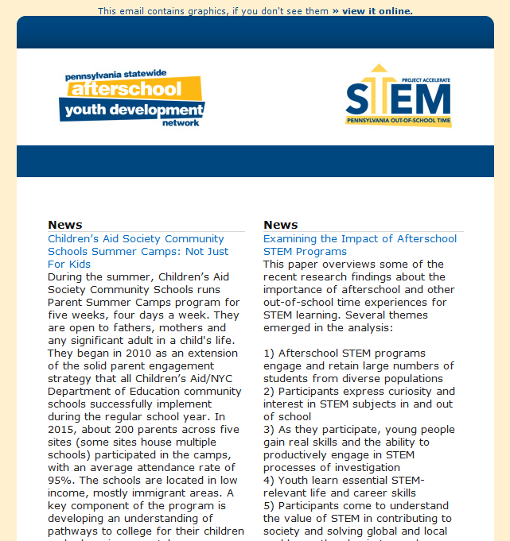
Eblast
Notes:
Our members also receive a weekly eblast. The Eblast provides news articles, resources, grants and professional development for OST providers and partners. We have also been sending out a monthly hlealthy living and nutrition eblast as well as just started a quarterly Enewsletter for policymakers that is being worked on with the afterschool caucus.

Slide 7
Afterschool/Summer Learning Resources
Afterschool Alliance
www.afterschoolalliance.org
National Afterschool Association
www.naaweb.org
Afterschool STEM Hub
www.afterschoolstemhub.org
National Summer Learning Association
www.summerlearning.org/
National Conference of State Legislatures
www.ncsl.org/
21st Century Learning Centers Pennsylvania
www.21stcclc.org/
Notes:
Laura
Part of National Community of support from Technical Assistance and research providers in afterschool…

Slide 8
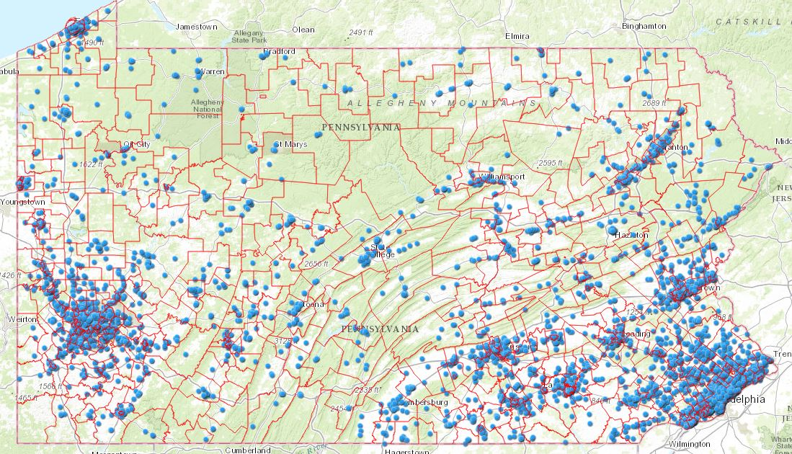
OST Landscape

Slide 9
The Afterschool Field
youth development
school-age child care
school-linked & school-based
Notes:
We work with a vast array of out-of-school time partners from school-based programs, private youth development programs and school-age child care.
On average, children spend
7.47 hours and 3.62 days per week
in an afterschool program.
Programs are vita lto child’s development.

Slide 10
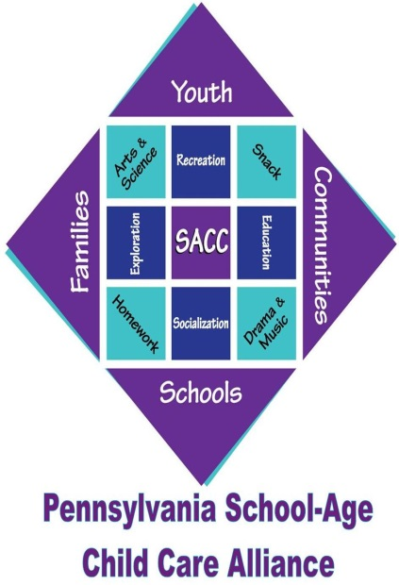
Coalition-building
OST across the state
Notes:
Laura
Resources-america after 3 pm
STEM toolkit
ESSA
Electino toolkit

Slide 11
Pennsylvania After 3 PM Report
321,296 kids participate in afterschool programs
346,457 kids on their own after school
811,954 kids would participate
America After 3PM 2014 Compared to 2009 | Pennsylvania
 | 2009 | 2014
Kids in Afterschool Programs | 15% | 17%
Kids in Self Care | 26% | 18%
Parents Satisfied with Afterschool Program | 84% | 93%
Kids Who Would Participate if a Program were Available | 32% | 50%
Notes:
Laura
Being part of the national network provides for a lot of useful data.
America After 3PM spans a decade of data chronicling how children spend the hours between 3 and 6 p.m. — and is avaialble through the afterschool alliance a
It highlights the trends of afterschool program participation, documents the benefits associated with participation in afterschool programs, and measures public support for afterschool programs.
You can download the latest edition of America After 3PM, or learn about special topics on afterschool, through their special reports such as health and wellness , STEM , summer learning or top 10 states for afterschool.
1.4 million school-age children and youth in PA have working parents
42,559 kids in PA participate in a 21st Century Community Learning Center.

Slide 12
Other Areas of Focus for PSAYDN
STEM/STEAM
COMMUNITY SCHOOLS
KEYSTONE STARS REVISIONING
SOCIAL EMOTIONAL LEARNING
ENVIRONMENTAL EDUCATION
SCHOOL IMPROVEMENT
LITERACY
FAMILY & COMMUNITY ENGAGEMENT
CAREER/COLLEGE READINESS
Notes:
Laura
Examples include:
Providing draft legislation to be introduced, commenting on legislation
Face-to-face meetings
Asking your legislator to support or oppose legislation
Other examples:
Advising on the state budget
Testifying at committee hearings
Direct Lobbying is when an organization attempts to influence specific legislation by stating its position to a legislator (or other government employee who participates in the formulation of legislation) through its staff or members. Grassroots lobbying is when an organization urges the general public (non-members in the field) to take action on specific legislation. Key elements of grassroots lobbying include referring to specific legislation, reflecting or stating a point of view on the legislation’s merits, and encourage the general public to contact legislators.

Slide 13
Cutting Edge Research
www.stemreadyamerica.org

Slide 14
Quality Matters
Research and evaluation point to three primary, interrelated factors that are critical for OST’s to create positive Key factors outcomes for children and youth:
• Access to and sustained participation in the program
• Quality programming, particularly
-Appropriate supervision and structure
-A well-prepared staff
-Intentional programming
• Partnerships with families, other community organizations and schools.

Slide 15
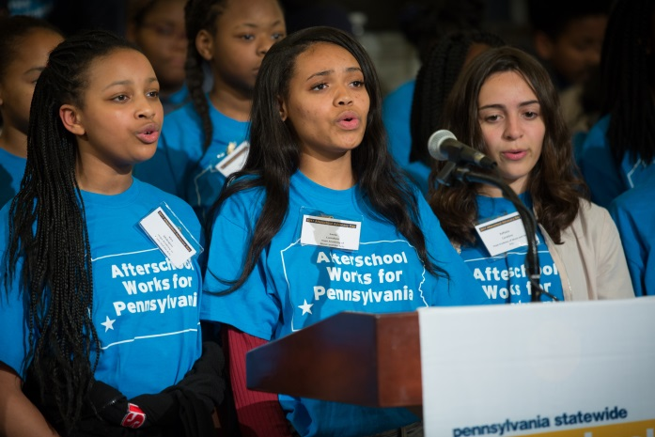
Afterschool Matters
Children and youth who regularly attend high-quality afterschool programs have:
Better grades and conduct in school
More academic and enrichment opportunities
Better peer relations and emotional adjustment
Lower incidences of drug-use, violence and pregnancy

Slide 16
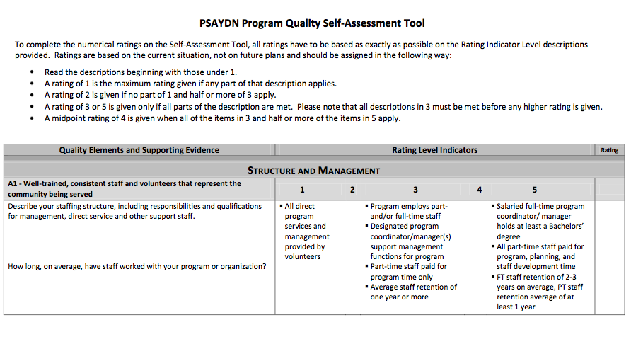
PSAYDN Self Assessment Tool
Notes:
Now that we’ve established the value of a self-assessment process, let’s take some time to look at the PSAYDN Self-Assessment Tool.
First, you’ll see there are 4 sections or building block areas
Section A: Structure and Management
Section B: Positive Connections
Section C: Safety and Health
Section D: Activities
DHS and PHMC have added an Addendum, think of it as a Section E, for elementary providers. This addendum addresses the quality of homework assistance time in OST programs. This section does not need to be completed by middle or high school programs.
A separate self-assessment is needed for each program model.
As the names suggest, each section has a specific focus. These areas of focus have been determined as the minimum things that high quality programs are able to demonstrate.
We have cross-walked this tool with the DHS youth outcomes as well as the Site Visit Assessment Tool. As you complete the self-assessment, you can understand how the building block areas affect site visit assessment indicator areas and ultimately how these bring you closer to meeting DHS youth outcomes. For example, a strong staffing structure (well-trained and consistent staff) is expected to yield staff who engage youth through meaningful activities. Engaged youth are expected to have strong relationships with staff and their peers – a DHS outcome.
You can see that this tool uses a rating scale. Descriptions are provided for a “1” a “3” and a “5” with the understanding that programs that exceed the standards of a 1 but fail to meet the criteria for a 3, for example, could be rated a 2.
We know that some programs are going to rate higher in some areas than others. That’s okay and that’s to be expected. It’s extremely RARE that a program will score ALL 5s throughout the whole assessment. That’s NOT what DHS or PHMC is looking for. We want sites to take an HONEST look at their program in these 4 (or 5) specific areas and set some goals about how to IMPROVE, not be perfect. REMEMBER that these scores are not tied to FY 2015 funding. It is more important to DHS and PHMC that you rate your program honestly so that we can work together toward improvement rather than have you inflate your rating and stay stagnant. If you fail to change, you fail to grow.
Something you’ll want to think about as you complete this assessment is how do we know? What’s the EVIDENCE that this is accurate? So for example A1, the second question is: What methods does your program use to recruit, screen, hire, and retain qualified staff? If you have a sample job description, be prepared to have it on hand to demonstrate a 2-3 rating, etc. You will have the chance to talk with your Program Specialist about what will make for reliable examples.

Slide 17
Quality Crosswalk
Assessment of Program Practices Tool (APT-O & -Q)
School Age Care Environment Rating Scale (SACERS)
Youth Program Quality Assessment (Youth PQA Forms A & B)
Allegheny Partners for Out-of-School Time Quality Self-Assessment (APOST QSA)
Chester Core Standards for Older Youth Programming Self-Assessment Tool
PSAYDN Quality Self-Assessment Tool
Philadelphia Core Standards Assessment Tool
UWGPSNJ Older Youth Program Quality Rubric (PQR)

Slide 18
Future Opportunities
Every Student Succeeds Act (ESSA)
Notes:
Serve as the voice of afterschool: Collect feedback/suggestions for state plan. Help with the draft, comment on the draft plans.
Engage OST partners: Resources for providers, communities, allies to influence plan provided through PSAYDN website.
Inform OST on stakeholder opportunities: Find where, when, and how to raise our voices.

Slide 19
Afterschool: Reducing Chronic Absenteeism
OST staff can work with parents and school staff to:
• Create a culture of good attendance in the program and in the school
• Talk with parents and students about the importance of attendance
• Suggest and support ways to help parents, families, and students help each other
• Monitor school attendance data for program participants and reach out when students are chronically absent
• Help schools identify barriers to good attendance and potential solutions

Slide 20
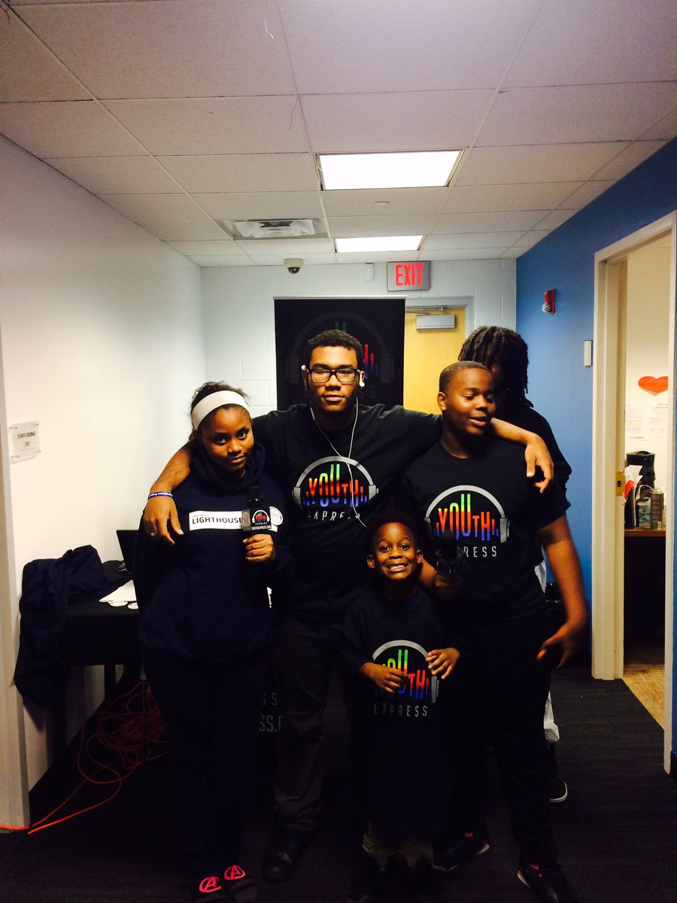
College/Career Readiness
Out-of-School Time offers opportunities for all the things employers say new employees need:
• 21st Century Skills
• Problem solving through project based
learning opportunities
• Community service
• Activities that focus on communication
skills
• Activities that develop interpersonal and
team building skills
• Programs that integrate the use of
technology

Slide 21
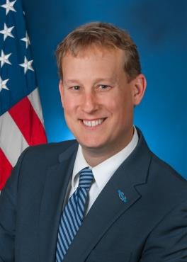
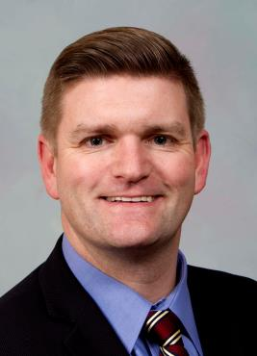
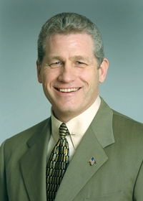
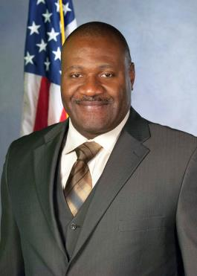
Afterschool Caucus
Senator Ryan Aument (R)
Senator John Yudichak (D)
Representative Bernie O’Neill (R)
Representative Jake Wheatley (R)

Slide 22
Future Opportunities
Legislative Budget and Finance Committee (LBFC) report recommendation (June 2016 report)
Identify stable funding sources for afterschool in PA;
Develop a protocol to recruit and retain qualified afterschool staff;
Establish quality standards for afterschool programs;
Promote the use a statewide afterschool program directory; and
Forge strong workforce, business and formal education partnerships.
Notes:
Laura
Resources-america after 3 pm
STEM toolkit
ESSA
Electino toolkit

Slide 23
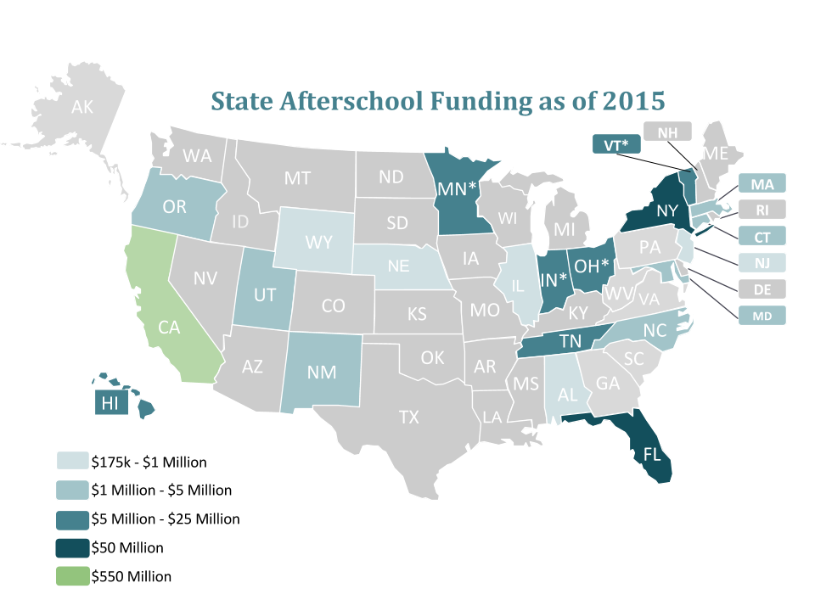
OST Challenges in PA
Dedicated funding/state line-item
Notes:
Laura
Psaydn has historically been involved in the advocacy efforts of protecting dedicated 21st CCLC funding, even as recently in 2015, when dedicated funding was been threatened by a block grant.
Fortuntely,, dedicated funding remained in the Every student succeeds act, historic legislation that replaces No Child Left Behond.

Slide 24
21st Century Community Learning Centers
Notes:
Psaydn has historically been involved in the advocacy efforts of protecting dedicated 21st CCLC funding, even as recently in 2015, when dedicated funding was been threatened by a block grant.
Fortuntely,, dedicated funding remained in the Every student succeeds act, historic legislation that replaces No Child Left Behond.
PA had a huge part of maintaining funding, as one of the key prponents, Congressman Lou Barletta, is a PA Congressman, Congressman Barletta also highlighted the importance of 21st CCLC funding during the hearings of Education Secretary John King.
21st CCLC is vital as over
42,559 kids in PA participate in a 21st Century Community Learning Center.
Not enough afterschool available but high support for public funding

Slide 25
Out of School Time Programming in Lehigh Valley, PA
UWGLV – initiated a Campaign for 3rd Grade Reading in 2014
Part of national effort, sponsored by Annie Casey Foundation
3 key pillars: early childhood education, every day attendance, summer learning
2014-2018, 2018-2022 investment plan aligned to increasing 3rd grade reading, 8th grade math proficiency rates
UWGLV supports a community school network in 4 highest need school districts (22 schools in total)
3 urban, 1 rural
All UWGLV education program investments serve students/families in one of these 22 community schools

Slide 26
How UWGLV Promotes OST Programs
During the school year:
Goal of OST = increased student engagement in school; improved student attendance
Both before and after school time, school-based
Must demonstrate how the OST program supports development of the “5 C’s” of PYD:
Competence, confidence, connection, character, caring/ compassion
In Summer Months:
Goal of OST = reducing summer learning loss, fighting child hunger
Both school and community-based
Both program investments and systems change work

Slide 27
Why Summer Learning Matters
In 2014, we added summer learning programs to our investment plan.
Then we asked partner school districts to prioritize all of our education strategies…
they all ranked summer learning LAST!!
Then we showed this video: https://youtu.be/ZolcNG3GVCs

Slide 29
Community Call to Action!
In 2014, the Lehigh Valley Summer Learning Coalition was launched.
3 highest need school districts are active members
LVSLC Goals:
1. To increase community awareness of summer learning loss and family engagement in summer learning opportunities
2. To increase access to high quality summer learning programs for low income youth
3. To raise quality of existing summer programs

Slide 30
The Lehigh Valley Summer Learning Coalition
Provides professional network for summer providers
All providers must add 30 minutes of literacy/day
Provides training to raise quality
Hosts annual community awareness event: Kick Off to Summer Learning
Distributes/Analyzes Summer Provider Surveys
Measures summer learning “opportunity gap”
Tracks impact of summer programming on summer slide
Hosts online summer learning resource: www.lehighvalleycamps.com
Generates newsletters, marketing efforts
Solicits summer learning scholarship drives ($15,000)

Slide 31
UWGLV-LVSLC Billboard

Slide 32
And NOW…
Our 3 urban partner school districts ranked behavioral health services #1 and out of school time programming #2:
Before and after school programs to promote improved student engagement in school and improved school attendance
Summer learning to fight summer slide and summer hunger and help increase grade level proficiency rates
Bethlehem Area School District invested significant Title 1 funds to launch a district-wide summer learning program for k-2nd graders across all Title 1 elementary schools

Slide 33
Local Research Efforts: Summer Provider Landscape
Launched Summer Provider Survey (2014)
Most summer providers rely on family fees to operate, few have the resources to scholarship youth
Only 1 in 3 low income youth in Allentown, Bethlehem and Easton were being engaged in summer learning programs - most without needed dosage to fight the summer slide
Few community-based providers incorporated literacy
Providers said they could double # of low income kids served with if they were provided the resources to add extra staff
Used this data to generate interest in local foundations and corporate partners: leveraged $300-400,000 in new dollars
Increased # low income youth in SL programs by 6%, higher rate at elementary school level
Asked all providers to add 30 min. reading/literacy to program day

Slide 34
Local Research Efforts: What Families Tell Us
Launched Parent/Family Survey (2016)
Over 1,700 surveys returned, all elementary schools, 3 urban school districts
Parents want summer learning opportunities for their kids
But they need help with cost, transportation and meals
They want math and reading supports BUT they also want the programs to be FUN
Math/Reading were top parent picks; arts/sports/STEM second top picks
If teachers talk to parents/caregivers about summer learning programs, families are more likely to sign their kids up

Slide 35
Summer…also a time of hunger
LVSLC is partnering with LV Food Policy Council to fight child hunger in the summer
Added questions on summer meals to summer provider survey
Found that 20% of youth eligible for free school meals in LV are being fed over the summer by our summer partners, national average is 15%
Developing family messaging on summer meal locations, working with 211 and area school districts to get the word out
Geo-mapping need and resources to target interventions and identify likely partners in the solution

Slide 36
What Does The Research Tell Us
Summer learning loss disproportionately affects low income youth
Summer learning loss is cumulative and damaging over time
High quality summer learning programs can prevent summer loss and create summer gains
25 hours of math + 34 hours of reading+ enrichment activities for 20 days or 120 hours = Right Dosage
QUALITY MATTERS: to see positive attendance and retention, and achieve positive academic growth
LVSLC piloting SL-PQA tool in 10 sites this summer to increase quality programming

Slide 37
Contact Info
Beth Tomlinson, betht@unitedwayglv.org
Dominique Pennes, dominiquep@unitedwayglv.org

Slide 38
Questions?

