Slide 1
TMG Health + United Way Persistence and Truth A Love Story
Gary Drapek
President & CEO
United Way of Lackawanna and Wayne Counties

Slide 2
Some history….
War and Peace…the sequel
Yin-Yang of the name “United Way”

Slide 4
Campaign Highlights
Winning Plan
Obtain top-down support
Develop a collaborative and diverse campaign committee
Know your numbers
Employee – Corporate – Leadership
Educate and engage employees
Educational meetings
Community Fair
Campaign movie
Fundraisers

Slide 5
United Way Campaign History
Fundraising Activities (000)

Slide 6
Plan
Objective to increase the amount of giving of leadership team
Promoted giving of .5%+ of annual salary
Execute
Invited United Way and ARC to share testimonies
Results
74% gave to the Campaign; 7% increase over prior year
Dollar amount per contributor almost doubled. Yielded over $14K more to the campaign
Targeted communications from CEO and peers
Leadership Strategy

Slide 7
United Way Community Fair
Educational opportunity for employees to learn directly from agencies who are supported by the United Way
Representatives from 21 partner agencies
Future expansion in 2015 to include other United Way chapters and agencies

Slide 8
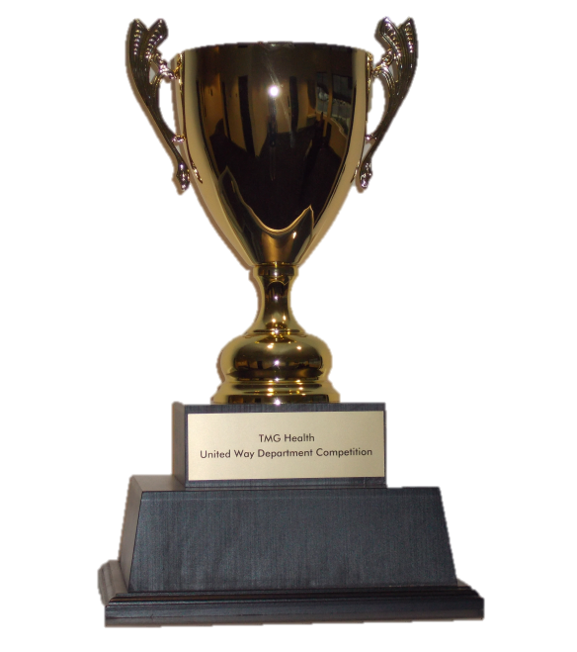
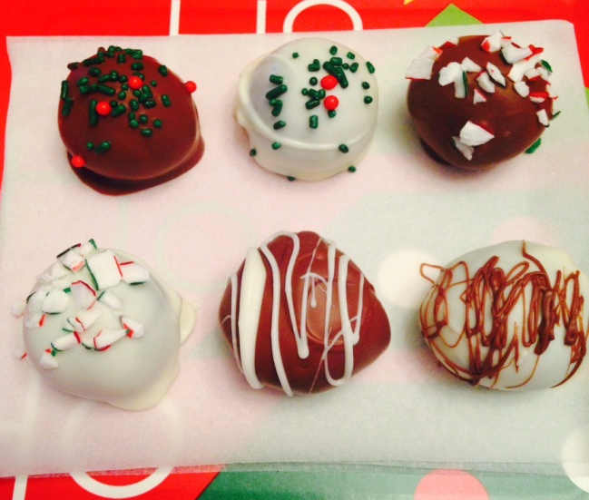
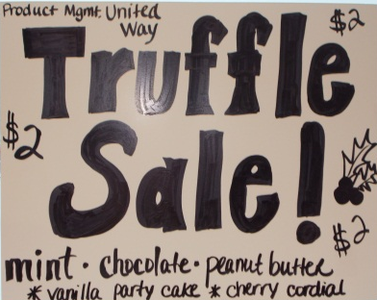
“Fun” Raising Activities
Basket Auction
Department Competition
T-Shirt Sales
Plant a Tree Sales

Slide 9
TMG Health Incentives
Contribute to Win!

Slide 10
TMG Health Incentives – Point System
Donation Level Names | Donation Levels | Suggested Points
GIVING | $10 - $100 | 10
HELPING | $101 - $300 | 15
SHARING | $301 - $500 | 20
CARING | $501 - $700 | 25
GROWING | $701 - $1000 | 30
REACHING | +$1001 | 35
Prize Raffle
Use your points to enter the prize raffle for the prize(s) you want!

Slide 11
TMG Health Incentives – Fast Responders
Beat the Clock…
Complete your pledge form in EDD by
October 10
and receive DOUBLE points for the prize raffle.
…Double your Points!

Slide 12
TMG Health Incentives – Prize List
Create Your Own Charity Jeans Day
Free PTO Day
XBox
Night Away at Bed & Breakfast
Limo to NYC from NE PA
$100 Visa Gift Card (5)
Year-Long FREE Jeans Days
$5 Eurest Voucher (25)
Preferred Parking (24)
Magazines.com Gift Card
$50 Amazon Gift Card (5)
$50 Barnes & Noble Gift Card (5)
iPad Mini
iPad
Galaxy Tab 4 (16 GB)
Amazon Fire HDX (16 GB)
Beats Earbuds
Beats Headphones
Vizio 32” Smart TV
Jawbone
Wireless Computer Setup
12” Wireless Photo Frame
AppleTV
Hulu Plus 12 Month Subscription

Slide 13
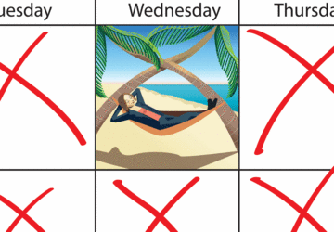
TMG Health Incentives – Free United Way Day
Receive a FREE Day Off for your contribution to the United Way.
Qualifying Levels:
Exempt: $286 Annual Contribution
Non-Exempt: $208 Annual
Contribution

Slide 14
Expansion…..
King of Prussia PA.
Pittsburg PA.
Amarillo TX.

Slide 15
Questions

