Slide 1
Major Gifts
A Growing Trend
June 16, 2016
United Way of the Greater Lehigh Valley

Slide 2
SECTION I
Are Major Gifts relevant
to my United Way?

Slide 3
Leadership & Major Gifts continue to fuel revenue growth
“A shift from major reliance on workplace giving isn’t a change of strategy, but rather a longstanding trend in the United Way system nationally. Over one-third of United Way donations come from major gifts, not from workplace donations.”
Shifting income mix
Generational transference
Change in leadership styles
Technology means
Notes:
Sources: https://nonprofitquarterly.org/2013/01/16/what-we-lose-when-we-lose-workplace-giving/
80/20 Rule: On average, 80% of an organization’s funds come from 20% of their donors.
What is causing the change from workplace giving?
Income mix: Income mix is shifting toward more major gifts, corporate donations, bequests and government grants.
Generational transference: 72% of millennials want to have a job where they can have an impact. However, technologically savvy young givers are more inclined to use online giving platforms to pick organizations that most clearly meet their specific charitable interests. Another reason why the workplace giving infrastructure is weakening.
Change in leadership styles: Leaders no longer dominate the conversation or strong-arm their employees. They empower their employees to make their own decisions and provide a more inclusive, collaborative approach within the workplace. Giving to a particular cause is no longer an expectation, it’s an ask to consider, with no consequences any which way.
Technology wherewithal: An increasing number of corporate employers (Microsoft, Target, etc.) already possess the technology and organizational wherewithal to run their own campaigns, rather than looking to United Way for set-up, support and guidance.

Slide 4
Total Charitable Giving: 2004 – 2014
Total in Billions
Inflation-Adjusted Dollars
Inflation-Adjusted Dollars in Recession Years
Current Dollars
Notes:
Total giving per billions.
Total giving rose 7.1% in current dollars in 2014, or 5.4% adjusted for inflation.
In the last decade, total giving has increased by $98.12 billion in current dollars, or $32.20 billion in inflation-adjusted dollars.
Total inflation-adjusted giving in 2014 is estimated to have surpassed the heights seen prior to the recession.

Slide 5
2014 Contributions by Type of Organization
Total: $358.38 Billion
Notes:
2014 Contributions: $358.38 billion by type of recipient organization.
Our UW share falls in the public-society benefit slice. We have ample growth opportunity.
#1 Religious
#2 Education
#3 Human Services
#4 Foundations
#5 Health
#6 Public – Society Benefit

Slide 6
Public-Society Benefit
Percent Change
+10.7%
+17.6%
+11.6%
-13.70%
-10.2%
-3.6%
+11%
+15.7%
+5.6%
+6.6%
+5.1%
Notes:
Giving USA 2015 Data. Property of Giving USA Foundation. Contributions Received by Type of Organization, 1954-2014 (in billions of current dollars).

Slide 7
Observations
“The single largest contributor to the increase in charitable giving in 2014 was an increase of $13.88 billion in giving by individuals – 58% of the total giving increase.”
Giving to public-society benefit is up 5.1% YOY
48.87% cumulative return over the last 10 years.
4.56% average annual return over the last 10 years.
Giving by individuals is up 7.1% YOY
268.97% cumulative return over the last 10 years.
16.14% average annual return over the last 10 years.
In the last 10 years, charitable giving has increased by 39%, resulting in $98 billion.
Notes:
Total contributions in 2014: $358.38 billion by source, Giving USA Foundation.
Jump in individual giving—5.7 percent—made greatest impact
The 5.7 percent more that individuals donated in 2014 over 2013 accounted for 58 percent of last year’s total growth in giving.
Historically, charitable giving rises about one-third as fast as the stock market.

Slide 8
Single Largest Contributor in Charitable Giving: Individuals
Total: $358.38 Billion
Notes:
Individuals. 72% | $258.51 billion
Foundations: 15% | $53.97 billion
Bequests: 8% | $28.13 billion
Corporations: 5% | $17.77 billion

Slide 9
United Way Worldwide: 10-Year Trend
Notes:
Campaign (workplace giving) vs. Major Giving. Campaign consistently on the decline. Major gifts and individual giving consistently on the rise.
Data Highlights:
Overall Campaign
Overall Campaign Totals have increased by 21% from 2003 to 2014
Major Gifts
Total dollars brought in as Major Gifts has increased by 159%
Increase as a portion of total campaign from 7.43% in 2003 and 15.93% in 2014
Corporate Employee Giving
Total dollars brought in through Corporate Employee Giving has increased by 16%
Decrease as a portion of total campaign from 45.16% in 2003 and 43.22% in 2014

Slide 10
United Way Worldwide: 10-Year Trend (cont’d)
Campaign Year | Campaign Total | Major Gifts Total | Corporate Employee Giving Total | % Major Gifts | % Corporate Gifts
2003 | $2,705,236,612 | $201,110,628 | $1,221,681,176 | 7.43% | 45.16%
2004 | $2,826,885,766 | $290,462,734 | $1,240,460,561 | 10.28% | 43.88%
2005 | $2,955,307,866 | $336,331,716 | $1,273,276,426 | 11.38% | 43.08%
2006 | $3,546,605,528 | $466,713,714 | $1,528,297,813 | 13.16% | 43.09%
2007 | $3,640,273,699 | $488,115,282 | $1,543,816,612 | 13.41% | 42.41%
2008 | $3,496,907,543 | $455,141,385 | $1,490,300,003 | 13.02% | 42.62%
2009 | $3,357,745,756 | $439,019,930 | $1,419,269,202 | 13.07% | 42.27%
2010 | $3,354,001,126 | $478,512,775 | $1,436,022,183 | 14.27% | 42.82%
2011 | $3,380,321,661 | $478,884,819 | $1,442,077,253 | 14.17% | 42.66%
2012 | $3,404,554,661 | $484,233,783 | $1,488,057,842 | 14.22% | 43.71%
2013 | $3,328,011,732 | $517,122,217 | $1,442,851,928 | 15.54% | 43.35%
2014 | $3,272,235,296 | $521,362,178 | $1,414,184,103 | 15.93% | 43.22%
 | 1.20959301 | 2.592414847 | 1.157572148
% Change | 20.96% | 159.24% | 15.76%
Notes:
Data used for previous graph.

Slide 11
Current Tocqueville Members in Pennsylvania
Approximately 1,850 donors, generating $35,000,000.
All but 100 of these are with United Ways of BPM 3 & 4.
2/3 of all members come from Philadelphia, Pittsburgh, Allentown, Greensburg and Reading.
Only 2 United Ways with sizes 1 or 2 BPM have 10 or more members.
18 United Ways have only 1–6 members.
23 United Ways have 0 members.

Slide 12
The potential is there. Understand it.
“I come from a small United Way, I do not have any Tocqueville donors...”
“What I am hearing is not really relevant to my community.”
“Tocqueville donors are simply not present in my area.”
“Is it really worth pursuing this group, given my local context?”

Slide 13
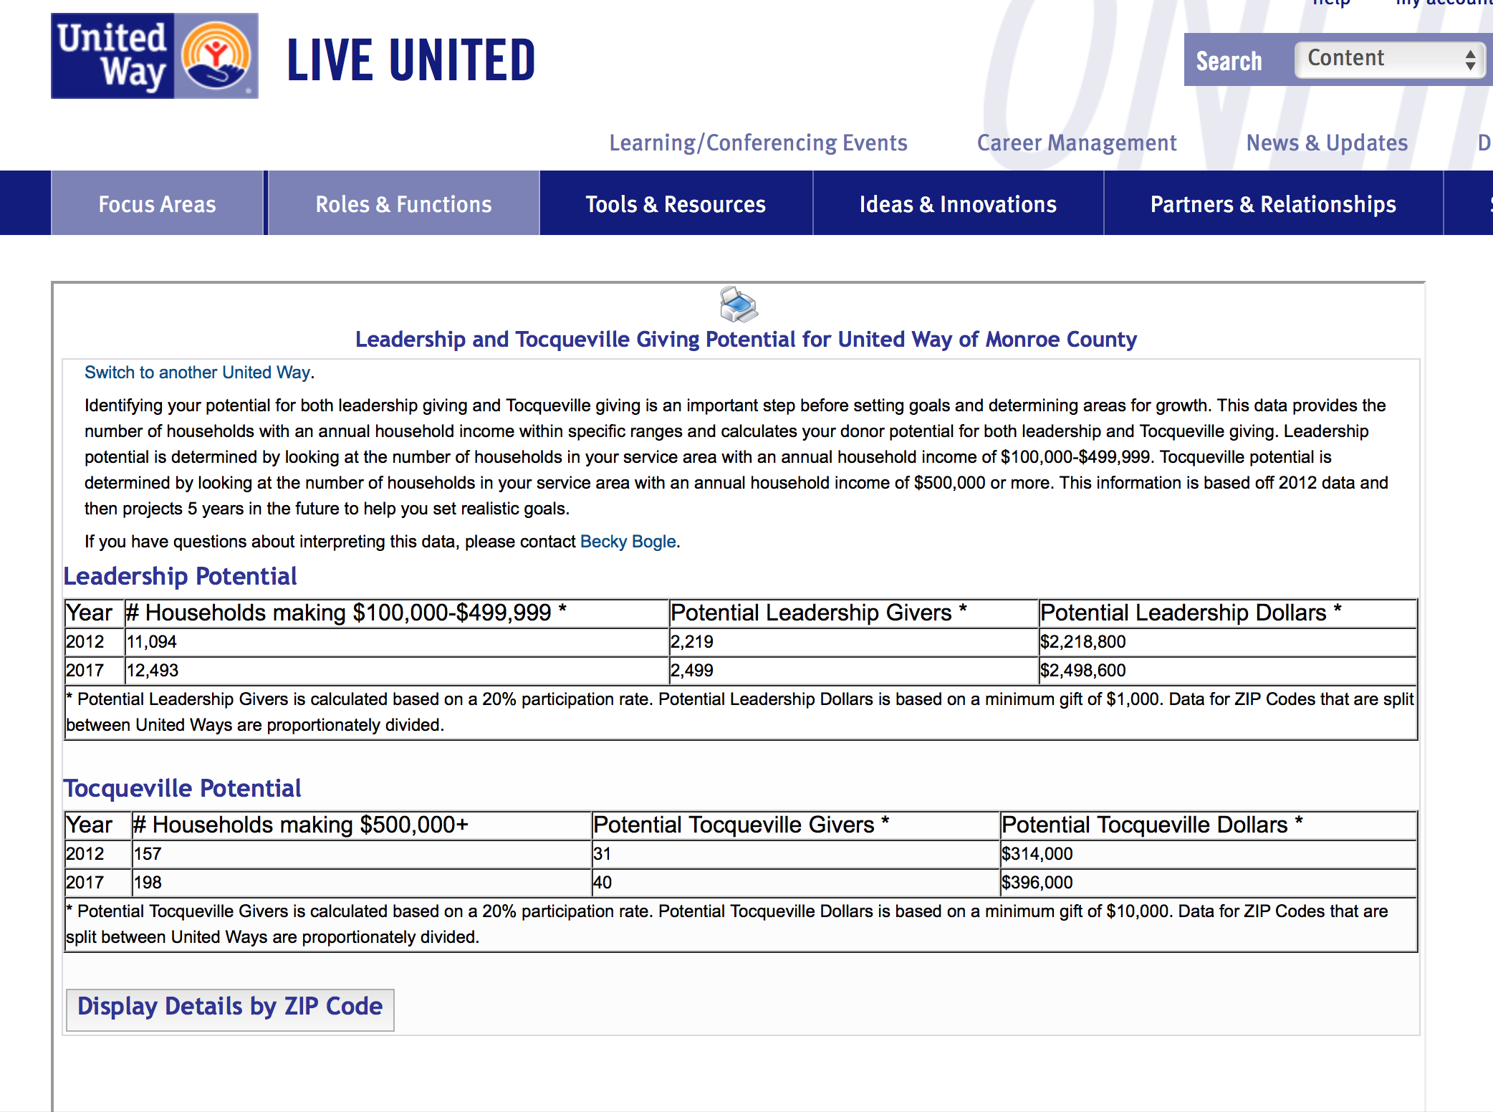
Identify your “Giving Potential” or “Achievability”
https://online.unitedway.org/system/giving-potential

Slide 14
State of Pennsylvania
67 Counties
110,819 households with income of $250,000+
If 20% gave a minimum gift of $10,000 = $221,638,000
Notes:
20% = 22,164 households.
Source. Pennsylvania Budget and Policy Center based on Pennsylvania Department of Revenue data available
Online at http://goo.gl/Fcj03

Slide 15
SECTION II
Getting Started
Lessons Learned

Slide 16
LESSON 1: Make the most of your 1% dues.
You do not need to re-invent the wheel. United Way Worldwide has resources to help you establish an Alexis de Tocqueville Society:
PEOPLE
Kathy Parker, Manager, Major Gifts Services, UWW, kathy.parker@uww.unitedway.org
Becky Bogle, Manager, Leadership Giving, UWW, becky.bogle@uww.unitedway.org
TOOLS
“Giving Potential” measurement tool
Major Gifts Resource Guide:
https://online.unitedway.org/groups/major-gifts-and-planned-gifts-resource-guide
CONNECT WITH SIMILAR UNITED WAYS

Slide 17
LESSON 2: Create a Major Gifts Plan
A Tocqueville Society is PART of an overall Major Gift Plan
Establish Aggressive and Achievable Goals
Align and allocate time and resources
Find (and train) people to help you
Then identify prospects…
Notes:
20% = 22,164 households.
Source. Pennsylvania Budget and Policy Center based on Pennsylvania Department of Revenue data available
Online at http://goo.gl/Fcj03

Slide 18
LESSON 3: CREATE VALUE
Plan Events - and partner with your neighbors on their events!
Leverage United Way of Pennsylvania.
Choose a strong leader for your ADT Society.
Recognize your Society.
Notes:
Source: https://www.entrepreneur.com/article/241983
Major gifts are a game-changer. WHY? 6 simple reasons:
Major gifts, major impact: It you want to be able to accomplish bigger & better aspects of your mission, you need to incorporate major giving. If we want to continue moving the needle and supporting strategies and programs that are making a real difference, it has a price tag. The reality is there is a big financial piece attached to those successes. It takes big gifts to make a big change.
Effective & efficient use of your resources: To use an example with easy calculations, imagine that your organization regularly receives gifts right around the $25 range and rarely over that mark. A major gift of $1,000 from one donor is equivalent to 40 gifts of $25. The extra effort it would take to secure just one gift balances out when you consider just how many small gifts you would need to reach that number. Find the time and resources to combine both efforts and your fundraising total jumps up by $2,000 from 41, not 80, donors.
Real outcomes: The mind of a major gift donor revolves around results, their ROI. When you continue to communicate those results, you’re building loyalty over time, and that support will follow. That financial backing usually grows with their level of interest and satisfaction with how their investments are being handled.
Long-term commitments: Start with the end in mind. Elevating average gift size is an excellent formula for growth over time. Multi-year commitments provide strong support for long-term community goals, lessening significant losses campaign to campaign.
Opportunity to position oneself or company in a positive light: Successful business people benefit by giving to charitable causes. Being apart of the Tocqueville Society puts them and their organization on the map; it’s a who’s who of powerful individuals. Membership brings powerful people together, and those connections are an invaluable resource. Also, by building a culture of giving, leaders are building respect and a good reputation throughout their community. Employees respect leaders who do good. When businesses help other people, those people tend to want to support the company in return. Their contributions result in a better place to live and work for the company, its employees and the people who live there already. Expectations and giving fall from the top-down. “Philanthropy is the gateway to power.”
Trust: Be transparent and to-the-point. Major gifts donors are usually very busy individuals. They want to know specifics, why and how they are an integral part in all of this, and see accountability. When they trust the team and the work being done, they will invest more and help rally other individuals to invest as well. People give to people. It always has been and always will be about relationships.

Slide 19
LESSON 4: Get to work.
One of the main reasons we do not have a Tocqueville Society is because it is hard work.
No one gives if they are not asked, so ask and ask often.
Get people to help you – and make sure they are trained.
Peer to peer.
Sell the value you have created.
Get out there.

Slide 20
SECTION III
Enhancing and Sustaining a Successful Major Gifts Portfolio

Slide 21
Game-Changers
Major gifts, major impact.
Effective and efficient use of resources.
Real outcomes.
Long-term commitments.
Opportunity to position oneself or their company in a positive light.
Trust.
Notes:
Source: https://www.entrepreneur.com/article/241983
Major gifts are a game-changer. WHY? 6 simple reasons:
Major gifts, major impact: It you want to be able to accomplish bigger & better aspects of your mission, you need to incorporate major giving. If we want to continue moving the needle and supporting strategies and programs that are making a real difference, it has a price tag. The reality is there is a big financial piece attached to those successes. It takes big gifts to make a big change.
Effective & efficient use of your resources: To use an example with easy calculations, imagine that your organization regularly receives gifts right around the $25 range and rarely over that mark. A major gift of $1,000 from one donor is equivalent to 40 gifts of $25. The extra effort it would take to secure just one gift balances out when you consider just how many small gifts you would need to reach that number. Find the time and resources to combine both efforts and your fundraising total jumps up by $2,000 from 41, not 80, donors.
Real outcomes: The mind of a major gift donor revolves around results, their ROI. When you continue to communicate those results, you’re building loyalty over time, and that support will follow. That financial backing usually grows with their level of interest and satisfaction with how their investments are being handled.
Long-term commitments: Start with the end in mind. Elevating average gift size is an excellent formula for growth over time. Multi-year commitments provide strong support for long-term community goals, lessening significant losses campaign to campaign.
Opportunity to position oneself or company in a positive light: Successful business people benefit by giving to charitable causes. Being apart of the Tocqueville Society puts them and their organization on the map; it’s a who’s who of powerful individuals. Membership brings powerful people together, and those connections are an invaluable resource. Also, by building a culture of giving, leaders are building respect and a good reputation throughout their community. Employees respect leaders who do good. When businesses help other people, those people tend to want to support the company in return. Their contributions result in a better place to live and work for the company, its employees and the people who live there already. Expectations and giving fall from the top-down. “Philanthropy is the gateway to power.”
Trust: Be transparent and to-the-point. Major gifts donors are usually very busy individuals. They want to know specifics, why and how they are an integral part in all of this, and see accountability. When they trust the team and the work being done, they will invest more and help rally other individuals to invest as well. People give to people. It always has been and always will be about relationships.

Slide 22
No excuses!
Do the research…
And do the math…
Wealth
Interest
Leads
Look to your pre-existing pool of donors
# of households
Average annual income
20% overall
Notes:
Have the “will” to do the background work.
There's a common excuse that nonprofits use when justifying why they do not actively seek major gifts. Those nonprofits claim that major gifts are for large organizations and are beyond the scope of a smaller nonprofit. For those who feel that way: any organization can seek major gifts because the parameters of major gifts are defined by the respective fundraising capacities of the nonprofits seeking them. The exact size of the gift is not the most important principle driving major giving anyway. What's more critical is the action of securing gifts far larger than your standard.
(Look to pamphlets that have census data for all 67 counties in the state of PA).
As long as you have kept track of donor data in your CRM, you'll be able to sort out the major giving prospects from your list of donors.

Slide 23
State of Pennsylvania
2014 Lehigh Valley Income and Benefits
Total Households | 246,474
$100,000 to $149,999 | 35,917 | 15%
$150,000 to $199,999 | 12,831 | 5%
$200,000 or more | 10,521 | 4%
Total | 59,269 | 24%
Total Families | 167,570
$100,000 to $149,999 | 30,588 | 18%
$150,000 to $199,999 | 11,610 | 7%
$200,000 or more | 9,524 | 6%
Total | 51,722 | 31%
Notes:
*Census data does not specifically show $500,000+. The most consistent and accurate valley-wide household and family income data comes from the American Community Survey/Census and maxes out at $200,000+.
What is the difference between “households” and “families?” A family consists of two or more people (one of whom is the householder) related by birth, marriage, or adoption residing in the same housing unit. A household consists of all people who occupy a housing unit regardless of relationship. A household may consist of a person living alone or multiple unrelated individuals or families living together. (From the U.S. Census Bureau).

Slide 24
Back to the Basics: The 5 C’s …
Cultivate – Build a relationship.
Connect – Link the individual to a specific interest so they become inspired to sign on for the cause and commit to action.
Change their mindset – Welcome objections & misconceptions, and educate them on your work.
Close the deal – Make your case & pitch the appeal.
Communication – Otherwise known as “stewardship.” Keep the lines of communication open and keep individuals close to their investments. Acknowledge the impact they are making and ensure they understand the extent of their generosity.
Notes:
Your nonprofit might be growing and performing well with a large pool of small to mid-level donors, but if you want to move up and be able to accomplish bigger and better aspects of your mission, you need to incorporate major giving.
Any easy way to remember – the 5 C’s.

Slide 25
Successes
Events: When executed well, events can significantly help with retention, recruitment and growth. They must have a clear purpose, achieve an organizational need and provide a unique opportunity to interact with donors. Keep it interesting and close to the cause.
Guideline for Giving: Ask for a specific amount or to increase by a particular percentage; or implement a step-up program that allows donors to plan their philanthropy over time.
Leverage company matches: Moves individuals to higher levels and provides more RUM.
Notes:
Our biggest successes have been these three strategies.

Slide 26
Increase Individual Giving
Analyze your competition: Universities, partner agencies and more. Just as competitive intelligence is essential to the development of sound for-profit business strategies, it is also critical to the development of successful, sustainable fundraising strategies for nonprofits.
Focus on at-risk or lapsed donors: It takes more time and resources to gain a new donor than it does to maintain one and move them up in giving levels.
Stewardship: You cannot thank donors enough. Host a thank-a-thon, attend community events, recognize birthdays and anniversaries, etc.
Notes:
3 other things that have helped maximize increases in individual giving:
Analyze your competition:
- Identification of nonprofits in your sector
-Researching the various aspects of these nonprofits’ operations, services, outreach, and fundraising efforts
-Keeping abreast of events and giving trends that impact your organization, your sector, or your cause
-Identifying the foundations, governmental agencies, corporations, and individuals giving to other nonprofits in your sector or supporting your cause
-Staying knowledgeable about the regulatory environment that impacts operations, giving, or fundraising in your sector
-Being aware of organizational changes (e.g., changes in trustees or leadership) that impact foundations, agencies, or corporations that give in your sector or support your cause
What is a competitive intelligence quotient (CIQ)?
It means learning as much as possible—as soon as possible—about other nonprofit organizations competing for funding, your sector, your donors, and your constituents. In short, having a high CIQ empowers you to anticipate and face challenges head on and boost your fundraising success.
Source: https://charitychannel.com/competitive-intelligence-fundraising/

Slide 27
Go a Step Further:
Nine 6-figure annual gifts
Don’t worry about attaining 9 all at once. Secure 1 and that will influence others. Success breeds success.
Less desk time, more face time.
Capitalize on competitive nature of CEOs.
As the president, make the ask yourself. Don’t delegate to a gift officer for a 6- or 7-figure gift.
Notes:
In 4 years, we’ve gone from one six-figure gift to three, to six, and nine. Friendly competition.

Slide 28
Key Takeaways
Use resources that are available to you and learn from others.
Make a plan.
Create Value.
Look at the numbers. Confirm them and know them well.
Set a goal and go after it.
Engage an influential volunteer or chair.
Identify your top 3 prospects and close on 1.
Notes:
Next steps for when you leave here today… 7 action items.

Slide 29
Q&A
David S. Lewis, President
United Way of the Greater Lehigh Valley
610.807.5705
davidl@unitedwayglv.org
Michael Albert, President
United Way of Monroe County
570.629.5680
Michael@unitedwaymonroe.org

