Slide 1
U.S. Network Focus and Support United Way Worldwide
United Ways of Pennsylvania
June 22, 2017
Mary B. Sellers | @mbsellers U.S. President, United Way Worldwide

Slide 8
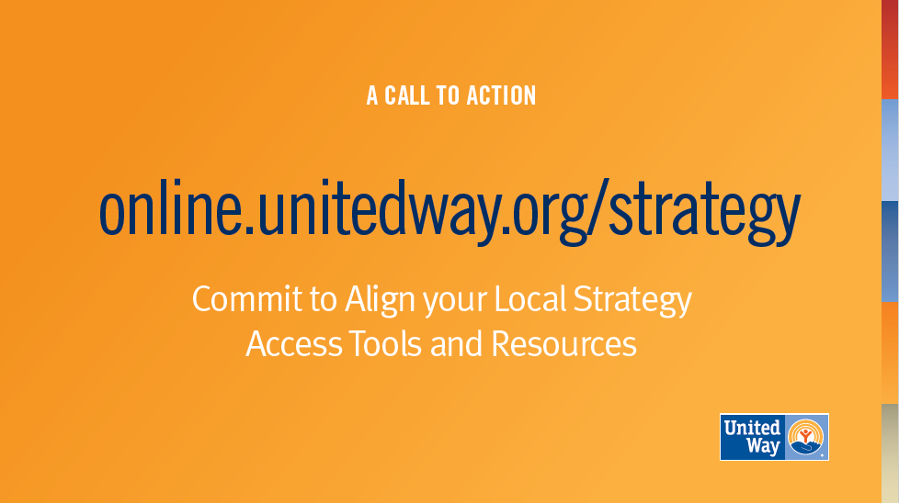

Slide 10
Evaluating U.S. Revenue Performance and Potential
Creating a Revenue Performance Index:
Campaign: Best, most consistent indicator of community support across markets
Growth: Indicates effective resource development practices
Market Penetration: Indicates relevance
Time: Indicates consistency and takes into account economic variations

Slide 11
Revenue Growth and Changes in Per Capita Giving
Top 20 and Bottom 20 United Ways in the Revenue Performance Index
 | 1999 Campaign | 2014 Campaign | % Change | 1999 Per Capita | 2014 Per Capita | $ Change
Top 20 | $506,329,836 | $669,134,139 | 32.2% | $31.54 | $37.83 | $6.29
Bottom 20 | $582,547,230 | $300,081,523 | -48.5% | $15.31 | $6.84 | -$8.47

Slide 12
Network Engagement POV: Baseline of Performance
1. Robust volunteer engagement in workplace and Major Gifts / Tocqueville fundraising
2. Balancing top line (CYS) with Resources Under Management (RUM) and adept at incorporating donors / public sector / companies who designate
3. Deep relationships with corporate leaders
4. Ability to unbundle impact agenda into products and causes donors want to invest in
5. Knowledgeable CEO / Board in United Way practices and accompanying accountability
Notes:
So what are those differentiators? This list is NOT comprehensive, but as the team visited markets and conducted interviews, these are five themes that began to rise to the surface.
Volunteer Fundraising Bodies: This was the #1 differentiator. To a United Way, the highest performers have maintained robust volunteer fundraising structures over time. On the flip side, the United Ways struggling the most have often dismantled these structures and are relying solely on staff.
Many reasons: some perceived it wasn’t working anymore. Others times, institutional knowledge of how to execute walked out the door with turnover. We also saw a sharp drop in 2008 of these types of volunteers that some UWs didn’t recover from.
Volunteer fundraising isn’t easy, but peer-to-peers asks are so effective and can open doors you can’t open alone.
Balancing top-line with RUM: As a network, we have been so focused on Resources Under Management over the past few years that we have at times taken our eye off the top-line. This is a balancing act.
Absolutely you want as many unrestricted dollars as possible to do your work.
But in our pursuit of RUM, we have often walked away outright from designated gifts.
This is taken away our ability to collect donor data, employ conversion tactics, and balance what our corporate partners want.
In the case of workplace giving, even highly designated campaigns often produce highly valuable unrestricted corporate matches.
And in some communities, top-line has dropped so precipitously the United Way is no longer relevant / a player at the table.
3. Deep relationships with corporate leaders: We have talked a lot about this in the past few years.
Annual transactional CEO calls are no longer sufficient.
It is absolutely critical to have deep relationships with the workplace leaders in your community… and even better if other members of your staff and board have parallel relationships to other leaders in the company.
This prevents the relationship from disintegrating if the one champion leaves.
Deep relationships also allow you to truly understand the company and where your United Way can add value.
4. Ability to unbundle impact into products and causes donors want to invest in:
United Ways are the most successful when they are working on what matters the most to their community.
Unfortunately, we sometimes have a hard time translating that into products or causes that are easy to understand and donors want to invest in.
High-performing United Ways have done this well.
5. Knowledgeable Board / CEO in United Way practices and accountability:
This is a little bit all-encompassing to the previous 4
We have lost so much institutional knowledge
How do we continue to retain what’s good and strong about United Way’s model… AS we innovate toward the future?

Slide 13
Business Model Guided Toolbox online.unitedway.org/bizmodel
Business Model Explainer
Guided Self-Assessment
Bundled Resources & Tools
Continuous education within the United Way network on the elements of our business model
Users answer questions about their United Way to determine areas for potential improvement
Curation on UWO of the best UWW has to offer, geared towards immediate execution locally.

Slide 14
Upcoming Events in 2017 | Date | Location
Donor-Centered Development | July 25-27 | Hartford, CT
Retention, Recruitment, and Growth | Aug. 2 - Sep. 6 (Six Wednesdays) | Online
Donor-Centered Development | August 8-10 | Indianapolis, IN
United Way-Labor Partnership Conference | August 15-17 | Portland, OR
Overview of United Way | September 19-21 | Alexandria, VA
Roundtable on Philanthropy | September 27-29 | Bucharest, Romania
Finance, Talent, and Technology Forum | October 2-4 | Dallas, TX
Women United Summit | October 18-20 | Cincinnati, OH
Strategic Volunteer Engagement Summit | November 6-7 | Alexandria, VA

Slide 15
Examples of Revenue Performance Supports
Mid-campaign review
Staff campaign training
Volunteer / Board / Loaned Executive training
Onboarding for CEO / key staff members
Establishing / energizing Campaign and Tocqueville Cabinets
Account prioritization
Cross-market corporate relationship management
Product development

Slide 16
Discussion & Sharing Activity
What are the top 2-3 challenges facing your United Way and our network?
What are the top 2-3 opportunities for your United Way and our network?
How can United Way Worldwide best support you in these areas?

Slide 17
Thank you

