Slide 1
United Way of Lancaster County

Slide 2
About United Way of Lancaster County
OUR MISSION:
To build a stronger Lancaster County by mobilizing the caring power of our community.
OUR VISION:
We will be a catalyst to improve lives.
Notes:
10% live in poverty
60,000 city
29% poverty
Business Performance Matrix – 3B – Metro 2

Slide 3
Making a Difference
United Way’s
Bold Move to Collective Impact

Slide 4
Results of Traditional Approach
program clients
direct service
program clients
direct service
direct service
program clients
program clients
direct service
program clients
direct service
direct service
direct service
program clients
program clients
direct service
program clients
direct service
program clients
program clients
direct service

Slide 5
Former vs. Current Models
The Former Way
The Bold Way
An inch deep and a mile wide
Fund as many agencies as we could
Investing enough resources into issues to truly make a measurable difference
Convening as many partners as needed
Financial
Stability
Education
Health

Slide 6
Mobilizing for Collective Impact
Focus on community level data
Set Bold Goals
Follow Collective Impact framework
Working strategically together for maximum impact
Focus resources to partnerships
Touch more lives in a localized approach
Show measurable results to our community

Slide 7
Community Needs Assessment

Slide 8
Early Education Statistics
Children Aged 3-4 Enrolled in Publicly-Funded Pre-K
A Child’s Brain is 90% Developed by Age 5
Every $1 Invested in Quality Early Education Saves at least $7 in Special Education, Public Assistance, Corrections, and Lost Taxes

Slide 9
Bold Goal 1
By 2025, 100% of our children will enter kindergarten ready to learn.

Slide 10
Secondary Education Statistics
Graduation Rate
Unemployment Rate
by Education Level
Millennials Living in Poverty (Aged 25-32)

Slide 11
Bold Goal 2
By 2025, 100% of students and adults will have post-secondary credentials.

Slide 12
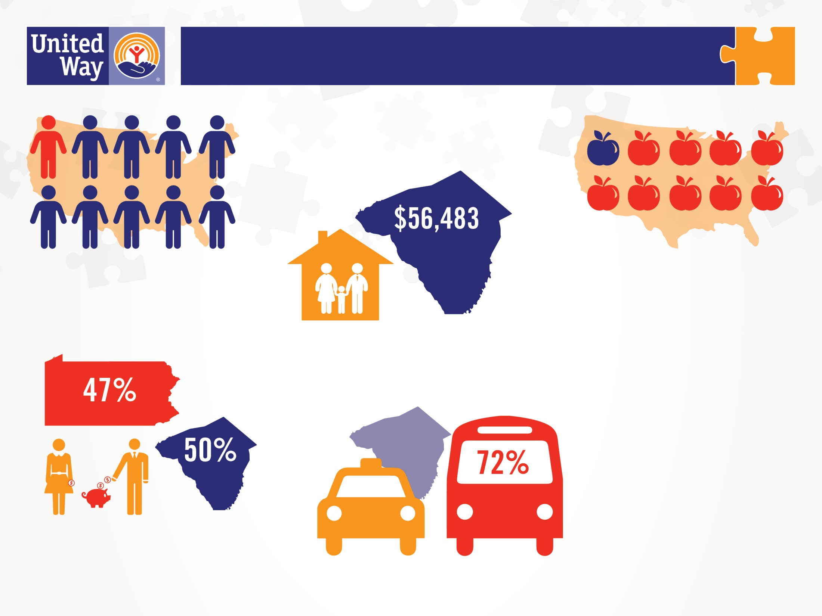
Financial Stability Statistics
Median
Household Income
1 in 10 People
Live in Poverty
More than 1 in 10 People have Limited Access to Adequate Food
Households Having a Combined Housing and Transportation Cost Burden of 45%+ of Income
Gross Rent > 30% of Household Income

Slide 13
Bold Goal 3
By 2025, decrease individuals and families living in poverty by 50%.

Slide 14
Healthcare Statistics
Uninsured
Mentally Unhealthy Days Reported in Past Month (Age-Adjusted)
Ratio of Patients to Providers
1 in 10 People Do Not
Seek Medical Treatment
Due to Cost
Adults Reporting
Fair or Poor Health

Slide 15
Bold Goal 4
By 2025, 100% of individuals, children, and families will have a medical home.

Slide 16
Technical Assistance

Slide 17
RFP Process
Notes:
3 year funding

Slide 18
Community Impact Partnerships
Community Wellness
Elizabethtown Area Family Hub
Impacting Generations
Integration Services for New Americans
Lancaster County Coalition to End Homelessness
Lancaster Medical Legal Partnership
Lancaster-South Connections
The Learning Lancaster Collaborative
Let’s Talk, Lancaster
Moving Forward
Pathways Out of Poverty
Pinwheel Partners
Plant the Seed of Learning
Reunify, Empower, Prevent
Solanco Family Life Network
Systems Aligned in Learning (SAIL)
Together Community Center
17 Community Impact Partnerships = 105 Partners
Notes:
Spring of 2015 – after an 8 month process of community education sessions, technical assistance, and a letter of intent process – 17 CIP’s were evaluated highly enough to receive funding. Show annual report – bold goals and location

Slide 19
Challenges and Successes
Challenges:
Funding
Press
Messaging
Backbone Functions
Traditional Mindset
Evaluation
Shared Data
UW Capacity and Structure
Successes:
Year 2
Early Wins
CaseWorthy
Local Focus
Leverage
Cross County Collaboration
Strategic Planning

Slide 20
Thank you!
Andrea Heberlein, Lead Director, Community Impact
United Way of Lancaster County
630 Janet Avenue, Lancaster
Heberlein@UWLanc.org
(717) 824-8124
www.LiveUnitedLancaster.org

