Slide 1
The Changing Landscape of Donor Development: Engaging Individuals
Janet Torres
Director of Partnership Development
June 17th 2016

Slide 2
Giving USA Stats
Charitable giving reached
$373.3 billion in 2015
up 4% from previous year
source: Giving USA Annual Report 2016
Notes:
Intro-

Slide 3
Giving USA Stats
Giving to public-society-benefit organizations
grew 5.9 percent to $27 billion.
(includes advocacy groups, Jewish federations, and United Way affiliates)
source: Giving USA Annual Report 2016
Notes:
The public is donating but how do you activate and migrate individuals to your cause.

Slide 4
Engaging individuals online
The Changing Landscape

Slide 5
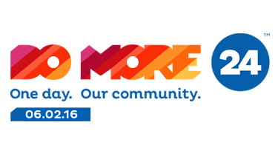
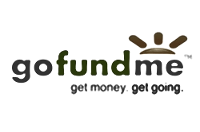
The Rise Of Crowdfunding
P2P (Peer-To-Peer)
Giving Days
Individual Giving Pages
Notes:
Why should nonprofits consider engaging individuals online?
We are in an age where modes of donor cultivation is continually being redefined and now includes strategies for online fundraising- where a person regardless of age or financial means, can be a philanthropist.
Crowdfunding is the practice of funding a project from a large number of people, today often performed via internet giving platforms.
The rise of and increased focus on digital fundraising has been dominating the nonprofit space in the past few years.
Digital strategies are currently outpacing more traditional ones, and that number is set to only grow larger.
Types of crowdfunding:
P2P- Individual is the driver. Fundraising solicitations received directly from friends and family (versus from the nonprofit) via email are 300 times more effective at generating income. Peer-to-peer fundraising is proving to be a very effective online fundraising strategy for nonprofits.
A Giving Day is a powerful 24hour online fundraising competition that unites a community around local causes.
Individual giving pages like those found on Kickstarter, Indieagogo or GoFund Me

Slide 6
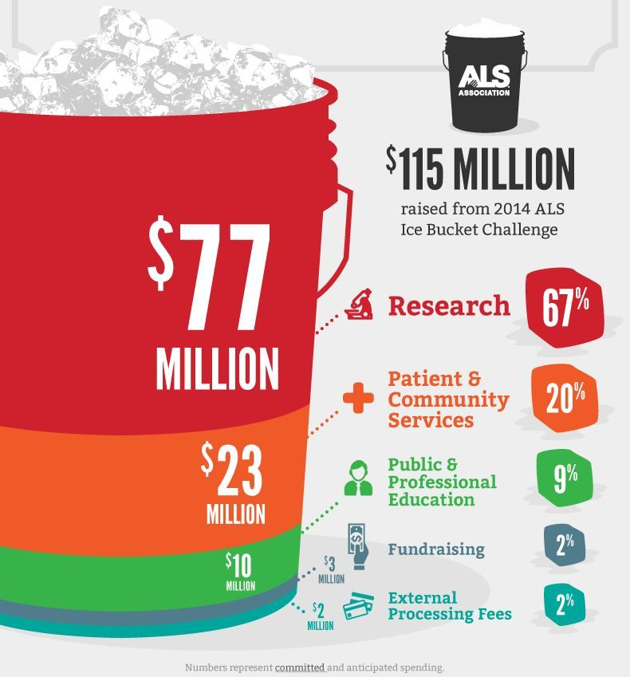
The Power of “The Crowd”
Internet Phenomenon, yes.
But what else,
did this teach us about online giving?
Notes:
I wanted to bring it up because it taught us something about the power of individual people behind a passion, or behind an event that was fun. What caused people to donate? Was it the mission – yes, because of the awareness that it brought about for the mission that wasn’t widely known. But, it was also about fun. The power of getting individuals behind something fun, that also happens to do good for the world.

Slide 7
Crowdfunding: Just A Shiny Fad?
In 2013, donors gave approximately $5 billion to crowdfunding projects (of which $1.5 billion went to social causes)
Estimates predict that it will
increase to $15 billion annually
source: Forbes/Tubesmart

Slide 8
Crowdfunding: The Stats
$88 is the average donation size
$534 is the average total amount raised by an individual
$9,237 is the average amount raised when groups are working on a team to fundraise
28% of donors are repeat donors
source: “Cracking the Crowdfunding Code”

Slide 9
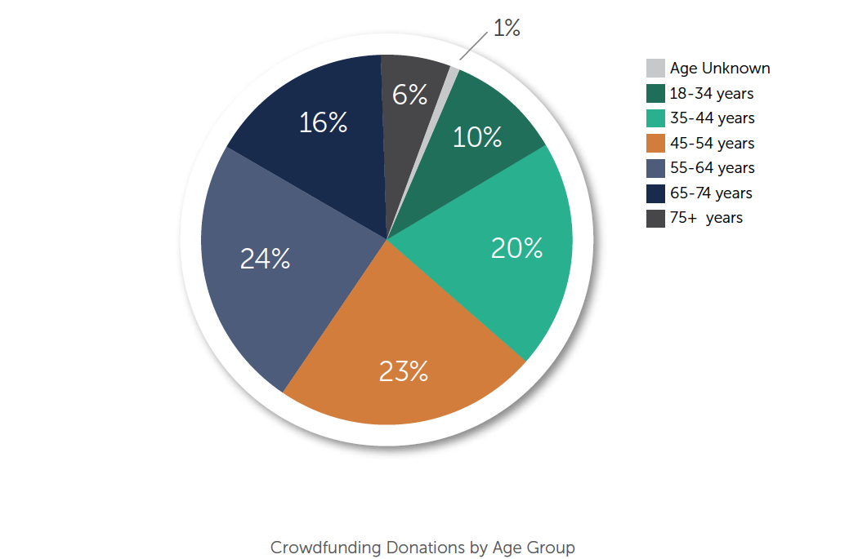
Online Giving Demographics
Crowdfunding events are one of the few, campaign types that engage all age groups, providing high campaign ROI.
Notes:
Digital fundraising strategies and crowdfunding events have been proven to engage donors of all demographics.

Slide 10
Online Giving Demographics

Slide 11
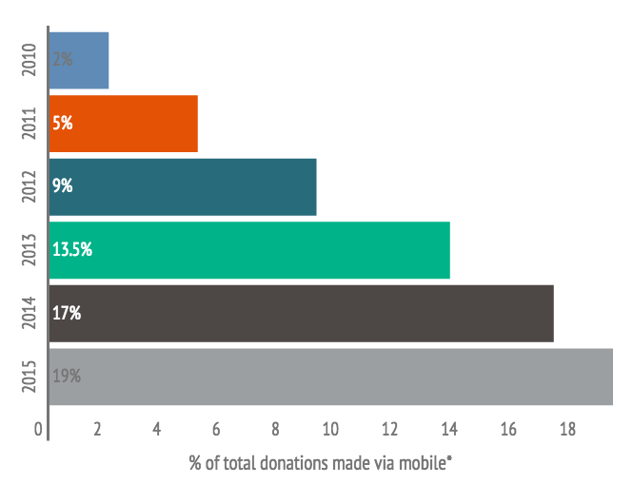
Percentage of Donations from Mobile
*data based on all Kimbia customer online fundraising
Notes:
Not just smart phones but tablets and ipads.

Slide 12
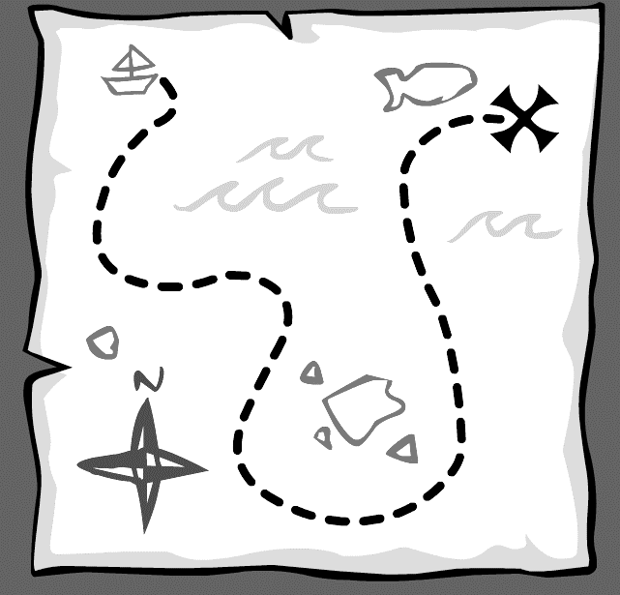
Giving Day Roadmap
Set a goal
Have a plan
Incorporate social media
Notes:
Donors want to be in control of their giving more than ever before in light of limited time and there is always competition for their attention. Crowdfunding events such as giving days can provide a scalable way to make donating to a cause easy and fun.
Giving days raise money through a single online donation platform. A Giving Day is a great way to build community, connect donors to local nonprofits, teach organizations to use digital tools and generate excitement for the organization leading the event.
For example, Kimbia works with UW Palm Beach, UW Delaware, UW of the National Capital Area and UW Westchester/Putnam. Do More 24 is the annual 24-hour online fundraiser for the United Way of the National Capital Area and they raised $1.5 million with over 11,000 gifts for over 700 participating NPOs.
Let’s talk about the roadmap to a successful giving day.
Select a goal that is achievable and appropriate for your organization.
For example,
Raising set amount of funds for particular project
Growing audience on particular social media platforms
Engaging new donors
Building awareness
Have a plan. Giving days are all about motivated action.
Choose your giving day staff and volunteers
Donor engagement- Know your audience
Create a work plan, including a communications calendar
Maximize communication tools including social media
Social media is important:
Raises awareness of your giving day
Directly connects you to constituents
Increases follower excitement and engagement
Empowers supporters to share with their networks – growing your donor base
Beyond the dollars raised, there is also value in growing your organization’s network. It encompasses more than just the transactional act of making a donation, it includes asking for the help of influential stakeholders to create online social fundraisers and reach out to their networks. In a social media world, anyone can become a philanthropist for a charity, whether they have been in the organization’s database for years or whether they’ve just connected with the organization for the first time. Social channels are also used to continue to cultivate and engage with the donor to retain them.

Slide 13
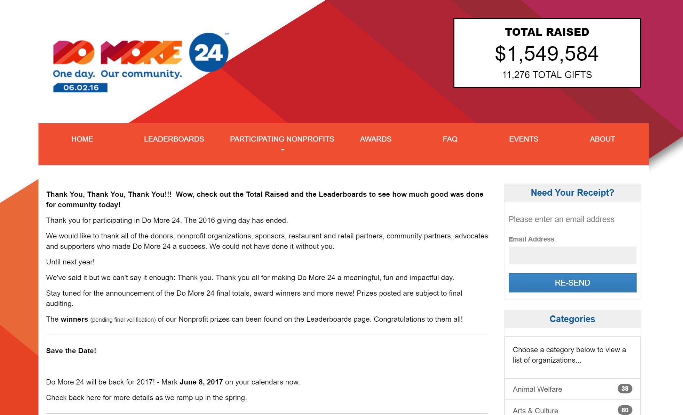

Slide 14
The Changing Landscape of Donor Development: Engaging Individuals
Janet Torres
Director of Partnership Development
June 17th 2016

