Slide 1
Collective Impact in Action
United Way of PA
Annual Conference
June 16, 2016

Slide 2
Overview
What Collective Impact is … and isn’t
United Way of Berks County context
Development of Collective Impact initiative
Ready. Set. READ! overview and progress
Lessons learned

Slide 3
Collective Impact
Collective Impact originally defined by Kania and Kramer in SSIR article in 2011
A collaborative problem-solving process with the following five conditions:
Common Agenda
Shared Measurement
Mutually Reinforcing Activities
Continuous Communications
Backbone Support
Not just another term for Community Impact

Slide 4
UW of Berks County Context
Annual Campaign: $10 Million; continued success and growth; 146 Tocqueville members
Traditional Partner Agency/funding model: issue-focused; funding invested in High Priority/High Performing programs; limited donor designations; significant RUM %
Reading: “poorest” city in US in 2011; Latino majority; high teen pregnancy; city in financial distress, etc.

Slide 5
Community Impact Model 1.0: “Impact Investor”
fund and sustain services for individuals and families
improve lives of program clients
Mobilizing communities
to
that
Financial resources
of community, businesses and employees
Focus Areas:
Education
Income
Health
Safety Net Services
Investments in
High Priority &
High Performing
Programs
5
Notes:
5

Slide 6
Community Impact Model 2.0: “Impact Investor” AND “Community Solutions Leader”
People, time, talent, relationships, expertise, technology, etc.
create lasting changes in community conditions in critical issue (one focus area)
of community populations
Mobilizing communities
to
that
improve lives
fund and sustain services for individuals and families (all focus areas)
Financial resources
of community, businesses and employees
of program clients
6
Notes:
6

Slide 7
Critical Questions
Can we bring the entire community together to address a critical issue?
Can we organizationally commit to working to achieve a very long-term community goal?
Are we willing to invest the organizational resources needed to be successful?

Slide 8
But What’s the “Right” Community Issue?

Slide 9
Community Engagement
Community Survey and Community Conversations
Nearly 1,600 people participated in Community Survey
Held 23 Community Conversations, listening to 275
participants
Interviewed 65 Key Informants - representatives from educational community, business and community leaders, nonprofits, faith-based organizations and community coalitions
Reviewed national research & best practices
Collected and analyzed local data

Slide 10
Target Issue: Early Grade Reading Success Berks County Statistics Based on 2011 3rd Grade PSSA Scores
27% of all Berks County 3rd grade students were NOT proficient readers (1,316 students)
One-half of all school districts/elementary schools had proficiency rates below 80%
Struggling readers live in urban, suburban
and rural districts.

Slide 11
The mission of the Ready. Set. READ! initiative is to develop and implement a comprehensive county-wide system of support that will insure reading proficiency for students by the end of third grade.
90% of Berks County 3rd Graders will be proficient readers by 2023
(Measured by: 3rd Grade PSSA test scores)

Slide 12
Shared Leadership
Board of Directors established
Representatives from key sectors:
Business/Corporate
Education
Nonprofit/Government/Faith
Establish mission and goal, develop strategic plan, evaluate progress and measure success
Guide development and monitor
implementation of programs/activities

Slide 13
United Way’s Role
Serve as Backbone Organization
provide infrastructure for “the community’s” initiative
Added two staff and redeployed existing CI staff in part or full to support RSR
Mobilize and engage the community
Marketing and Resource Development staff fully involved
Reach into all sectors of the community to build awareness and active participation
Attract and invest resources
$103,000 of EITC contributions last year
Invested $145,000 of UW funds in programs

Slide 14
United Way’s Role
Promote conditions of “Collective Impact”
Common agenda
Data driven decision making
Consistent communication
Coordinated efforts
Do whatever it takes to make RSR successful – we are all in!
Notes:
If RSR is a symphony, UW is:
Conductor
Musician
Patron of arts
Composer
Music critic
Playbill publisher
And more

Slide 15
RSR Strategic Plan
Five Key Strategies
Community At-Large
INFRASTRUCTURE
Parents/Families
Children Birth-Pre-K
Students K-3 Grade

Slide 16
Star Readers Tutoring
2015-16 School Year
29 Elementary Schools; 12 School Districts
Close to 400 volunteers serve as tutors for nearly 500 2nd graders
2015 Evaluation
Tutored students experienced a significant increase in Fluency and Accuracy from Fall to Spring assessment
Growth greatly exceeded what would typically be expected in one year
There was a statistically significant difference when compared to non-tutored students

Slide 17
Key Tactics
Summer Learning: partnering with community programs to engage 455 children in structured literacy-based activities
Raising A Reader: partnering with four Reading schools to increase home-based book-sharing routines for 305 families
Story Friends: 85 volunteers read monthly to 1050 children in Pre-K classrooms
Ready Rosie: partnering with nine school districts to improve daily learning-based interactions of over
1500 parents and children, birth to age 6

Slide 18
Key Tactics
Growing Readers: one-on-one coaching for staff in five child care centers serving 265 Latino children to provide language and literacy-rich environment
Abriendo Puertas: partner with Centro Hispano to provide a 10- week education program for 49 parents to better support 101 children in early childhood
Reach Out and Read: partner with pediatricians to “prescribe” reading to parents and distribute new books at well-child visits to 10,050 children

Slide 19
In 2015 RSR directly benefitted
15,017 children
Birth to 3rd Grade
(1/3 of those in this age group in Berks County)

Slide 20
Lessons Learned: Challenges
Significant paradigm shift in UW thinking and acting
Long-term focus
New partnerships
Shared accountability and governance model
Change in backbone organization’s operations
No true precedent to follow
Learn from “experts” and others’ experiences, but application to local conditions is unique
Taking calculated risks is the norm
Learning while doing; being flexible and adaptive

Slide 21
Lessons Learned: Challenges
Long term commitment creates unique challenges
Need to constantly review/revisit history
Expect and manage turnover, internally/externally
Maintain momentum and commitment
Collecting/managing data and measuring progress is critical, yet challenging
Data sharing agreements
Technology/human resources to support effort
Rely on others to provide data
Report it in meaningful ways

Slide 22
Lessons Learned: Benefits
Community Engagement has been amazing
Increased relationships and credibility
Year-round, visible presence
Coordination and partnerships more critical than funding (mostly)
Volunteer interest hasn’t waned; they value opportunity to be part of “something bigger” than themselves

Slide 23
Lessons Learned: Benefits
Successfully leveraged Partner Agency relationships and funding
The community “sees” United Way’s work in a tangible, easily understandable way
RSR has inspired others to pursue collective impact initiatives
Berks Teens Matter, teen pregnancy prevention initiative
UW is a key funder

Slide 24
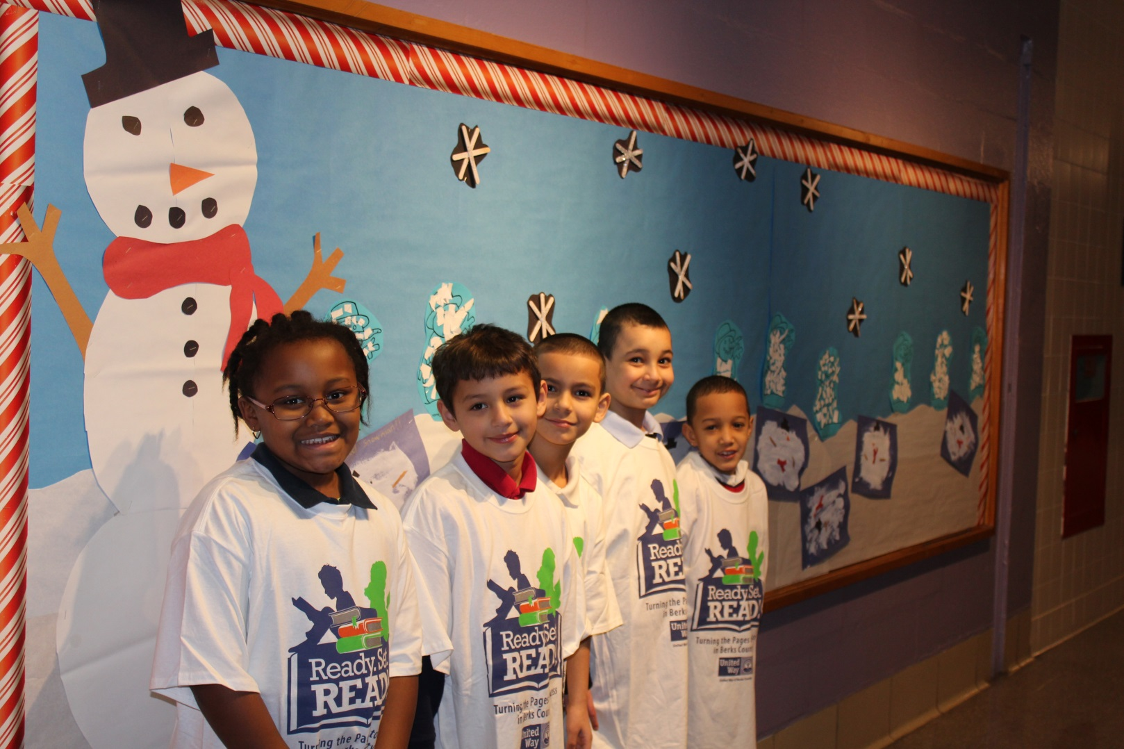
We couldn’t be prouder …

Slide 25
Contact Info
Pat Giles
Executive Vice President, Chief Impact Officer
United Way of Berks County
610 685—4567
patgiles@uwberks.org

Slide 26
Thank you!
QUESTIONS?

