Slide 1
Social Media Development

Slide 2
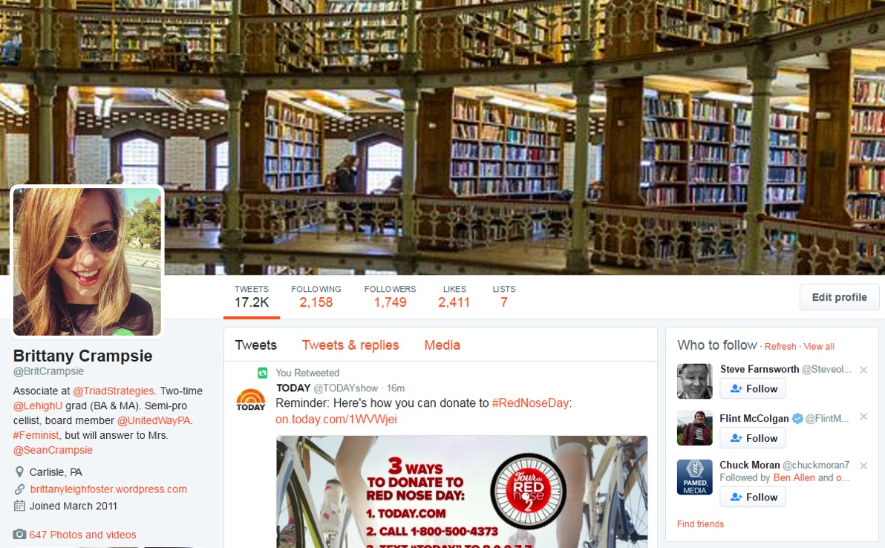
@BritCrampsie

Slide 3
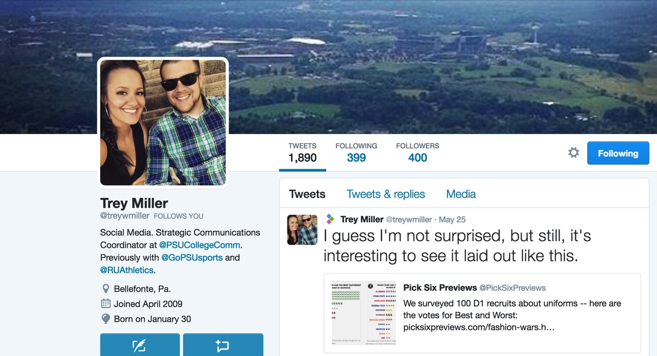
@treywmiller

Slide 4
CHANGE IN GATEKEEPING

Slide 6
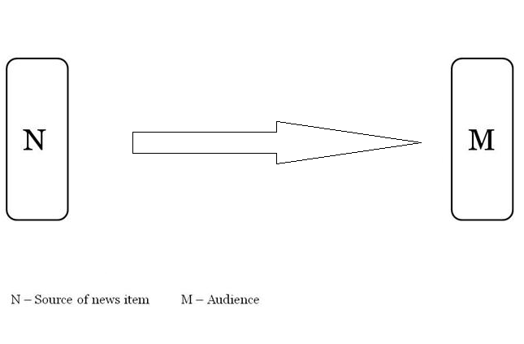

Slide 7
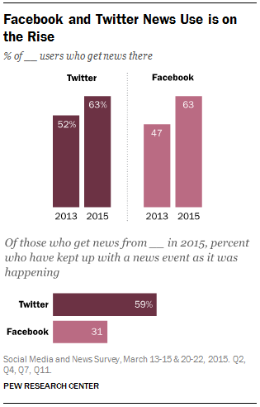
Facebook and Twitter News Use is On The Rise

Slide 8
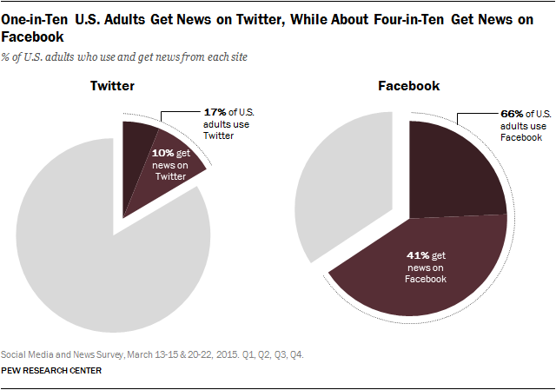
One-in-Ten U.S. Adults Get News on Twitter, While About Four-in-Ten Get News on Facebook

Slide 9
Social Media Myths

Slide 10
1. Only kids are on Social Media

Slide 11
No! Everyone is on Social Media

Slide 12
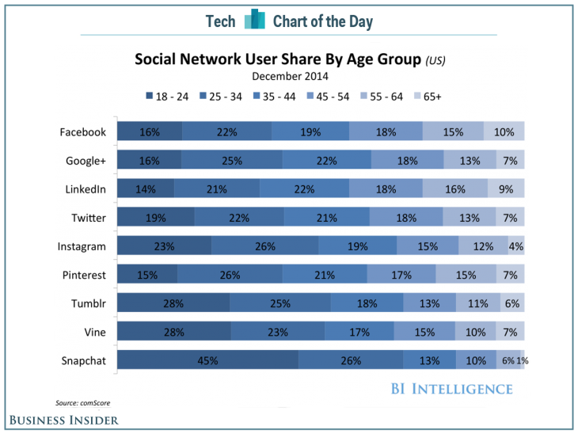

Slide 13
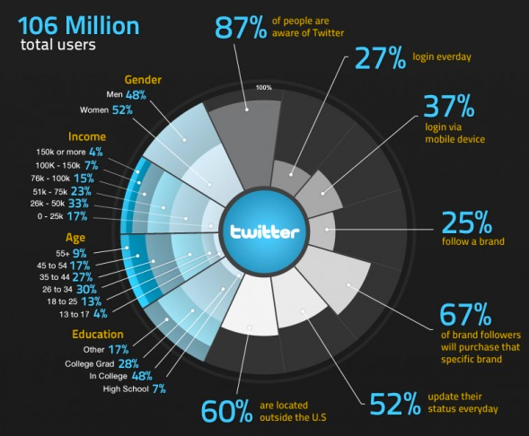
Twitter Users

Slide 14
2. Social Media is for pictures of cats, kids and brunch

Slide 15
No! Social Media is for Everything

Slide 16
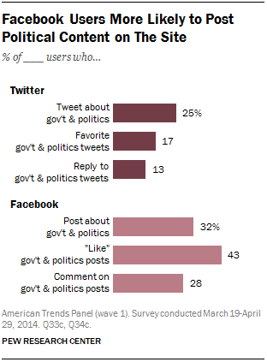
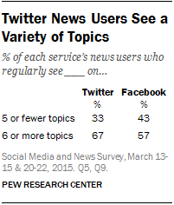

Slide 17
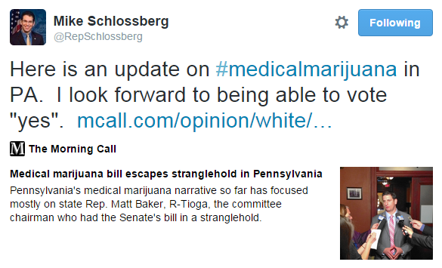
Politicians are engaging on social media
Respond to constituents
Converse with journalists
Promote legislation
Debate with colleagues

Slide 18
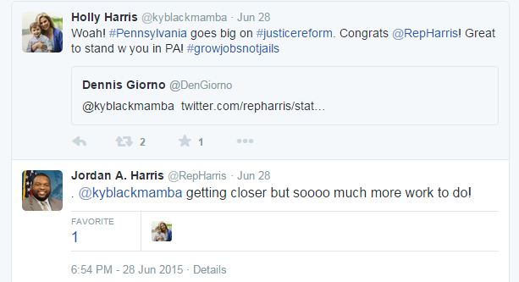

Slide 19
3. Any Millennial Can “Do” Social Media for my Organization

Slide 20
No! Social Media is a tool in the public relations toolbox, and should be treated as seriously as your earned media plan

Slide 21
Information Manipulation Theory
Quantity: Information is complete and full
Quality: Information is truthful and accurate
Relation: Information is relevant to the conversation
Manner: Information is expressed in an easy to understand way

Slide 22
Developing A Policy/Strategy
Goal?
Audience?
Voice?
Plan

Slide 23
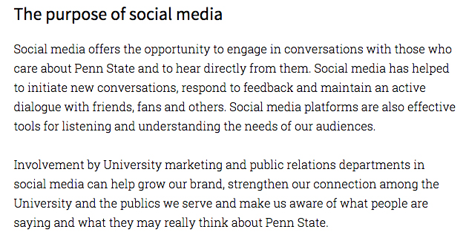
From Socialmedia.psu.edu

Slide 24
Goals
“The goal of our social media pages is to promote, inform and engage our audience with a variety of content (news, photos, videos, Q&As, etc.) The content is geared towards stakeholders, current students and prospective students, in that order.”
What are you trying to do?
Where are you trying to direct people?
Who are you trying to reach?

Slide 25
Audience
Who are they?
When are they online?
What do they respond to?

Slide 26
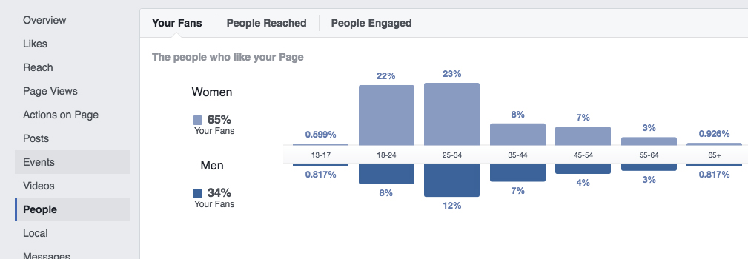
Audience: Who are they?
Facebook Insights: 65% female, 65% 18-34

Slide 27
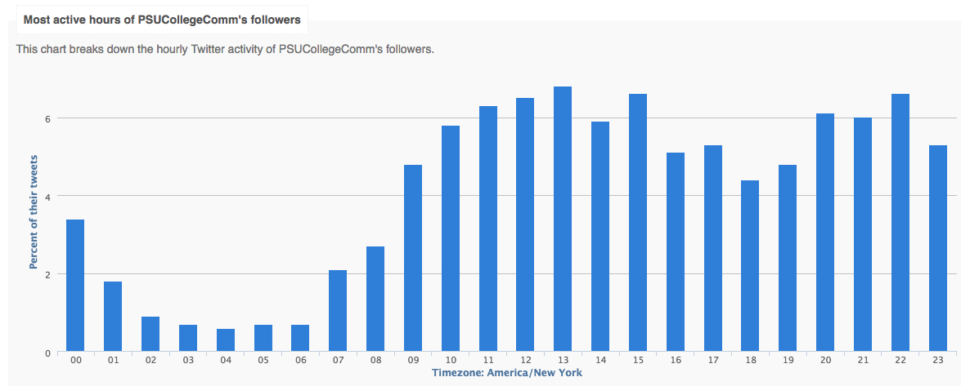
Audience: When are they online?
Followerwonk.com, Tweriod.com, Facebook Insights

Slide 28
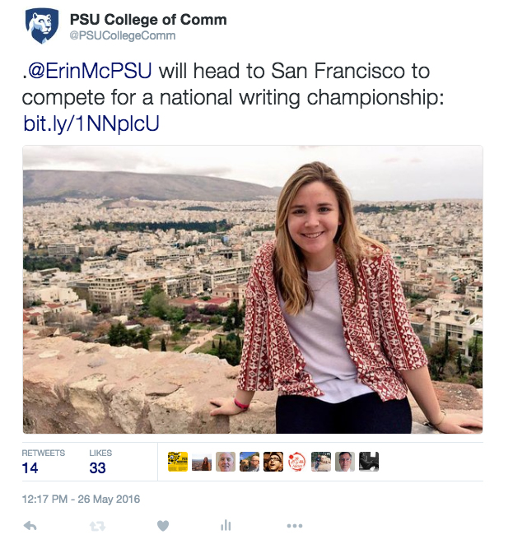
Audience: What do they respond to?
Bitly.com, Twitter Analytics, Facebook Insights.
Bitly and other link shortening sites provide link click numbers, Twitter Analytics/Facebook Insights will show impressions, reach.
For us, PEOPLE work.
Always tag the person or place if possible
PHOTOS!

Slide 29
Voice
Depends on audience and goals

Slide 30
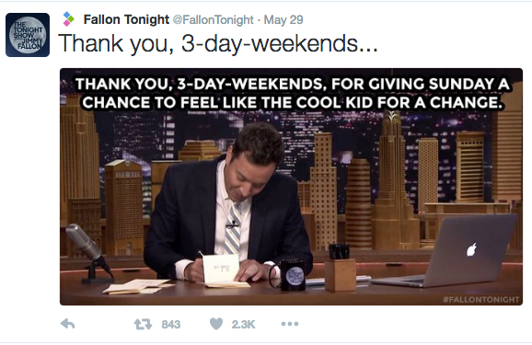
Trying to take on Jimmy’s “voice,” because the audience likes Jimmy. Goal is to try to get people to watch the show.

Slide 31
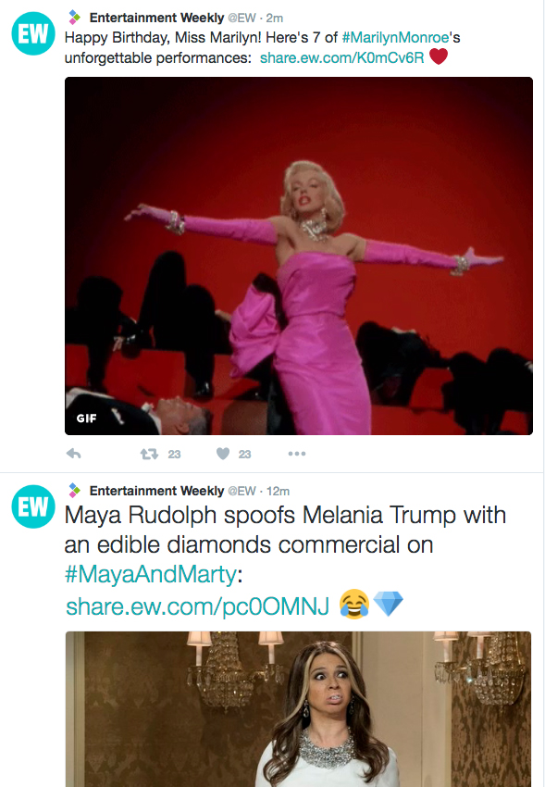
EW covers almost everything. They “seek to give readers unparalleled access to Hollywood's biggest talent and get exclusive scoops and news to them first."
Try to come across as “people’s companion and people’s friend.”

Slide 32
Engagement
Find ways to engage the unengaged. Keeping up with those who are already the most engaged is great, but also focus on getting those who aren’t engaged to become engaged.
Consistency. Our brand is @PSUCollegeComm on Twitter and Instagram, and Facebook.com/PSUCollegeComm.
Put the handle on everything: Handouts, giveaways, graphics, signs, etc.
Find your “influencers” and follow them
Q&As, alumni videos
Countdown to classes

Slide 33
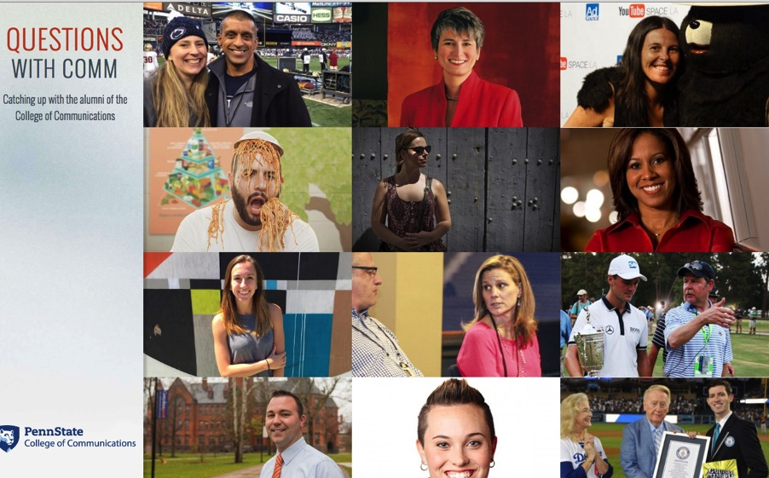
Engagement
These were promoted solely on social media.
Served multiple purposes. Engaged alumni/donors in interesting positions, and promoted the College to prospective students.

Slide 34
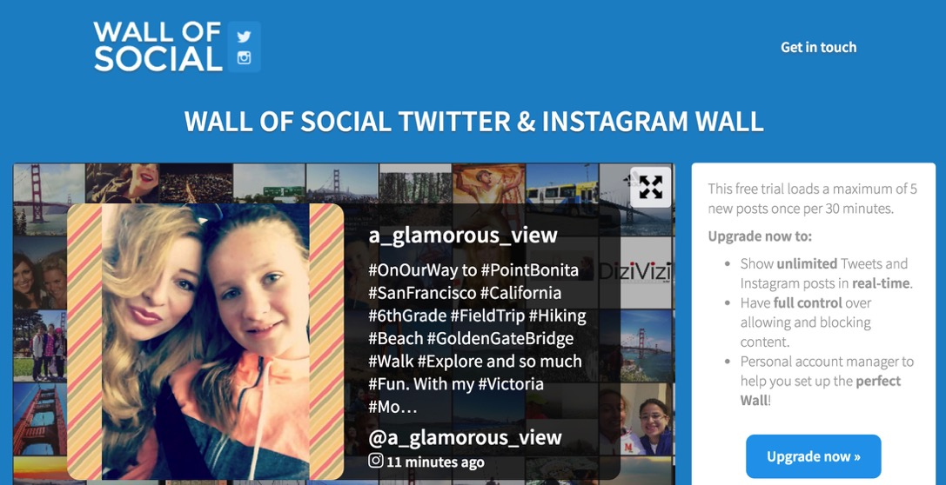
Engagement
Wall of Social: Can be used at events to get those in attendance to engage on social media.

Slide 35
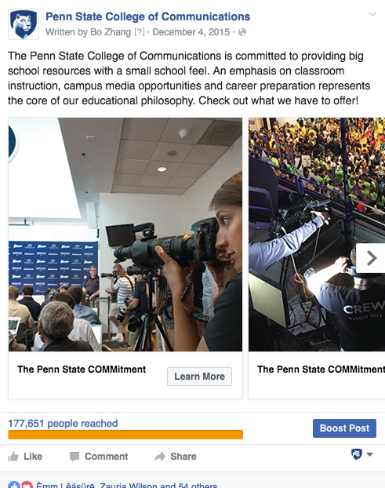
Engagement
Facebook Ads

Slide 36
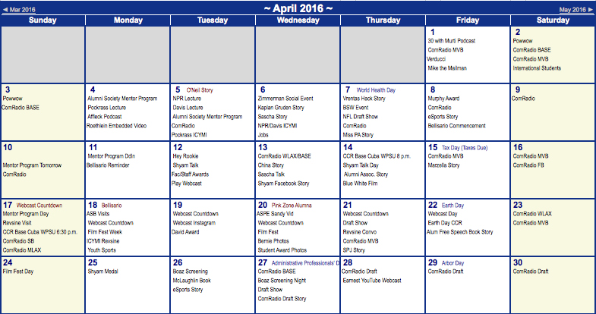
Plan
So, once you know your goals, your audience and your voice, then make sure you have a plan.

Slide 37
So, what platforms should we use?
Depends on YOUR audience and YOUR content
Don’t want to be stagnant. If you don’t have enough content to keep it up to date, don’t use it.
The fewer accounts you have, the better. Keep everything centralized.
Stay on topic and timely, but also realize when you won’t “get beat.”

Slide 38
Platforms
Twitter: 140 (for now) characters. Don’t be afraid to “recycle” content. Try it at different times of the day. While Twitter has changed a bit, your content still won’t stay around the same way Facebook content will. Twitter is still more “chronological” by nature.
Facebook: Find a good pull quote or fact from the story or video. Avoid repeating the headline.
Include visuals as much as possible

Slide 39
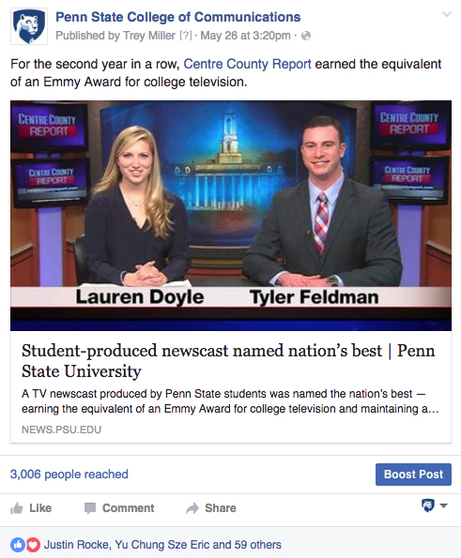

Slide 40
Hold Your Plan Accountable: Analyze
Measure the return on your investment
Use statistics
Tweak your plan

Slide 41
QUESTIONS?

