Slide 1
Welcome
Creating Change
Step by Step
Tammy Miller
Tammy@TammySpeaks.com
814-360-4031

Slide 2
Not all change is the same…
What are different types of change?
Notes:
verb
verb: change; 3rd person present: changes; past tense: changed; past participle: changed; gerund or present participle: changing
1.
make (someone or something) different; alter or modify.
"both parties voted against proposals to change the law"
become different; be altered or modified.
Systemic change – similar to the blood stream – affects all parts

Slide 3
Defining Systemic Change…
“Systematic change means a total transformation of a society's values and structures. By thinking about systematic change in our civic processes, we are thinking beyond ourselves and our time, to the legacies that we will leave for generations to come.”
-- MIT – Design for Systemic Change
Notes:
verb
verb: change; 3rd person present: changes; past tense: changed; past participle: changed; gerund or present participle: changing
1.
make (someone or something) different; alter or modify.
"both parties voted against proposals to change the law"
become different; be altered or modified.
Systemic change – similar to the blood stream – affects all parts

Slide 4
"The mind, once stretched by a new idea, never returns to its original dimensions."
--Ralph Waldo Emerson

Slide 5
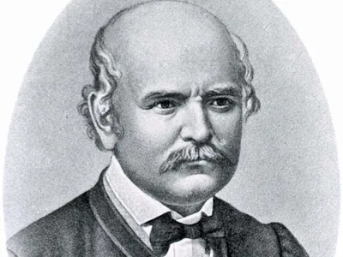
I helped change your life. Do you know who I am?
Ignaz Semmelweis 1818 - 1865
Notes:
Ignaz Philipp Semmelweis^{[A]} (German: [ˈɪɡnaːts ˈzɛml̩vaɪs]; Hungarian: Semmelweis Ignác Fülöp [ˈsɛmmɛlvɛjs ˈiɡnaːts ˈfyløp]; 1 July 1818 – 13 August 1865) was a Hungarian physician and scientist, now known as an early pioneer of antiseptic procedures. Described as the "saviour of mothers",^{[4]} Semmelweis discovered that the incidence of puerperal fever (also known as "childbed fever") could be drastically cut by the use of hand disinfection in obstetrical clinics. Puerperal fever was common in mid-19th-century hospitals and often fatal. Semmelweis proposed the practice of washing hands with chlorinated lime solutions in 1847 while working in Vienna General Hospital's First Obstetrical Clinic, where doctors' wards had three times the mortality of midwives' wards.^{[5]} He published a book of his findings in Etiology, Concept and Prophylaxis of Childbed Fever.
Despite various publications of results where hand washing reduced mortality to below 1%, Semmelweis's observations conflicted with the established scientific and medical opinions of the time and his ideas were rejected by the medical community. He could offer no acceptable scientific explanation for his findings, and some doctors were offended at the suggestion that they should wash their hands and mocked him for it. In 1865, the increasingly outspoken Semmelweis supposedly suffered a nervous breakdown and was committed to an asylum by his colleagues. In the asylum he was beaten by the guards. He died 14 days later from a gangrenous wound on his right hand that may have been caused by the beating. Semmelweis's practice earned widespread acceptance only years after his death, when Louis Pasteur confirmed the germ theory, and Joseph Lister, acting on the French microbiologist's research, practised and operated using hygienic methods, with great success.
Cadaver poisoning

Slide 6

Can we train ourselves to
“see” differently?
How?

Slide 7
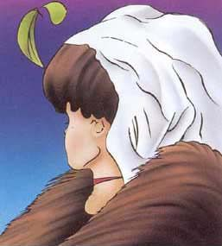
Old woman or young woman?

Slide 8
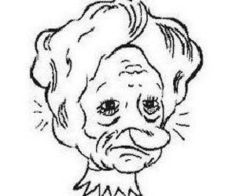

Slide 10


Slide 11
Jason started the conference with:
“I am a key, but it’s not about me.
Not about you, but about your values.”

Slide 12


Slide 13
What is YOUR frame of reference
What is YOUR story?
Why do you care?
Sometimes you have to “experience”
life/event to understand

Slide 14

In a
moment…
The
World
Can
change

Slide 15
S - Start at the beginning and see the change
T - Tell others – create momentum, interest, support
E - Evaluate – stop along the way – what is working, what isn’t
P - Power of ideas, power of people

Slide 16

S - Start at the beginning and see the change
How do we do that?
What is creating the NEED to change?
Where do we begin?

Slide 17
Where do we begin activity?

Slide 18
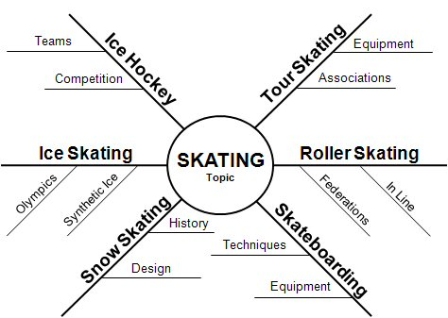

Slide 19
Simple Activity
More of…
Less of…
Same as…

Slide 20

T - Tell others – create momentum, interest, support
Do we have the right audience involved?
How do we gain support?

Slide 21

E - Evaluate – stop along the way – what is working, what isn’t
Listen to understand, not just to hear.

Slide 22
P - Power of ideas, power of people
Power to empower other
"Find your voice and inspire others to
find theirs.“
-- Stephen Covey’s 8th habit

Slide 23
S - Start at the beginning and see the change
T - Tell others – create momentum, interest, support
E - Evaluate – stop along the way – what is working, what isn’t
P - Power of ideas, power of people

Slide 24

We
May
Never
Pass
This
Way
Again
Step
By
Step

Slide 25
Making a change begins with
YOU!
Thank you for being here,
Now you are empowered
To go out and change your world!

